Slide 1
Functional Reconfiguration of Anterior Hippocampus During Context-Dependent Rule Learning
Tom Morin
Brandeis Postdoc Symposium
June 7, 2023

Slide 2
Context Dependent Rules
Notes:
Here, I have an example of a context-dependent rule you might encounter if you’re parking your car in the US.
This sign on the left indicates that you cannot park your car in this zone. The signs on the right, which are real signs that you can find in Boston, show you just how complicated it can be when deciding whether or not it is ok to park your car. Depending on the context (the time of day, your residency status, etc.) your actions have to change in order to follow the rule.

Slide 3
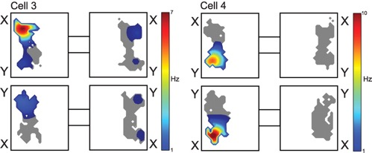
Context-Dependent Rule Task in Rodents
Individual hippocampal neurons develop responses to specific item-place pairs (Komorowski et al. 2009)
Komorowski et al. 2009

Slide 4
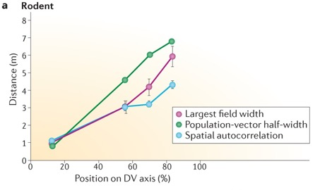
Context-Dependent Rule Task in Rodents
DORSAL ← → VENTRAL
There is a dorsal-ventral organization of place-field size in the rodent hippocampus.
(Lyttle et al. 2014 Kjelstrup et al. 2008; Strange et al. 2014;)
Komorowski et al. 2009
Eichenbaum, 2016

Slide 5
Homologous organization in humans
Eichenbaum et al. 2016
Anterior-Posterior organization in human hippocampus!
←ANTERIOR POSTERIOR →
Brunec et al. 2018

Slide 6
Rostro-caudal Hierarchical Organization of Prefrontal Cortex
More Concrete
More Abstract
Badre & Nee 2018

Slide 7
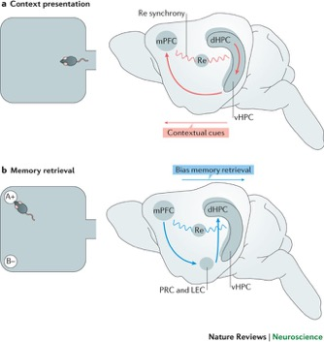
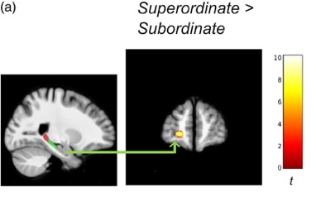
Prefrontal-hippocampal interactions support context-guided memory
Rodents
Humans
Brown et al. 2021
Eichenbaum, 2016

Slide 8
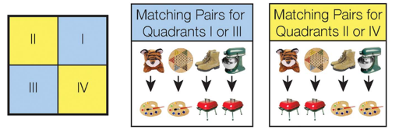
Hypotheses
Functional connectivity between anterior hippocampus and anterior prefrontal cortex supports the integration of higher order contexts.
In successful learners, this connectivity pattern will develop as context-dependent rules are learned.

Slide 9
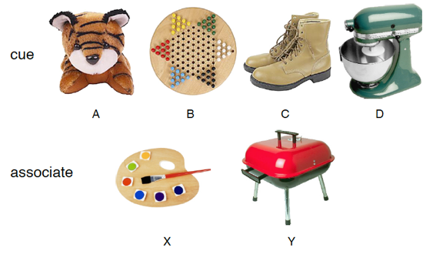
Context Dependent Rule Learning Task
Task Designed to Mimic Animal Studies:
Komorowski et al. 2009
Wallis et al. 2001
Allen Chang, PhD
Weida Ma
Morin et al. 2021

Slide 10
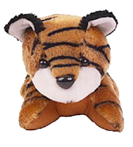
Incorrect
Correct
Pair?

Slide 11
Context Dependent Rule Learning Task – Underlying Rule Structure
Morin et al. 2021

Slide 12
Learning Varies Across Subjects
n = 19
n = 10
Morin et al. 2021
Notes:
If you think that is confusing, you are not alone, as 30% of our subjects never performed above chance during the task. Here you can see subject performance across the 9 scanning runs. Blue dots show subjects that successfully learned the task, and red dots show subjects that were unsuccessful. You can see that for the successful participants, accuracy is generally increasing over time. Our main question is: what is different about the brain network dynamics between these successful and unsuccessful participants.

Slide 13
Hippocampal ROIs
Matt Dunne

Slide 14
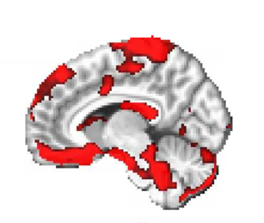
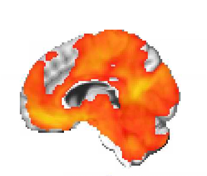
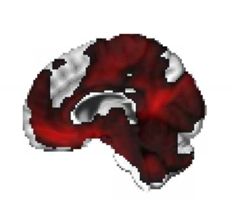
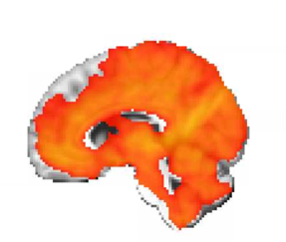
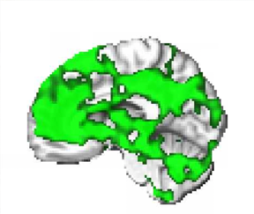
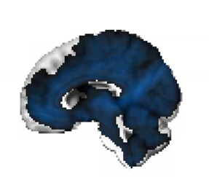
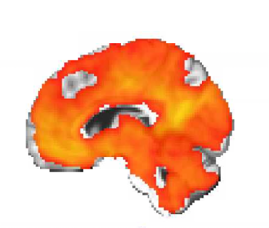
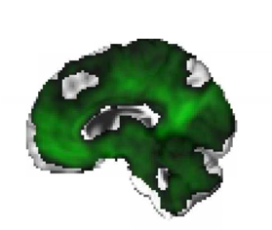
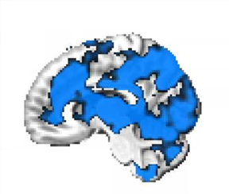
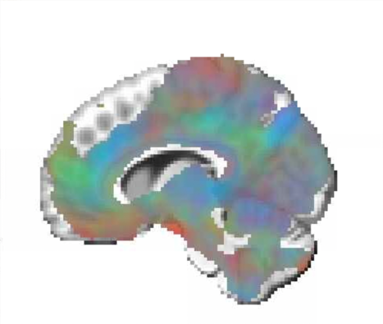
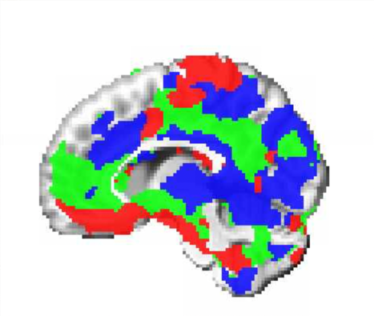
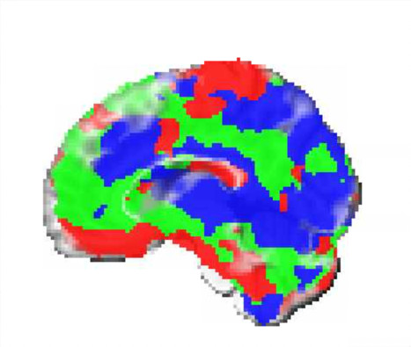
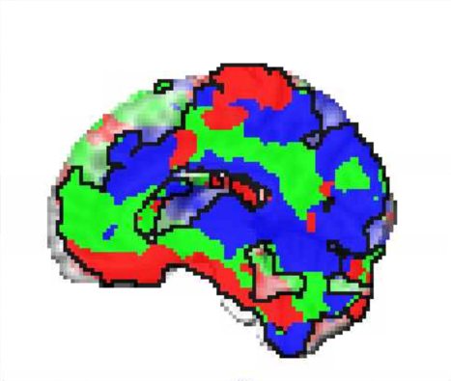
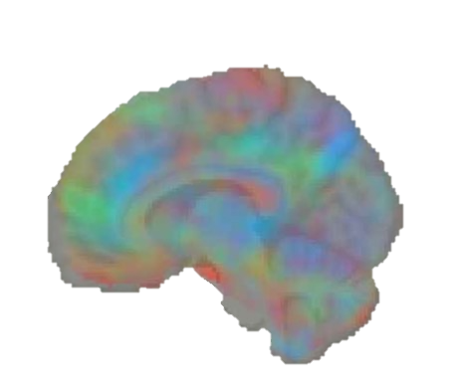
Fc → Red map → normalize → subtract composites → convert to RGB
Hippocampal Head
Hippocampal Body
Hippocampal Tail

Slide 15
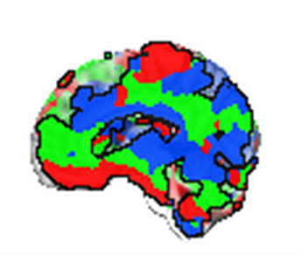
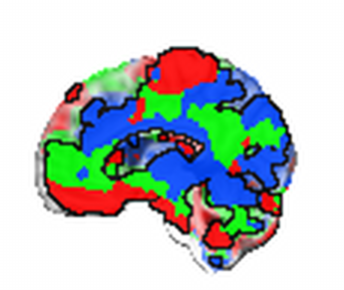
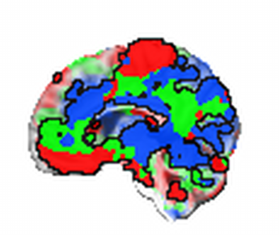
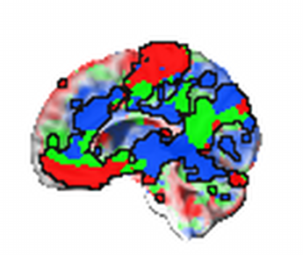
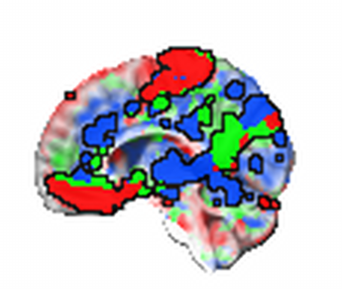
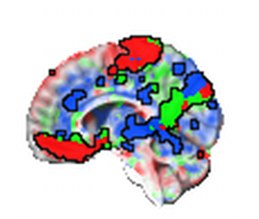
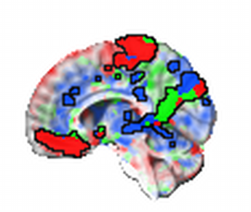
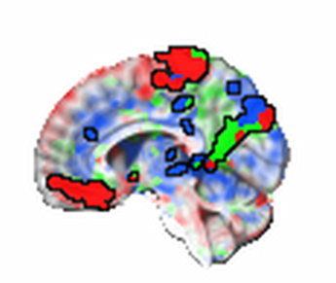
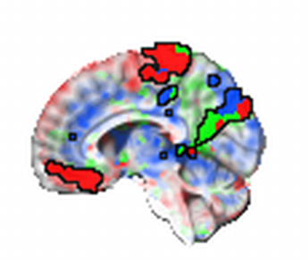
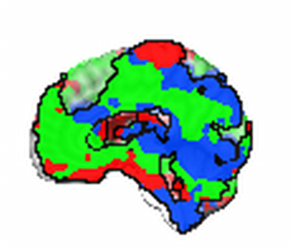
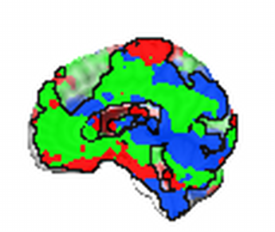
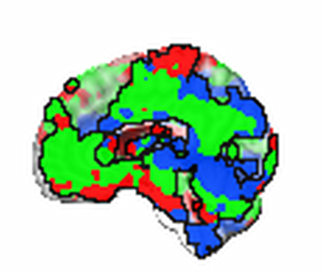
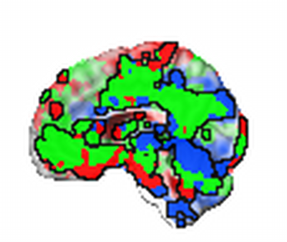
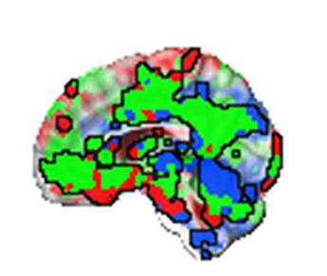
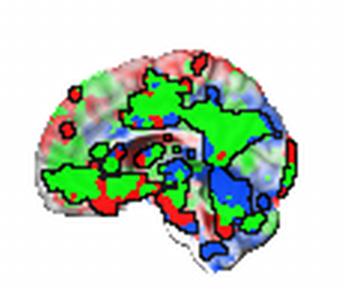
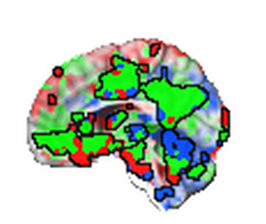
Successful
Learners
Unsuccessful Learners
t=1
t=1
t=2
t=3
t=4
t=5
t=6
t=7
t=8
t=9
t=2
t=3
t=4
t=5
t=6
t=7
t=8
t=9
Hippocampal Head
Hippocampal Body
Hippocampal Tail

Slide 16
Successful
Learners
Unsuccessful Learners
t=1
t=1
t=2
t=3
t=4
t=5
t=6
t=7
t=8
t=9
t=2
t=3
t=4
t=5
t=6
t=7
t=8
t=9
Hippocampal Head
Hippocampal Body
Hippocampal Tail

Slide 17
Conclusions
The hippocampus and prefrontal cortex exhibit gradient-like organization.
During successful context-dependent rule learning, anterior portions of the hippocampal and prefrontal gradients exhibit enhanced synchrony.

Slide 18
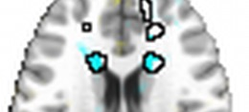
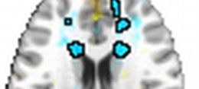
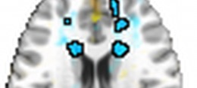
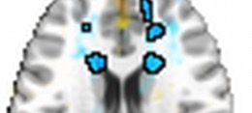
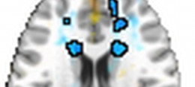
Hippocampal Head Functional Connectivity with the Caudate
Successful
Learners
Unsuccessful Learners
t=1
t=1
Beta Series Correlation (Z)
t=2
t=3
t=4
t=5
t=6
t=7
t=8
t=2
t=9
t=3
t=4
t=5
t=6
t=7
t=8
t=9
Time

Slide 19
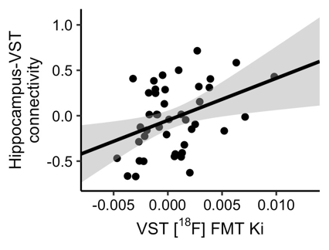
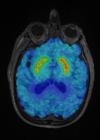
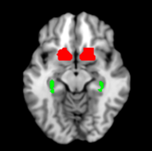
Future Directions
Are dopamine levels related to functional connectivity dynamics?
Preliminary Findings:
r = 0.34, p < 0.05
HIPPOCAMPAL-STRIATAL
FUNCTIONAL CONNECTIVITY
STRIATAL DOPAMINE SYNTHESIS CAPACIITY
(VST [¹⁸F]FMT K_{i})
Dopamine-PET
([¹¹C]-Raclopride)
Hippocampal-Striatal
Functional Connectivity
(Task fMRI)

Slide 20
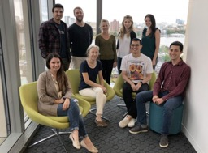
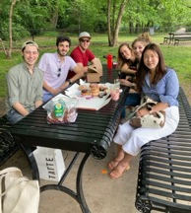
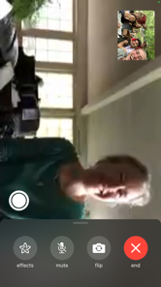
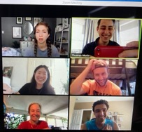
Acknowledgements
Collaborators
Allen Chang
Weida Ma
Joe McGuire
Dissertation Advisory Committee
Chantal Stern
Joe McGuire
David Badre
Mike Hasselmo
GPN Admin
Shelley Russek
Sandi Grasso
Stern Lab
Chantal Stern
Matt Dunne
Stamati Liapis
Kylie Moore
Caroline Ahn
Kylie Isenburg
Cognitive Neuroimaging Center
Stephanie McMaines
Shruthi Chakrapani
Funding
NSF Major Research Instrumentation Award 1625552
ONR MURI Award N00014-16-1-2832
ONR DURIP Award N00014-17-1-2304

Slide 21
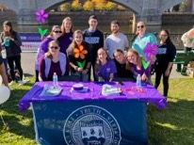
Acknowledgements
MGH Martinos Center
Chemical Neuroscience:
Jacob Hooker
Krista Fariel
Nicole Zürcher
Changning Wang
Hsiao-Ying (Monica) Wey
Michael Placzek
Chieh-En (Jane) Tseng
Chi-Hyeon Yoo
Mary Catanese
Peter Schaffer
Emma Johnston
Camila Canales
Donna Crowe
Mike Vest
Brandeis Universty
Berry Lab:
Anne Berry
Katherine O’Malley
Jordyn Cowan
Alex Adornato
Hsiang-Yu Chen
Jenny Crawford
Jourdan Parent
Claire Ciampa
Teodora Markova
Bailey Gold
Maya Stiefel
Arielle Schutt
Funding
R01 AG074330

Slide 22
Questions?
tmorin2@mgh.harvard.edu
tommorin@brandeis.edu
www.tmmorin.com

