Slide 1
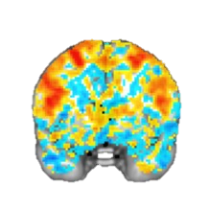
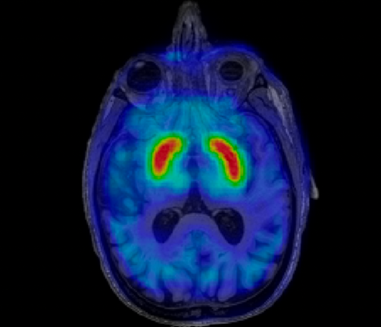
INTRO TO NEUROIMAGING: fMRI, DWI, and PET
February 2, 2026
Tom Morin

Slide 3
Agenda
How does MRI work?
Types of MRI Data
  Structural MRI
    Diffusion Weighted Imaging
  Functional MRI (fMRI)
    What is BOLD signal?
Three Ways to Look at fMRI Data
  Activity Maps
  Neural Decoding
  Functional Connectivity Networks
A Brief Overview of PET Imaging
The future…

Slide 4
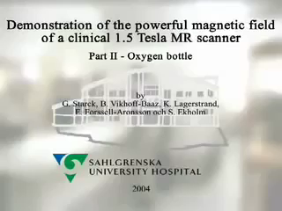
MR Safety
O₂ Tank vs. Watermelon: https://www.youtube.com/watch?v=plvIEf7JsKo

Slide 5

What Does MRI Sound Like?
MRI Sounds: https://www.youtube.com/watch?v=xS_V_OgeX-U

Slide 6
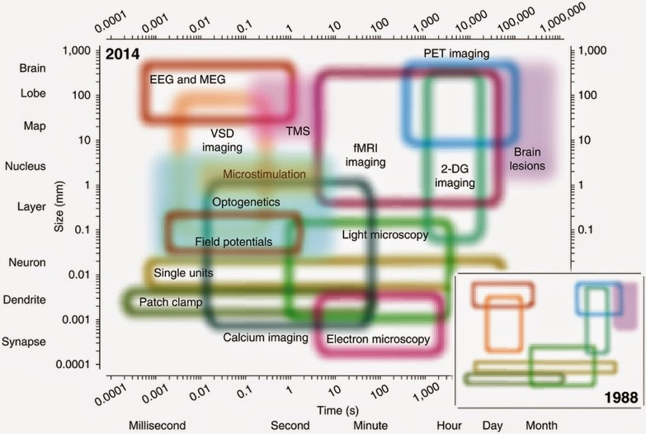
Temporal & Spatial Resolution
Sejnowski, et al. 2014

Slide 7
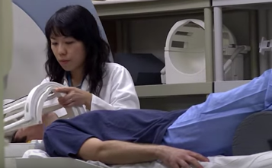
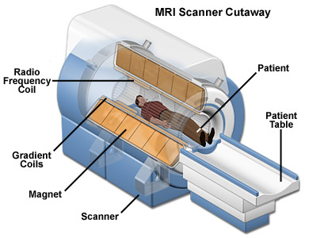
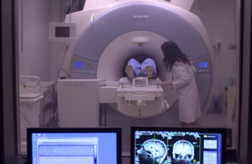
How Does MRI Work?
Notes:
https://www.youtube.com/watch?v=2COPkX5FUAI (2 min.)

Slide 8
Magnetic Resonance Imaging
Place subject in a strong magnetic field
  Protons align to the direction of the field
Apply Magnetic Field
Notes:
1T is 50 million times more powerful than the Earth’s magnetic field
Clinical scanners are typically 1.5T.
Research scanners (for live humans) can go up to 7T.
These things cost about $1 million per Tesla

Slide 9
Magnetic Resonance Imaging
2. Apply a radiofrequency pulse, temporarily sending some protons into an excited state
Apply RF Pulse
Notes:
Swing-set analogy
“RESONANT” frequency of radiowaves targets specific

Slide 10
Magnetic Resonance Imaging
3. End the pulse, allowing protons to relax back
  As they relax, the protons release energy in the form of radiowaves, that is detected by RF coils
End RF Pulse
Apply RF Pulse
Notes:
Swing-set analogy
“RESONANT” frequency of radiowaves targets specific

Slide 11
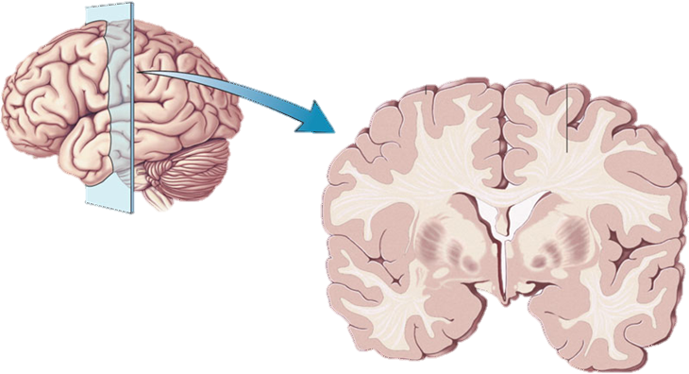
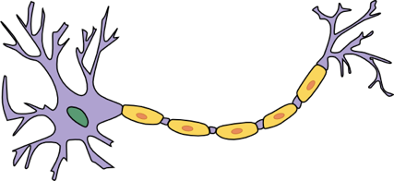
Quick Brain Anatomy Review
White Matter
Axon
Gray Matter
Cell Body

Slide 12
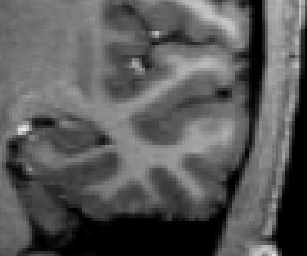
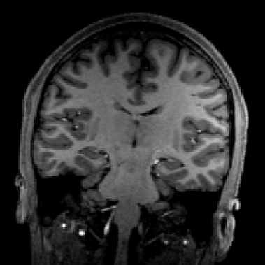
MR Signal Differs for Each Tissue
White Matter
Gray Matter

Slide 13
MR Signal Differs for Each Tissue
White Matter
Gray Matter

Slide 14
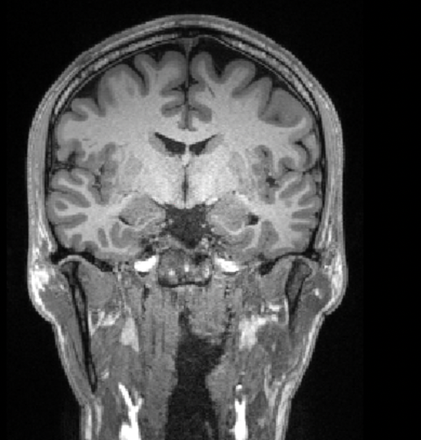
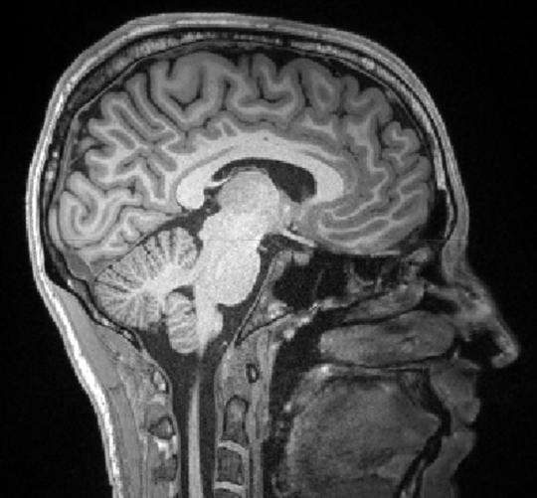
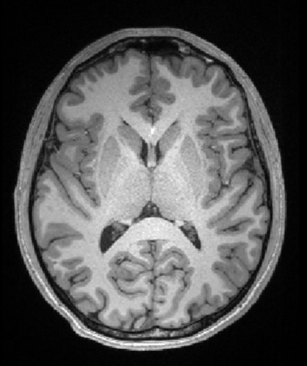
What am I Looking at?
Coronal
Sagittal
Axial

Slide 15
Agenda
How does MRI work?
Types of MRI Data
  Structural MRI
    Diffusion Weighted Imaging
  Functional MRI (fMRI)
    What is BOLD signal?
Three Ways to Analyze fMRI Data
  Activity Maps
  Neural Decoding
  Functional Connectivity Networks
A Brief Overview of PET Imaging
The future…

Slide 16

Structural MRI
5-10 minutes to acquire
~1mm resolution
3-Dimensional
  Acquired in slices

Slide 17
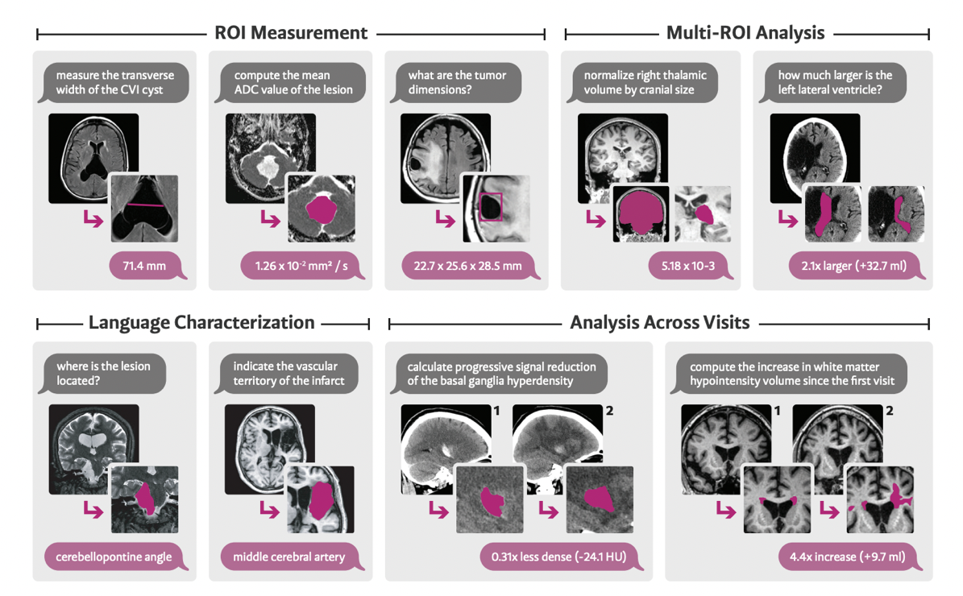
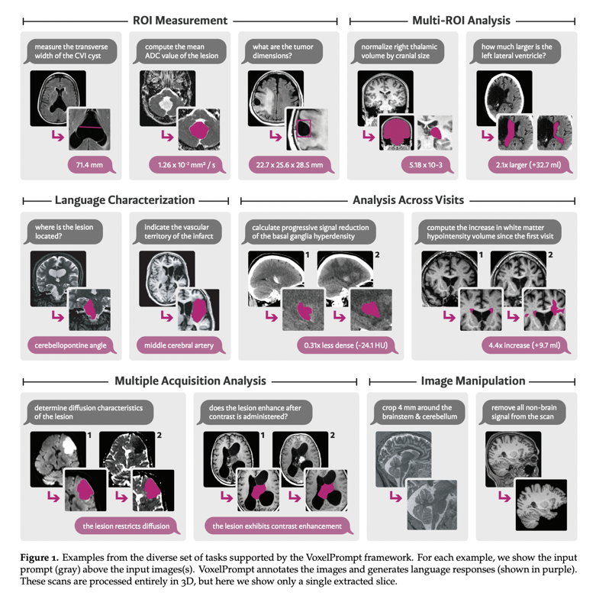
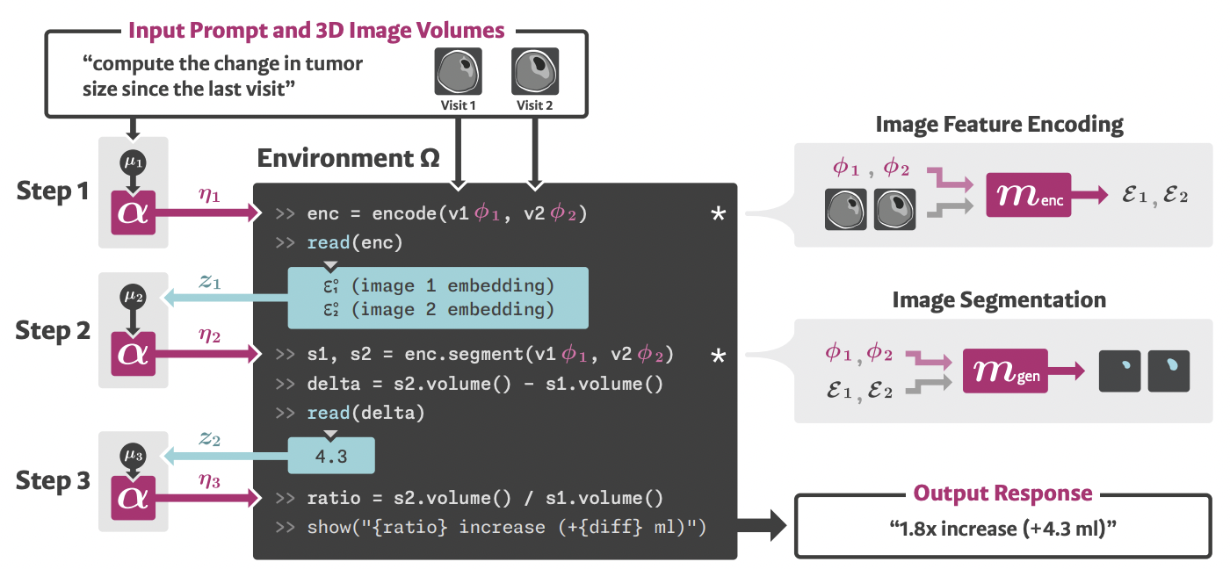
Voxel Prompt: “ChatGPT” for Structural MRI
Hoopes et al. 2024 (preprint)

Slide 18
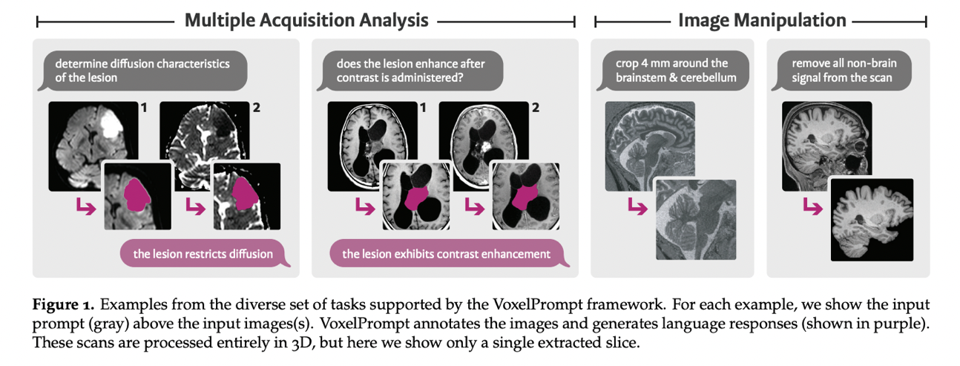
Voxel Prompt: “ChatGPT” for Structural MRI
Hoopes et al. 2024 (preprint)

Slide 19
Agenda
How does MRI work?
Types of MRI Data
  Structural MRI
    Diffusion Weighted Imaging
  Functional MRI (fMRI)
    What is BOLD signal?
Three Ways to Look at fMRI Data
  Activity Maps
  Neural Decoding
  Functional Connectivity Networks
A Brief Overview of PET Imaging
The future…

Slide 20
Diffusion Weighted Imaging (DWI)
Measures tissue water diffusion rate along different directions
Diffusion Tensor Imaging (DTI): A specific type of modelling for DWI datasets
  Assumption: Water molecules diffuse differently depending on the type, integrity, architecture, and presence of barriers, in the observed tissue
  Diffusion process is modelled by an ellipsoid, also known as a “tensor”
For Physics Nerds: http://xrayphysics.com/dwi.html
Anisotropic
Isotropic

Slide 21
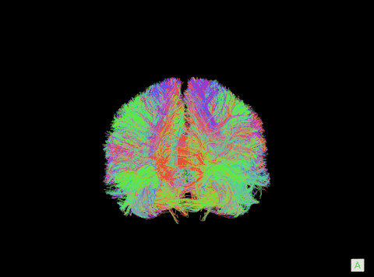
Diffusion Weighted Imaging (DWI)
Talvage et al. 2018

Slide 22
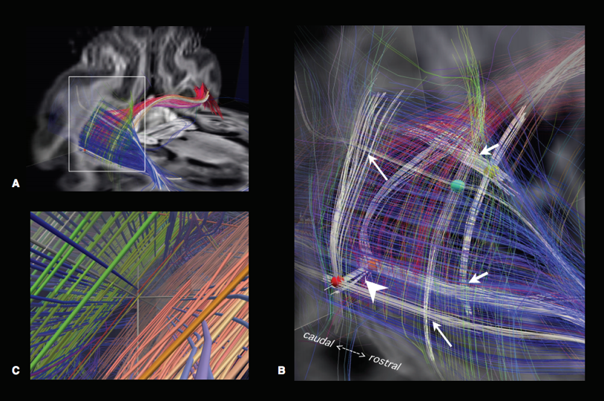
Diffusion Weighted Imaging: Case Study
Image white matter fiber tracts of the brain
Do these tracts follow a certain geometry?
Wedeen et al. (MGH & BU) identified “grids” and “sheets” of fibers
Catani et al. (London) refute the finding, saying it’s a side effect of the diffusion model that was used to reconstruct the data
Wedeen et al. (2012)

Slide 23
Diffusion Weighted Imaging: Case Study
“The thesis that brain pathways adhere to a simple geometric system best accounts for the available evidence—not like London, but Manhattan; not unfathomable, but unlimited.”
- Wedeen’s response to Catani’s critique
Manhattan
London

Slide 24
Agenda
How does MRI work?
Types of MRI Data
  Structural MRI
    Diffusion Weighted Imaging
  Functional MRI
    What is BOLD signal?
Three Ways to Look at fMRI Data
  Activity Maps
  Neural Decoding
  Functional Connectivity Networks
A Brief Overview of PET Imaging
The future…

Slide 25
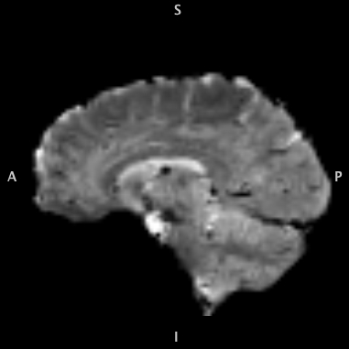
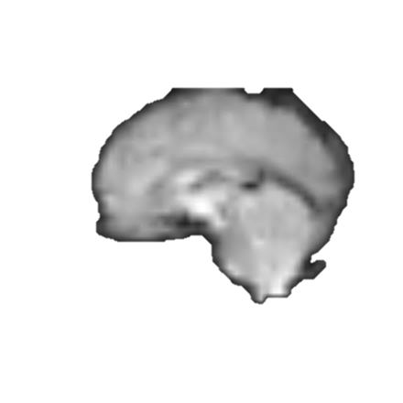
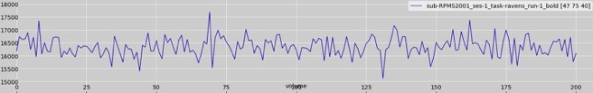
Functional MRI (fMRI)
Sped Up 20x
4D “Video” of BOLD signal
  An entire brain scan is acquired every 2-3 seconds (sometimes faster)
Temporal Resolution:
  500 – 3000ms
Spatial resolution:
  ~2-3mm³
Signal
time
Time

Slide 26
Blood Oxygen Level Dependent (BOLD) Signal
When neurons activate, they require oxygen as fuel
To deliver oxygen, blood vessels are dilated, increasing the flow and volume of oxygenated blood in the region.
Oxyhemoglobin is diamagnetic (not affected by the magnetic field), deoxyhemoglobin is paramagnetic.
The delivery of oxygenated blood to an active region lowers the overall concentration of deoxyhemoglobin, making the region appear brighter on the image
Stimulus
Neural Response
Blood Flow
Blood Volume
Metabolism of Oxygen
BOLD Signal
See Hillman 2015 for more detailed info:
https://www.ncbi.nlm.nih.gov/pmc/articles/PMC4147398/
Notes:
Neurons do not store internal reserves of glucose and oxygen, which are essential to their proper function.
Increases in neuronal activity, typically in response to a demand for information processing, require more glucose and oxygen to be rapidly delivered via the blood stream.
Via this hemodynamic response, blood releases glucose and oxygen to active neurons at a faster rate relative to inactive neurons.
This results in a surplus of oxyhemoglobin localized to the active area, giving rise to a measureable change in the local ration of oxy- to deoxyhemoglobin, thus providing a localizable marker of activity for MRI.

Slide 27
Historical Aside: Measuring Cerebral Blood Volume
Angelo Mosso’s “Human Circulation Balance” (1882)
What is the “weight” of a thought?
Balance would “tilt” as the brain processed the sound of a bell. (Presumably increased blood-flow to auditory cortex)
Sandrone et al., 2014

Slide 28
Agenda
How does MRI work?
Types of MRI Data
  Structural MRI
    Diffusion Weighted Imaging
  Functional MRI (fMRI)
    What is BOLD signal?
Three Ways to Look at fMRI Data
  Activity Maps
  Neural Decoding
  Functional Connectivity Networks
A Brief Overview of PET Imaging
The future…

Slide 29
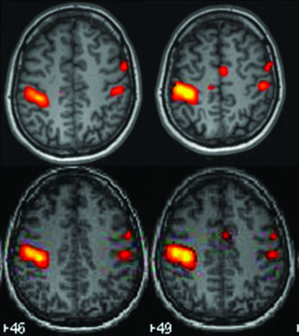
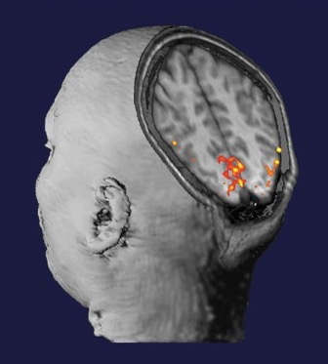
Functional MRI (fMRI)

Slide 30
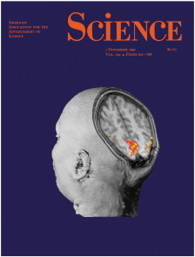
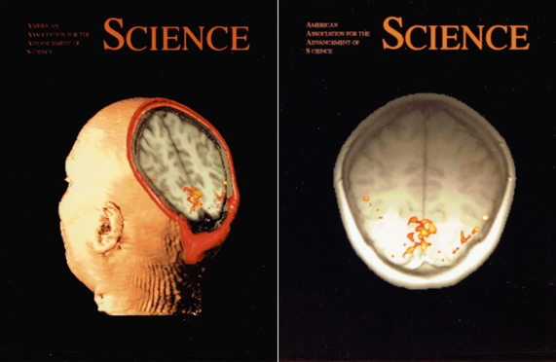
Aside: fMRI History
Much of the pioneering research for fMRI was conducted here in Boston at MGH
Published on the cover of Science in 1991
http://www.fmri25.org/behind-the-cover/

Slide 31
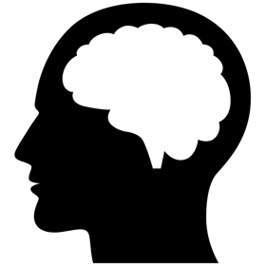
Image Subtraction
CONDITION A
-
CONDITION B
=
ACTIVATION MAP
A > B

Slide 32

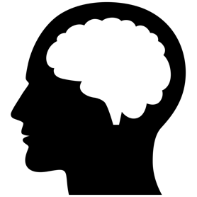
General Linear Model
Time
PERSON
CAT
Region 1
Region1 =
β_{P} * PERSON
+ β_{C} * CAT
β_{P} = 1.0
β_{C} = 0.0
β_{C}
β_{P}
-3
-2
-1
0
1
2
3

Slide 33
General Linear Model
Time
PERSON
CAT
Region 2
Region2 = β_{P} * PERSON + β_{C} * CAT
β_{P} = 0.0
β_{C} = 2.0
β_{C}
β_{P}
-3
-2
-1
0
1
2
3

Slide 34
General Linear Model
Time
PERSON
CAT
Region 3
Region3 = β_{P} * PERSON + β_{C} * CAT
β_{P} = 2.0
β_{C} = 0.5
β_{C}
β_{P}
-3
-2
-1
0
1
2
3

Slide 35
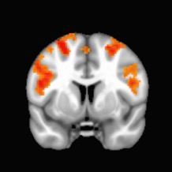
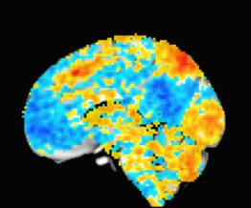
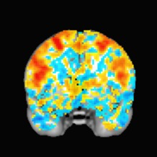
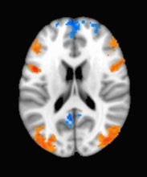
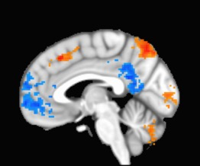
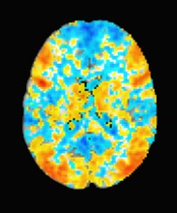
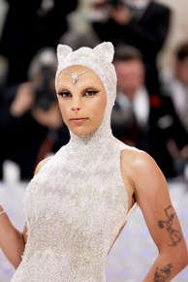
Thresholding the Image

Slide 36
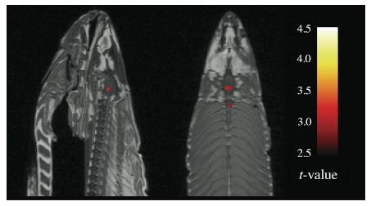
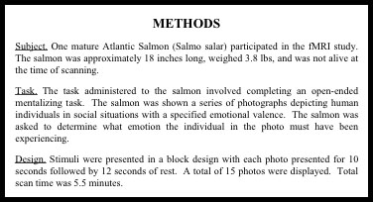
Limitations
fMRI is noisy! (you can have false positives)
Dead salmon shows “neural activity”
Bennett, et al. (2009)

Slide 37
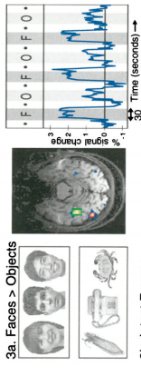
Finding Functional Brain Regions
Design a Task/Control Paradigm
Kanwisher, et al. (1997)

Slide 38
Agenda
How does MRI work?
Types of MRI Data
  Structural MRI
    Diffusion Weighted Imaging
  Functional MRI (fMRI)
    What is BOLD signal?
Three Ways to Look at fMRI Data
  Activity Maps
  Neural Decoding
  Functional Connectivity Networks
A Brief Overview of PET Imaging
The future…

Slide 39
Neural Decoding
Described in the homework reading
Also known as: Multivoxel Pattern Analysis (MVPA)
Goal: Can we “decode” behavior from brain signal?

Slide 40
Neural Decoding Analogy: Audience Applause
Section 1
Section 2
Section 3
Candidate 1
Candidate 2
Candidate 3
Mystery Candidate???:
Applause
Applause
Applause
Applause
0
1
2
3
0
1
2
3
0
1
2
3
0
1
2
3
Section
Section
Section
Section

Slide 41
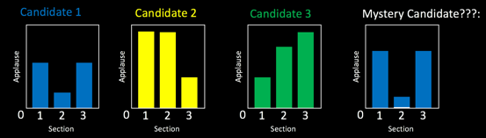
Neural Decoding Analogy
Audience Sections = Brain Regions
Candidates = Stimuli
Applause Levels = Brain Activation (BOLD signal)
Graphs = Activity Patterns
Brain Regions:
Stimulus Training Set:
Test Stimulus:
Section 1
Section 2
Section 3

Slide 42

Neural Decoding
TRAINING SET:
TEST ITEM:
BOLD Signal
BOLD Signal
Brain Regions
Brain Regions
?
BOLD Signal
Brain Regions

Slide 43
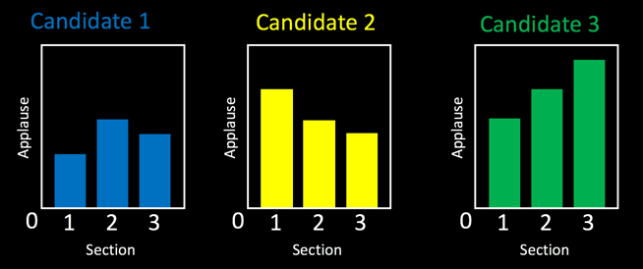
Sensitivity Analysis (Is a Region “Essential?”)
Run the neural decoding analysis many times
Each time, “perturb” activity in a different brain region, and see how it affects the results (drown out applause in one audience section)
If this worsens the decoding, then this region is important for representing information about these stimuli
  For example, removing section 1 in the plots below makes it difficult to differentiate Candidate 1 from Candidate 2.

Slide 44
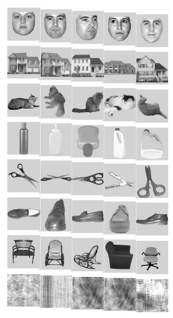

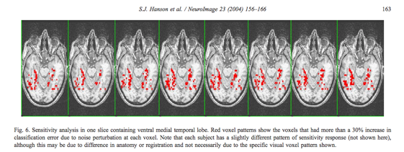
Neural Decoding Example
Hanson, et al. (2001) conducted a neural decoding analysis on faces, objects, houses, etc.
Sensitivity analysis showed that FFA signal was necessary for accurate decoding.
Kanwisher, et al. (1997)

Slide 45
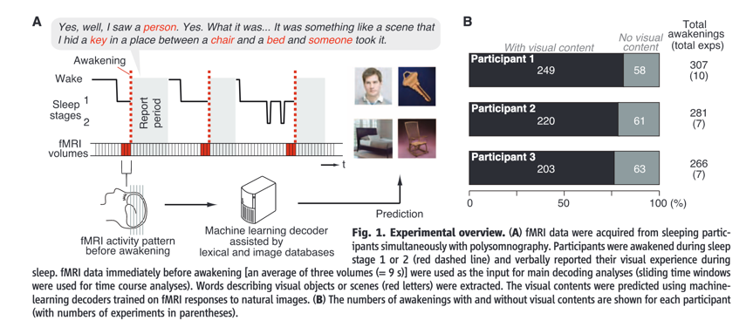
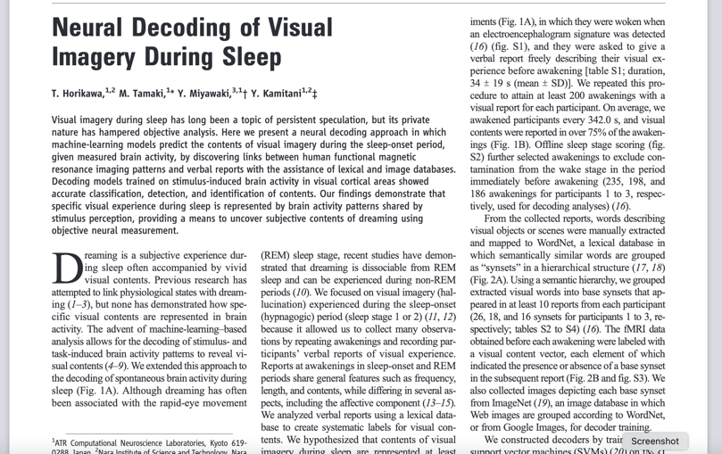
Neural Decoding Example (From the Discussion Forum!)
“I would want to test if an fMRI machine could be used to correctly predict what an individual is seeing in their dreams”
  – Josh W.
(Horikawa et al. 2013)

Slide 46
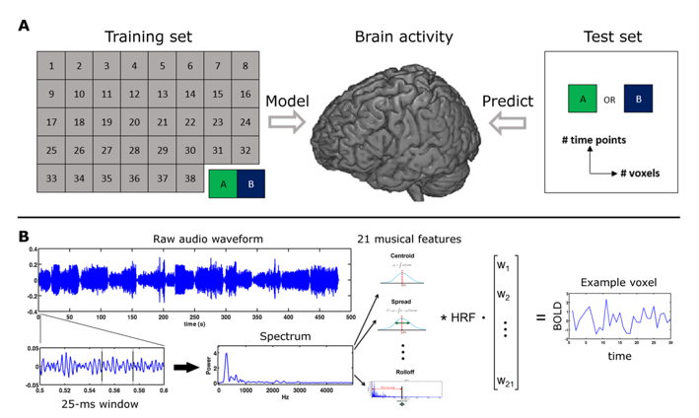
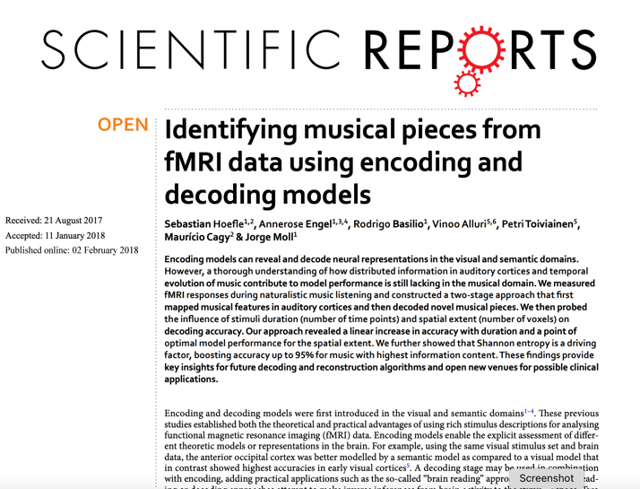
Another Neural Decoding Example (From the Discussion Forum!)
“I would want to study how the brain responds to different types of music...”
  – Billy L. B.
Hoefle et al. 2018

Slide 47

Issues surrounding Neural Decoding & Machine Learning (AI)
Are certain applications ethical (or even possible)?
  Lie Detection?
  Detection of “true” pain?
  Detection of consciousness in coma patients?
Training data affects validity
  Algorithms are as biased as the humans who create them and the datasets they “learn” from
  To make broad conclusions in a test set, you must use representative training data
(For AI Ethics Nerds)

Slide 48
Agenda
How does MRI work?
Types of MRI Data
  Structural MRI
    Diffusion Weighted Imaging
  Functional MRI (fMRI)
    What is BOLD signal?
Three Ways to Look at fMRI Data
  Activity Maps
  Neural Decoding
  Functional Connectivity Networks
A Brief Overview of PET Imaging
The future…

Slide 49
Representational Similarity Analysis (RSA): Motivation
Can we characterize the type of information that is represented in a brain region?
Use computational models to understand how information is represented in the brain
For a given brain region, what aspect of a stimulus or category is being represented?

Slide 50
Step 1: Estimate Brain Activity
BOLD Signal
Brain Region
BOLD Signal
Brain Region

Slide 51
Step 2: Measure Activity Pattern Dissimilarity
Dissimilar
BOLD Signal
Brain Region
BOLD Signal
Similar
Brain Region
Dissimilarity = 1 - Correlation

Slide 52
Step 2: Measure Activity Pattern Dissimilarity
Dissimilar
BOLD Signal
Brain Region
BOLD Signal
Similar
Brain Region
Dissimilarity = 1 - Correlation

Slide 53
Step 3: Predict Representational Dissimilarity with Models
Representational Dissimilarity Matrix (RDM)
Dissimilar
Modelling Theoretical
Activity Patterns
that Represent:
Cats vs. People
Similar

Slide 54
Step 3: Predict Representational Dissimilarity with Models
Representational Dissimilarity Matrix (RDM)
Dissimilar
Modelling Theoretical
Activity Patterns
that Represent:
Cats vs. People
Similar

Slide 55
Step 3: Predict Representational Dissimilarity with Models
Representational Dissimilarity Matrix (RDM)
Dissimilar
Modelling Theoretical
Activity Patterns
that Represent:
Movie Stars vs.
Non-Movie Stars
Similar

Slide 56
Step 3: Predict Representational Dissimilarity with Models
Representational Dissimilarity Matrix (RDM)
Dissimilar
Modelling Theoretical
Activity Patterns
that Represent:
Whiskers vs.
No Whiskers
Similar

Slide 57
Step 4: Compare Brain Data with Dissimilarity Models
Model #1:
Cats vs. People
Model #2:
Movie Stars vs. Non-Movie Stars
Model #3:
Whiskers vs. No Whiskers
Region A
Region B

Slide 58
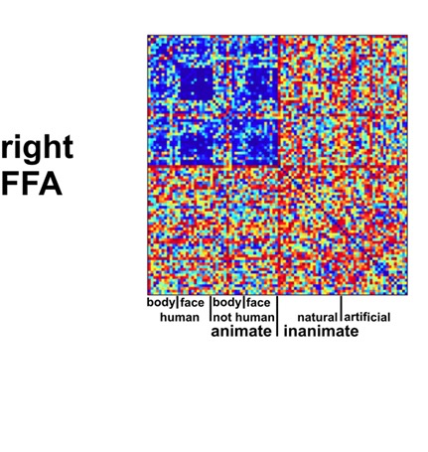
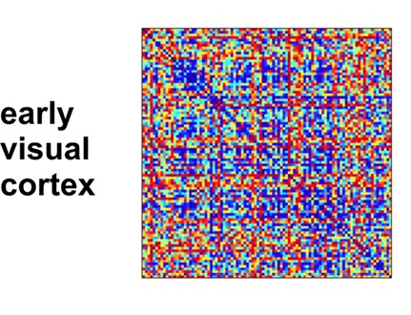


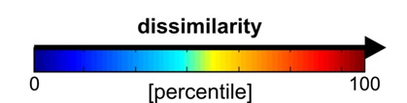
Real RSA Example: 96 Images
Kriegeskorte et al. 2008
Fusiform Face Area (FFA) has higher representational similarity for faces (and body-parts) compared to inanimate objects. Early visual cortex does not.

Slide 59



Real RSA Example
(From the Discussion Forum!)
Could we “predict the direction the subject wants to move their own bodies [from brain signal in motor cortex]… Could we then add more limbs to healthy people by simulating the other neural behaviors when moving [existing] body parts?”
  - Pingxuan Li
Could we “predict the direction the subject wants to move their own bodies [from brain signal in motor cortex]… Could we then add more limbs to healthy people by simulating the other neural behaviors when moving [existing] body parts?”
  - Pingxuan Li
Kieliba et al. 2021

Slide 60

Third Thumb Study Video
https://www.ucl.ac.uk/news/2021/may/robotic-third-thumb-use-can-alter-brain-representation-hand

Slide 61
Extending Representational Similarity Analysis
Vary the Model:
  Study Category Relationships
  Study other cognitive processes (e.g. reasoning, navigation)
Vary how similarity is calculated:
  Across Conditions
  Across Time (e.g. Learning, Aging)
  Across Subjects/Groups
Use Different Data as Input
  fMRI, EEG, Electrophysiological Recordings

Slide 62
Agenda
How does MRI work?
Types of MRI Data
  Structural MRI
    Diffusion Weighted Imaging
  Functional MRI (fMRI)
    What is BOLD signal?
Three Ways to Look at fMRI Data
  Activity Maps
  Neural Decoding
  Functional Connectivity Networks
A Brief Overview of PET Imaging
The future…

Slide 63

Aside: Cortical Surface
https://www.youtube.com/watch?v=aj-d8PZMXt8

Slide 64
Functional Connectivity
How do spontaneous fluctuations in BOLD signal correlate between brain regions?

Slide 65

Functional Connectivity
How do spontaneous fluctuations in BOLD signal correlate between brain regions?
(SEED REGION)
Fox et al. 2005

Slide 66


Example: Resting-State Functional Connectivity Study of Music Therapy for Autistic Children
Sharda et al. 2018

Slide 67

Functional Connectivity Networks
Yeo, et al. 2011

Slide 68


Functional Connectivity Networks
Yeo et al. 2011
Power et al. 2011

Slide 69




Default Mode Network Function
INTERNAL PROCESSING
EXTERNAL PROCESSING
Activated During…
Deactivated During Visuospatial Reasoning
Autobiographical Memory
Navigation
Theory of Mind
Resting State
Spreng et al. 2008
Morin et al. 2022
Activated During Self-Referential Thinking
Deactivated During Working Memory
Andrews-Hanna et al. 2010
Cole et al. 2012

Slide 70
Aside: Energy Use in the Brain
The brain is 2% of your body weight, but uses 20% of your body’s energy use
The brain uses ~17-20 Watts of energy (a typical light bulb uses about 60 W) (Balasubramanian 2021, PNAS)
  ~9W is lost to heat
  ~3W used by cortical gray matter (>80% of this is used to send signals between neurons)
  Remainder powers the rest of the brain
Is the brain’s energy use greater during a mental task compared to rest?
  Maybe, but probably only a little…
  Brain activity across regions is typically balanced by deactivations
Morin et al. 2022

Slide 71



Tau Tangles Spread Through the Default Mode Network in Alzheimer’s Disease
Early AD
Late AD
Spread of Tau Tangles in Alzheimer’s Patient
Mueller et al. 2020
Schöll et al. 2018

Slide 72
Agenda
How does MRI work?
Types of MRI Data
  Structural MRI
    Diffusion Weighted Imaging
  Functional MRI (fMRI)
    What is BOLD signal?
  Four Ways to Look at fMRI Data
    Activity Maps
    Neural Decoding
    Representational Similarity Analysis
    Functional Connectivity Networks
A Brief Overview of PET Imaging
The future…

Slide 73


Positron Emission Tomography (PET)
Temporal Resolution: Hours to Days (sometimes minutes)
Spatial Resolution: ~2mm³ (at best)

Slide 74
Positron Emission Tomography
https://www.youtube.com/watch?v=oySvkmezdo0 (1 min video – no sound)
https://www.youtube.com/watch?v=yrTy03O0gWw (4 min video - UCL)

Slide 75

Radiotracers
- “Tag” a chemical with a radioactive isotope
  For example, flourodeoxyglucose or FDG is just glucose (sugar) with an [¹⁸F] tag

Slide 76
PET Applications for Neuroscience
FDG Imaging (Cancer & Neurology)
Dopamine Imaging
Opioid Imaging
Amyloid & Tau Imaging (Alzheimer’s)
Imaging Neuroinflamation & Microglia
HDAC (epigenetic) imaging
And Many More!

Slide 77



Simultaneous MR/PET

Slide 78





Example: 79 year old Participant from the Brandeis Aging Brain Study
[¹⁸F]MK6240 PET Scan
(Measures Tau Burden)
[¹¹C]Raclopride PET Scan
(Measures Dopamine Receptor Density)
[¹⁸F]Fluoro-m-l-tyrosine (FMT) PET Scan
(Measures Dopamine Synthesis Capacity)

Slide 79
Agenda
How does MRI work?
Types of MRI Data
  Structural MRI
    Diffusion Weighted Imaging
  Functional MRI (fMRI)
    What is BOLD signal?
  Four Ways to Look at fMRI Data
    Activity Maps
    Neural Decoding
    Representational Similarity Analysis
    Functional Connectivity Networks
A Brief Overview of PET Imaging
The future…

Slide 80


The Future is Now
Dylan Williams, 21 year-old student at Tufts in 2012 when he was hit by a car
Deemed “minimally conscious” by physicians at MGH
Dr. Brian Edlow was conducting research at the time imaging unconscious individuals with fMRI
Dylan responded to music and language sounds
Dylan regained consciousness a few days later
  https://giving.massgeneral.org/fmri-reveals-brains-secrets/

Slide 81






Acknowledgements
Neurochemistry & Cognition Lab
(Brandeis University):
Anne Berry, PhD
Emma Carlson
Patrick Cao
Alex Kinney
Hsiang-Yu Chen, PhD
Jenny Crawford, PhD
Claire Ciampa
Teodora Markova
Rachel Marcus
Daisy Kiyemba
Chemical Neuroscience Program
(MGH Martinos Center):
Nicole Zürcher, PhD
Chieh-En (Jane) Tseng, PhD
Ya-chin Chen, PhD
Elisa Guma, PhD
Tye Chu
Mary Nickita
R01 AG074330

Slide 82



Acknowledgements
Boston University
Dr. Chantal Stern
Dr. Joe McGuire
Dr. David Somers
Dr. Shelley Russek
Dr. Rachel Nauer
Dr. Allen Chang
Matt Dunne
Stamati Liapis
Kylie Moore
Caroline Ahn
Weida Ma
MGH Martinos Center
Dr. Jacob Hooker
Dr. Hsiao-Ying (Monica) Wey
Dr. Nicole Zürcher
Dr. Martin Strebl
Dr. Tonya Gilbert
Christine Wu
Baleigh Hightower
Tufts University
Dr. Aniruddh Patel
Dr. Ayanna Thomas
Dr. Ben Hescott
Dr. Elizabeth Race
Dr. Nathan Ward

Slide 83

Questions?
www.tmmorin.com
tommorin@brandeis.edu
tmorin2@mgh.harvard.edu

