Slide 1
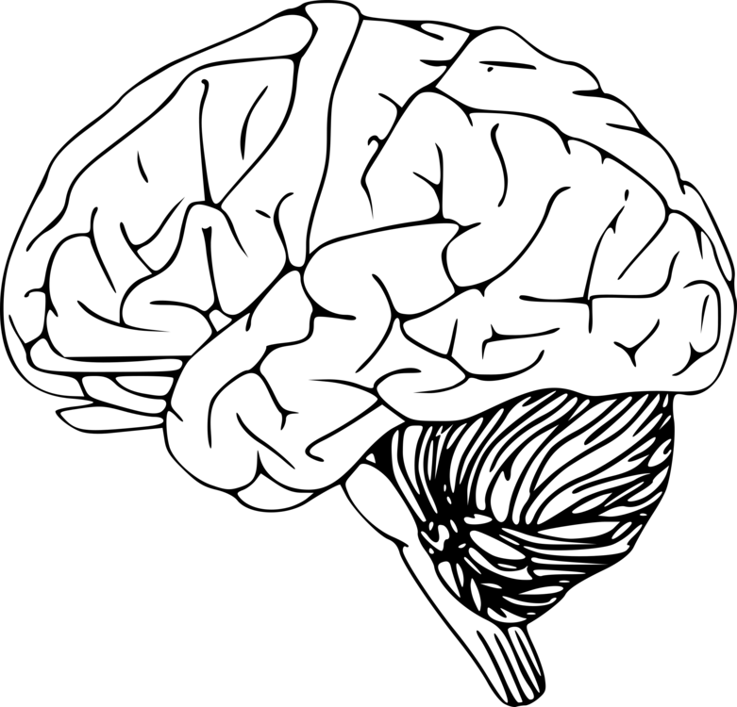
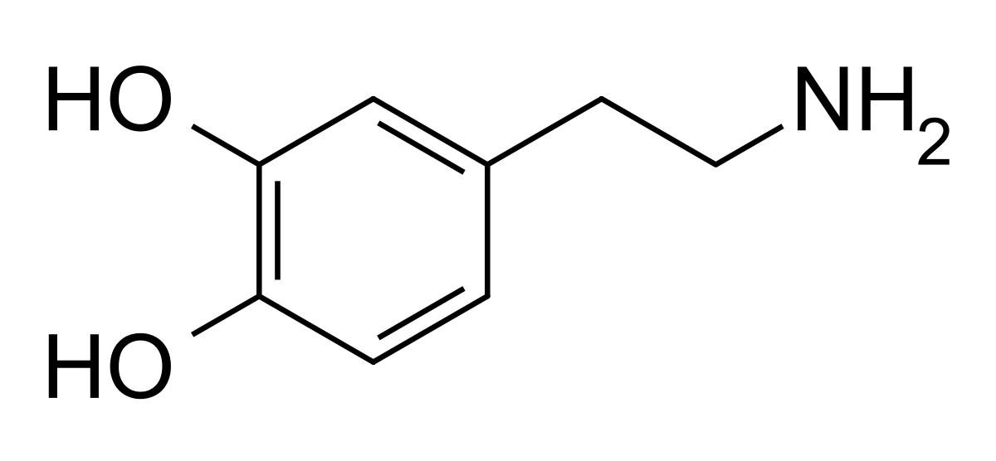


Deciphering Dopamine:
The Aging Brain’s Unsolved Riddle
Tom Morin, PhD
Beacon Hill Seminars
October 6, 2023

Slide 2
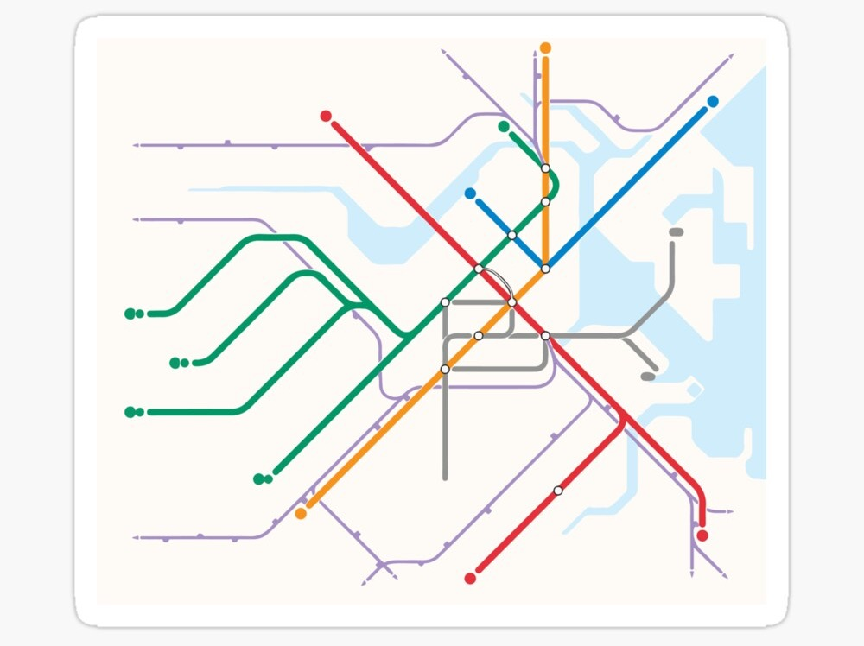

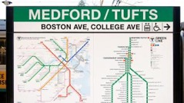


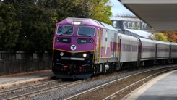


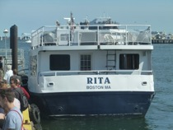

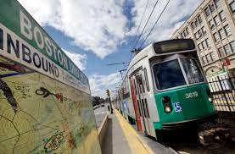



Medford/Tufts (Tufts University)
2017 B.S., Cognitive & Brain Science; Computer Science
2022 Adjunct Lecturer, Psychology
om Morin
Brandeis/Roberts (Brandeis U.)
2022-Present: Postdoc. w/ Anne Berry
Charlestown (MGH Martinos)
2015-2017 Hookerlab Intern
2022-Present Postdoc.
BU East (Boston University)
2017-2022 PhD, Computational Neuroscience
Braintree (Hometown)
www.tmmorin.com

Slide 3
Could Dopamine be a Cognitive Resilience Factor?

Slide 4
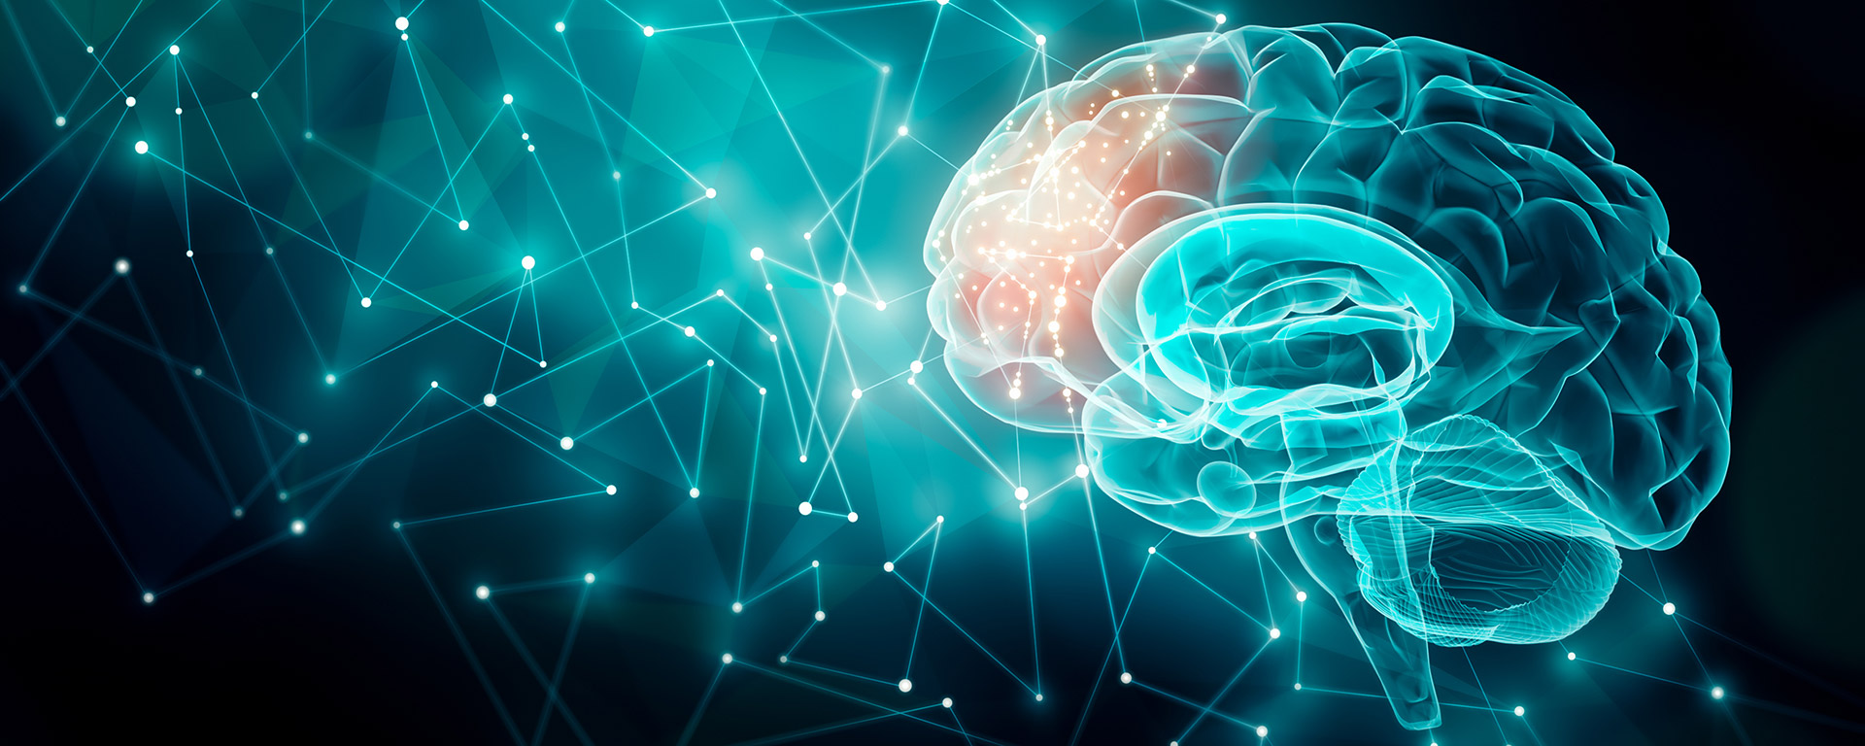

The Brandeis Aging Brain Study
Began in 2019
Repeat cognitive assessments and brain imaging sessions
300+ participants enrolled
100+ participants with at least one session of brain imaging
50+ participants with 2 or more cognitive assessments
Anne Berry, PhD
Contact Info:
781-736-3243
agingbrainstudy@brandeis.edu
www.brandeis.edu/psychology/neurochemistry-cognition

Slide 5

Anne Berry, PhD
Jacob Hooker, PhD
Contact Info:
781-736-3243
agingbrainstudy@brandeis.edu
www.brandeis.edu/psychology/neurochemistry-cognition

Slide 6
Today’s Topics
What is dopamine?
What happens to dopamine as we age?
What happens when the dopamine system breaks down? (Parkinson’s Disease)
What is norepinephrine and how is it like dopamine?
Can understanding these molecules offer new clues about Alzheimer’s Disease?

Slide 7
1. What is Dopamine?

Slide 8
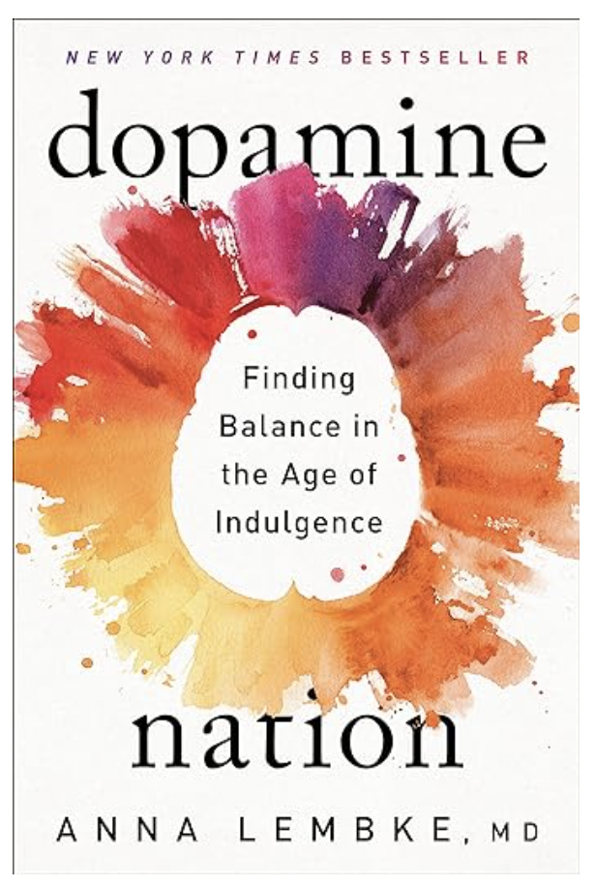

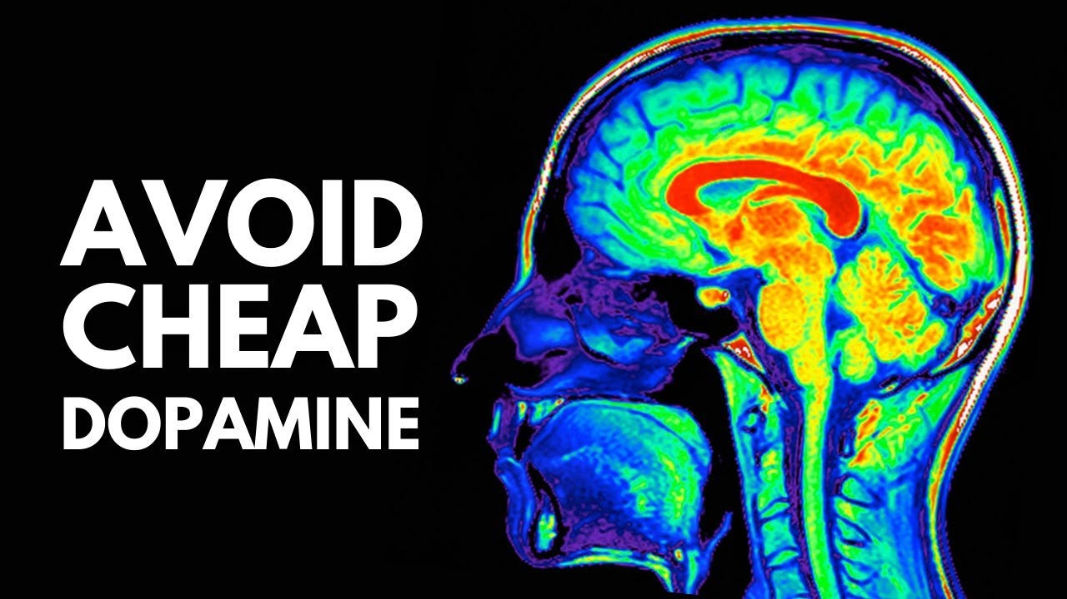



Dopamine: What’s all the hype?

Slide 9
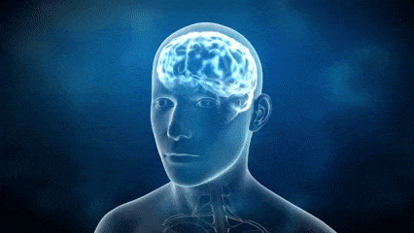
Your brain contains approximately 100 billion nerve cells called neurons.

Slide 10
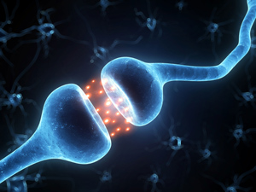
These neurons are separated by tiny gaps called synapses.
synapse
neurotransmitters
Two neurons communicate with each other by sending neurotransmitters across the synapse.

Slide 11
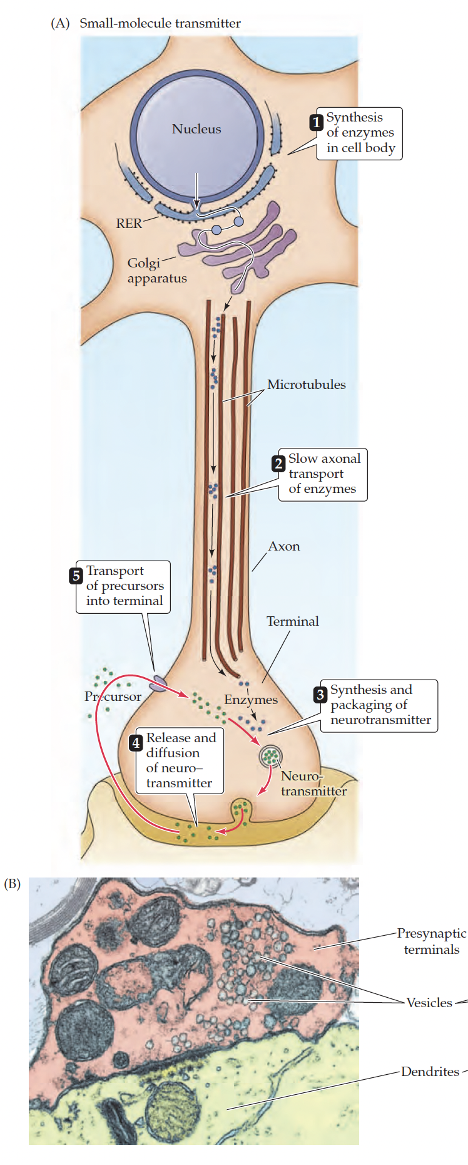
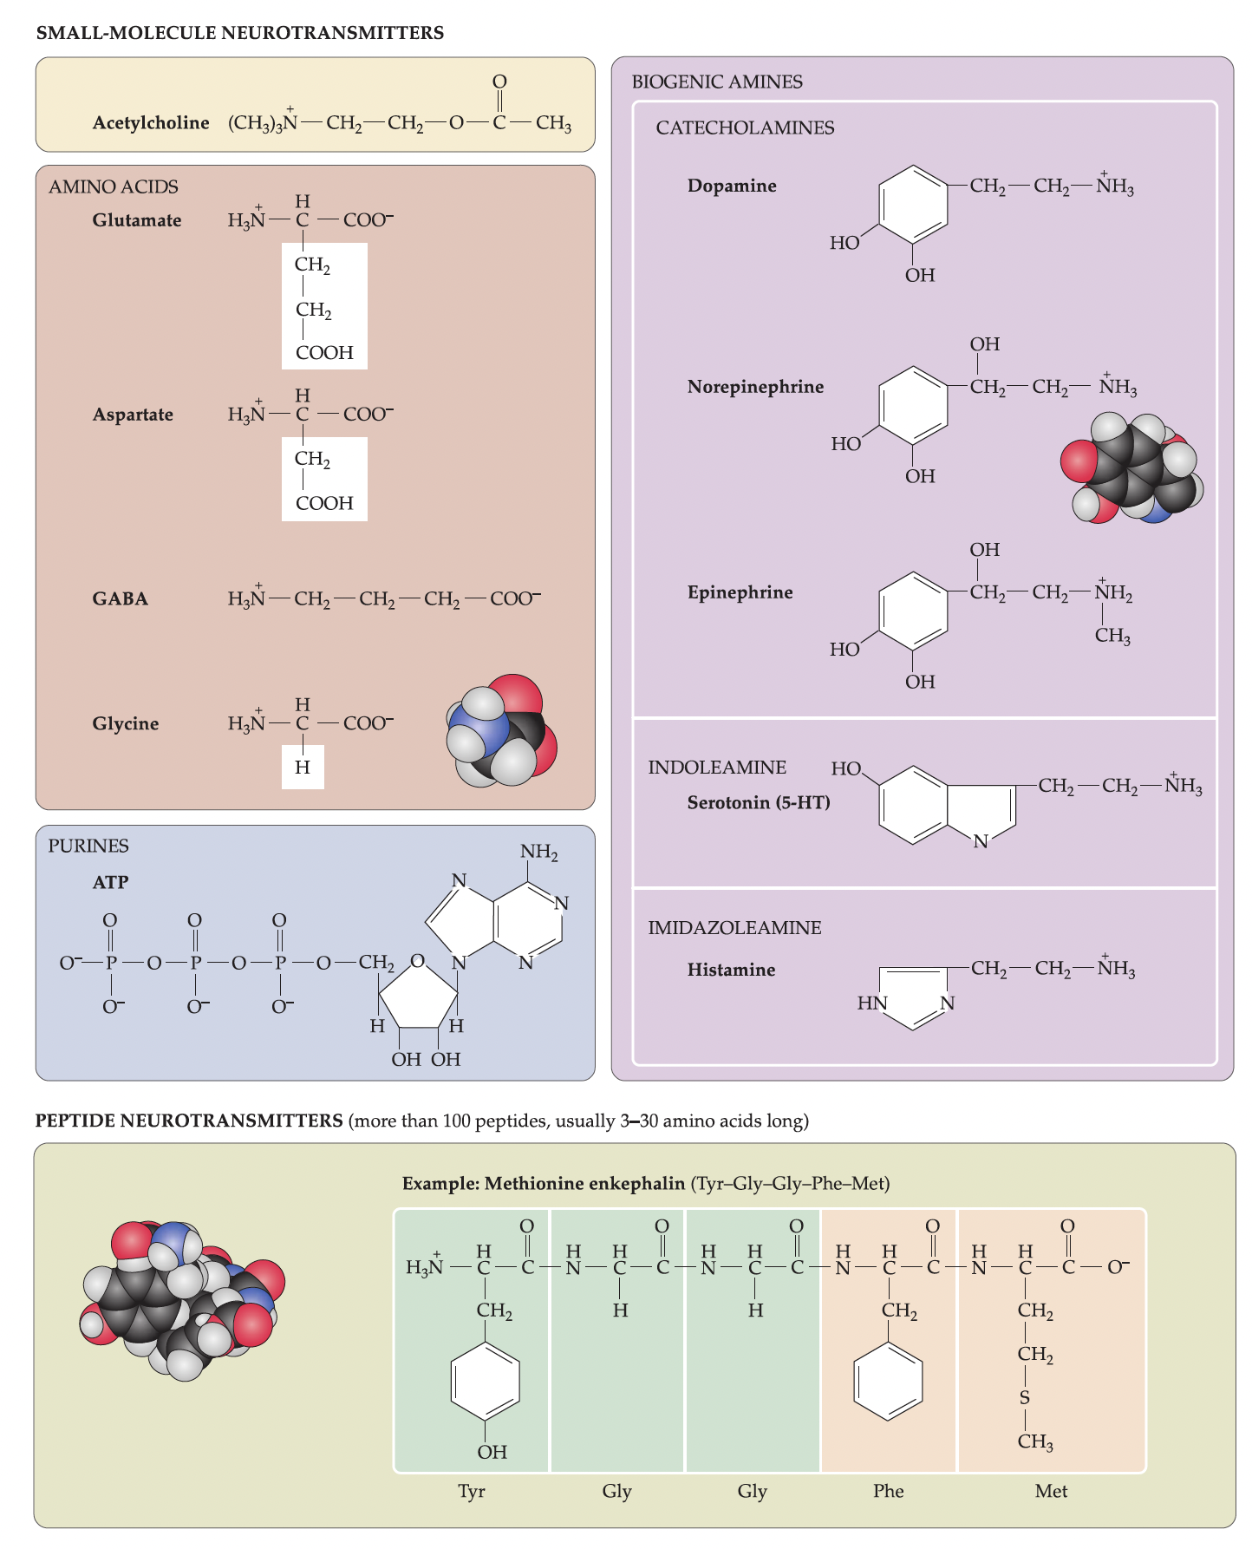
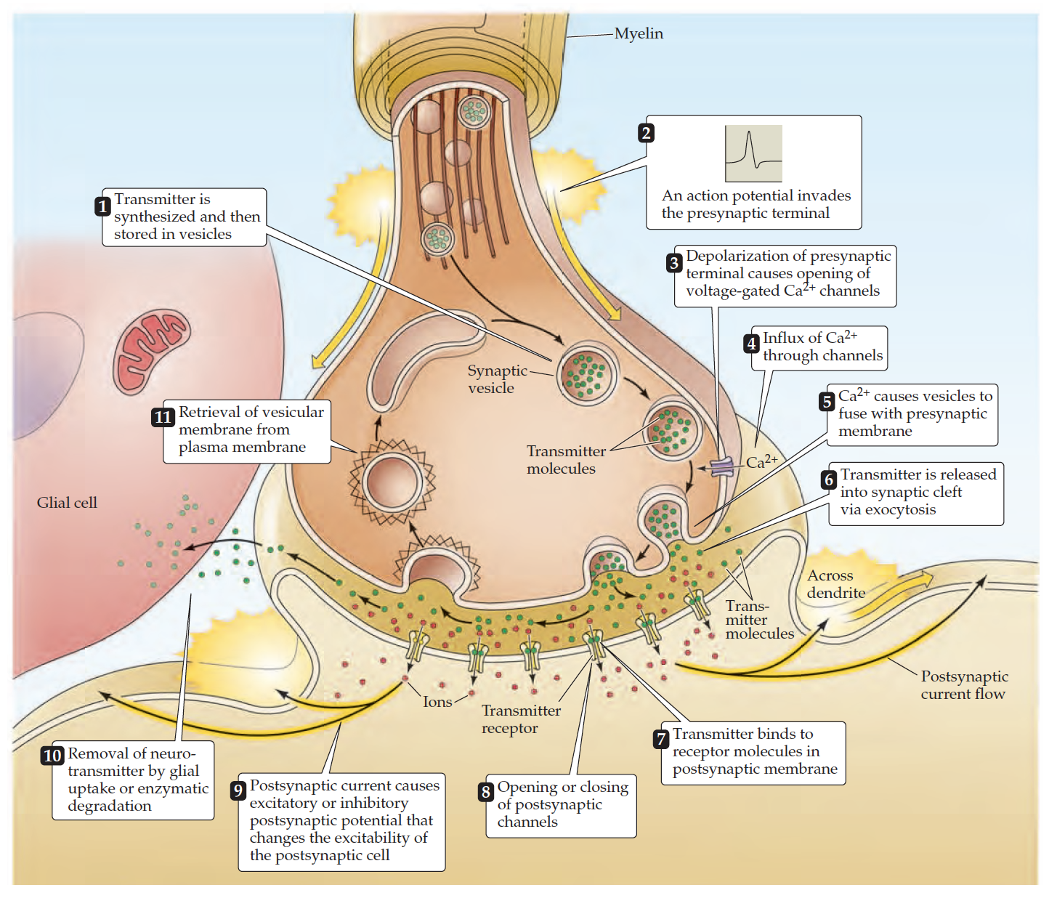
Dopamine is a Neurotransmitter
Neurotransmitter: A chemical messenger that allows neurons to communicate with each other.

Slide 12
What kinds of messages does dopamine send?
Too Many to List!
  Movement
  Reward
  Memory
  Lactation
  Attention
  Sleep Regulation
  Nausea
  Motivation
  Arousal
  Decision-making

Slide 13
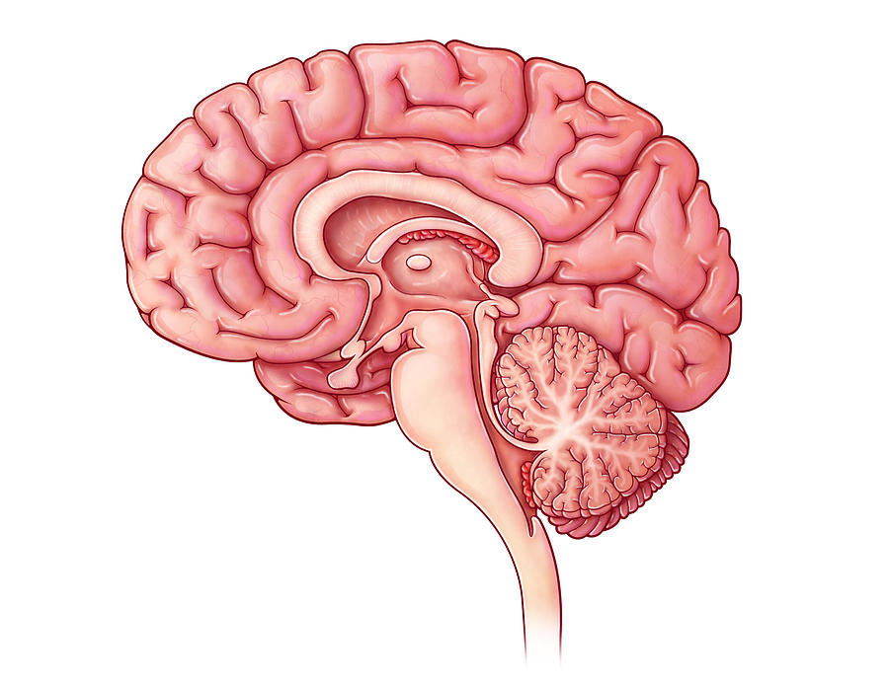
Dopamine is created by neurons that project from the substantia nigra.

Slide 14
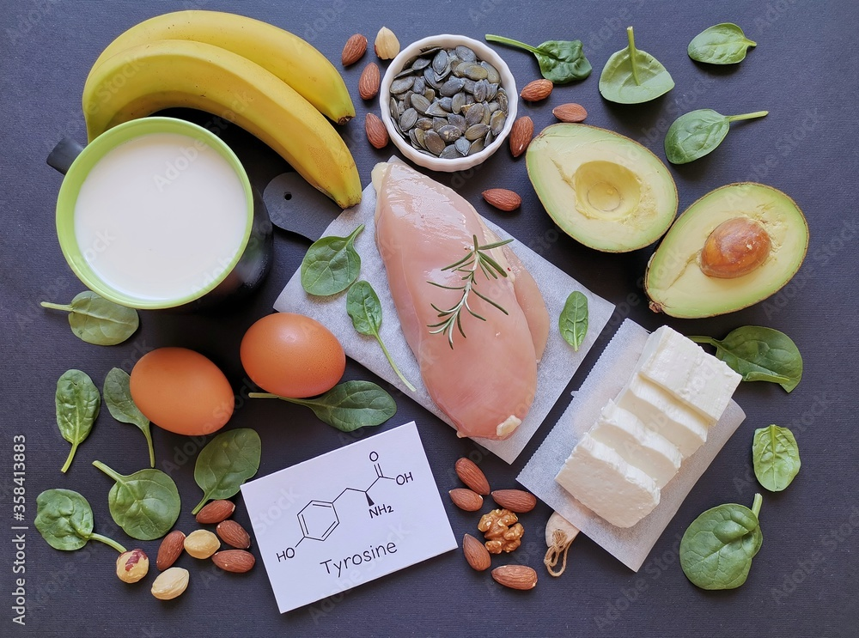
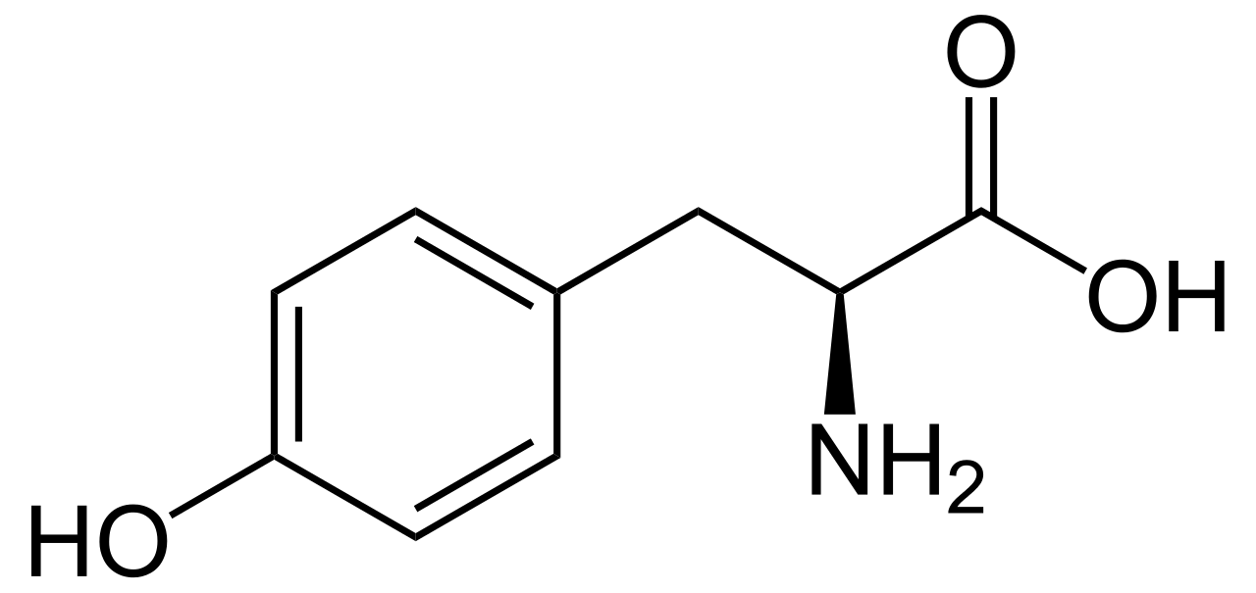
Your body needs to create dopamine.
The raw ingredient for dopamine is an amino acid called tyrosine.

Slide 15
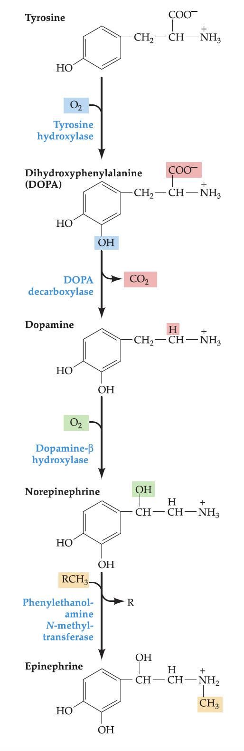
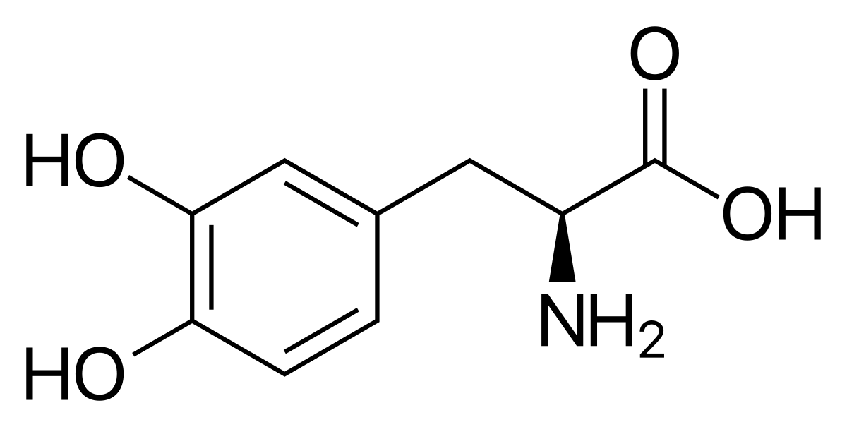
Manufacturing Dopamine
L-Tyrosine
L-DOPA
Purves et al. 2012)

Slide 16
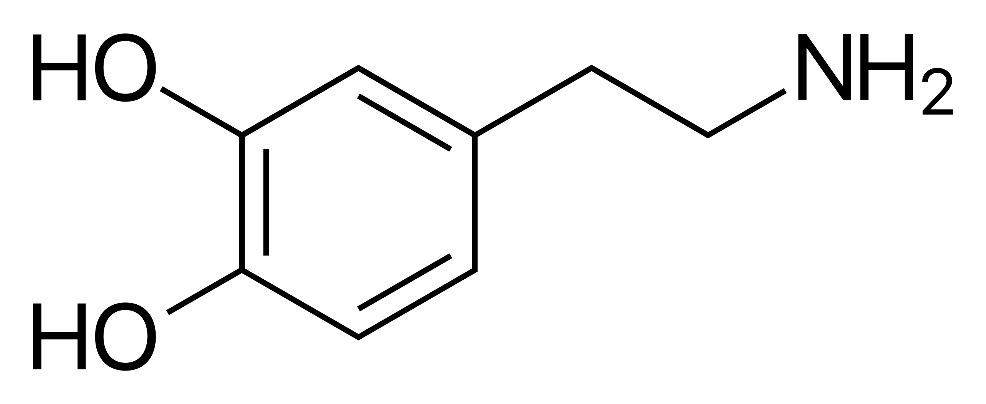
Manufacturing Dopamine
Purves et al. 2012)
L-Tyrosine
L-DOPA
Dopamine

Slide 17
2. What happens to the dopamine system as we age?

Slide 18
Cognitive Changes in Normal Healthy Aging
Decline | Remains Stable or Improves
Notes:
Problem-solving and reasoning: many of these peak in the third decade of life
Processing speed: general ability to think quickly; also effects motor speed
Attention/concentration: Calculating a tip at a restaurant
Vocab/General Knowledge: Trivia, facts, well-practiced or familiar skills
Language abilities: object naming
Visuospatial abilities: object recognition; spatial relationship between objects

Slide 19
Cognitive Changes in Normal Healthy Aging
Decline | Remains Stable or Improves
Problem-solving and reasoning
Notes:
Problem-solving and reasoning: many of these peak in the third decade of life
Processing speed: general ability to think quickly; also effects motor speed
Attention/concentration: Calculating a tip at a restaurant
Vocab/General Knowledge: Trivia, facts, well-practiced or familiar skills
Language abilities: object naming
Visuospatial abilities: object recognition; spatial relationship between objects

Slide 20
Cognitive Changes in Normal Healthy Aging
Decline | Remains Stable or Improves
Problem-solving and reasoning | Vocabulary and General Knowledge
Notes:
Problem-solving and reasoning: many of these peak in the third decade of life
Processing speed: general ability to think quickly; also effects motor speed
Attention/concentration: Calculating a tip at a restaurant
Vocab/General Knowledge: Trivia, facts, well-practiced or familiar skills
Language abilities: object naming
Visuospatial abilities: object recognition; spatial relationship between objects

Slide 21
Cognitive Changes in Normal Healthy Aging
Decline | Remains Stable or Improves
Problem-solving and reasoning | Vocabulary and General Knowledge
Processing speed
Notes:
Problem-solving and reasoning: many of these peak in the third decade of life
Processing speed: general ability to think quickly; also effects motor speed
Attention/concentration: Calculating a tip at a restaurant
Vocab/General Knowledge: Trivia, facts, well-practiced or familiar skills
Language abilities: object naming
Visuospatial abilities: object recognition; spatial relationship between objects

Slide 22
Cognitive Changes in Normal Healthy Aging
Decline | Remains Stable or Improves
Problem-solving and reasoning | Vocabulary and General Knowledge
Processing speed | Language Abilities
Notes:
Problem-solving and reasoning: many of these peak in the third decade of life
Processing speed: general ability to think quickly; also effects motor speed
Attention/concentration: Calculating a tip at a restaurant
Vocab/General Knowledge: Trivia, facts, well-practiced or familiar skills
Language abilities: object naming
Visuospatial abilities: object recognition; spatial relationship between objects

Slide 23
Cognitive Changes in Normal Healthy Aging
Decline | Remains Stable or Improves
Problem-solving and reasoning | Vocabulary and General Knowledge
Processing speed | Language Abilities
Attention and concentration
Notes:
Problem-solving and reasoning: many of these peak in the third decade of life
Processing speed: general ability to think quickly; also effects motor speed
Attention/concentration: Calculating a tip at a restaurant
Vocab/General Knowledge: Trivia, facts, well-practiced or familiar skills
Language abilities: object naming
Visuospatial abilities: object recognition; spatial relationship between objects

Slide 24
Cognitive Changes in Normal Healthy Aging
Decline | Remains Stable or Improves
Problem-solving and reasoning | Vocabulary and General Knowledge
Processing speed | Language Abilities
Attention and concentration | Visuospatial abilities
Notes:
Problem-solving and reasoning: many of these peak in the third decade of life
Processing speed: general ability to think quickly; also effects motor speed
Attention/concentration: Calculating a tip at a restaurant
Vocab/General Knowledge: Trivia, facts, well-practiced or familiar skills
Language abilities: object naming
Visuospatial abilities: object recognition; spatial relationship between objects

Slide 25
Cognitive Changes in Normal Healthy Aging
Decline | Remains Stable or Improves
Problem-solving and reasoning | Vocabulary and General Knowledge
Processing speed | Language Abilities
Attention and concentration | Visuospatial abilities
Planning, Organization, Task-switching
Notes:
Problem-solving and reasoning: many of these peak in the third decade of life
Processing speed: general ability to think quickly; also effects motor speed
Attention/concentration: Calculating a tip at a restaurant
Vocab/General Knowledge: Trivia, facts, well-practiced or familiar skills
Language abilities: object naming
Visuospatial abilities: object recognition; spatial relationship between objects

Slide 26
Cognitive Changes in Normal Healthy Aging
Decline | Remains Stable or Improves
Problem-solving and reasoning | Vocabulary and General Knowledge
Processing speed | Language Abilities
Attention and concentration | Visuospatial abilities
Planning, Organization, Task-switching | Ability to appreciate similarities, Reasoning about familiar material (analogies/proverbs)
Notes:
Problem-solving and reasoning: many of these peak in the third decade of life
Processing speed: general ability to think quickly; also effects motor speed
Attention/concentration: Calculating a tip at a restaurant
Vocab/General Knowledge: Trivia, facts, well-practiced or familiar skills
Language abilities: object naming
Visuospatial abilities: object recognition; spatial relationship between objects

Slide 27
Cognitive Changes in Normal Healthy Aging
Decline | Remains Stable or Improves
Problem-solving and reasoning | Vocabulary and General Knowledge
Processing speed | Language Abilities
Attention and concentration | Visuospatial abilities
Planning, Organization, Task-switching | Ability to appreciate similarities, Reasoning about familiar material (analogies/proverbs)
*Memory
Notes:
Problem-solving and reasoning: many of these peak in the third decade of life
Processing speed: general ability to think quickly; also effects motor speed
Attention/concentration: Calculating a tip at a restaurant
Vocab/General Knowledge: Trivia, facts, well-practiced or familiar skills
Language abilities: object naming
Visuospatial abilities: object recognition; spatial relationship between objects

Slide 28
Cognitive Changes in Normal Healthy Aging
Decline | Remains Stable or Improves
Problem-solving and reasoning | Vocabulary and General Knowledge
Processing speed | Language Abilities
Attention and concentration | Visuospatial abilities
Planning, Organization, Task-switching | Ability to appreciate similarities, Reasoning about familiar material (analogies/proverbs)
*Memory | Mood; Willingness to Trust
Notes:
Problem-solving and reasoning: many of these peak in the third decade of life
Processing speed: general ability to think quickly; also effects motor speed
Attention/concentration: Calculating a tip at a restaurant
Vocab/General Knowledge: Trivia, facts, well-practiced or familiar skills
Language abilities: object naming
Visuospatial abilities: object recognition; spatial relationship between objects

Slide 29
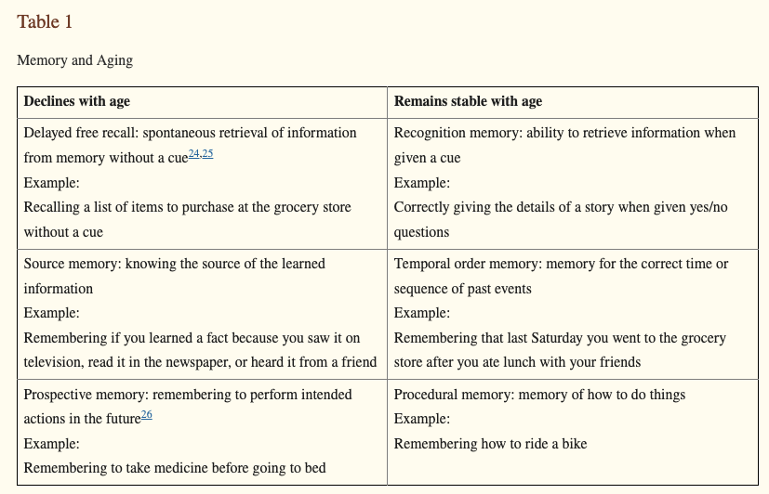
Harada et al. 2014

Slide 30
Dopamine and Aging:
“The Correlative Triad”
Aging
Dopamine
Cognition
Backman and Farde, 2005; Backman et al., 2006

Slide 31
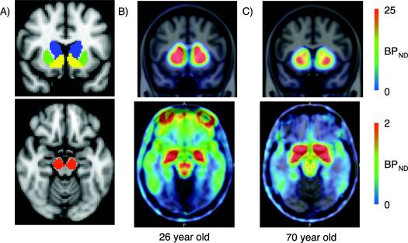
After approx. age 60, dopaminergic projections from the substantia nigra to the striatum are lost at a rate of 6-10% per decade.
Dang et al. 2018

Slide 32

We lose many of our dopamine factories as we age.
Purves et al. 2012)

Slide 33
One way our brain makes up for this is by increasing the production capabilities of the factories that remain.
Purves et al. 2012)

Slide 34
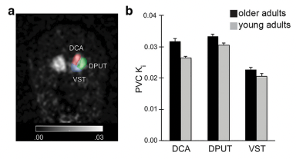
Dopamine Synthesis Capacity Increases with Age
DOPA-decarboxylase
(Dopamine-synthesizing enzyme)
Ciampa et al., 2022
Berry et al., 2016
Braskie et al., 2008
Brain Regions

Slide 35
3. What happens when the dopamine system breaks down?

Slide 36
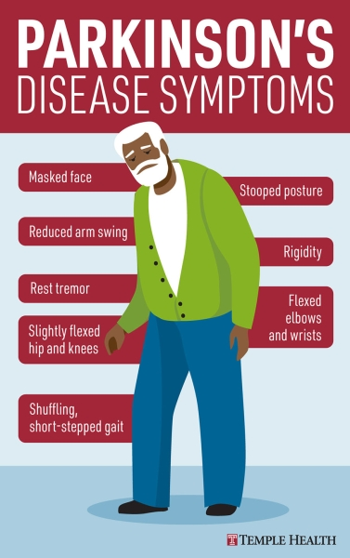
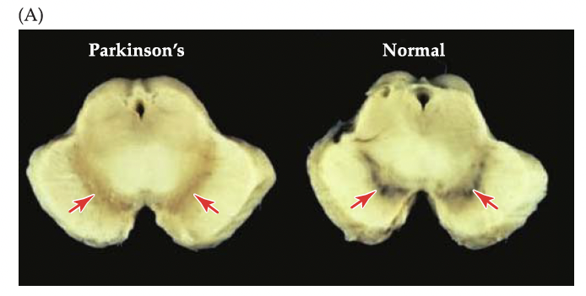
Parkinson’s Disease

Slide 37
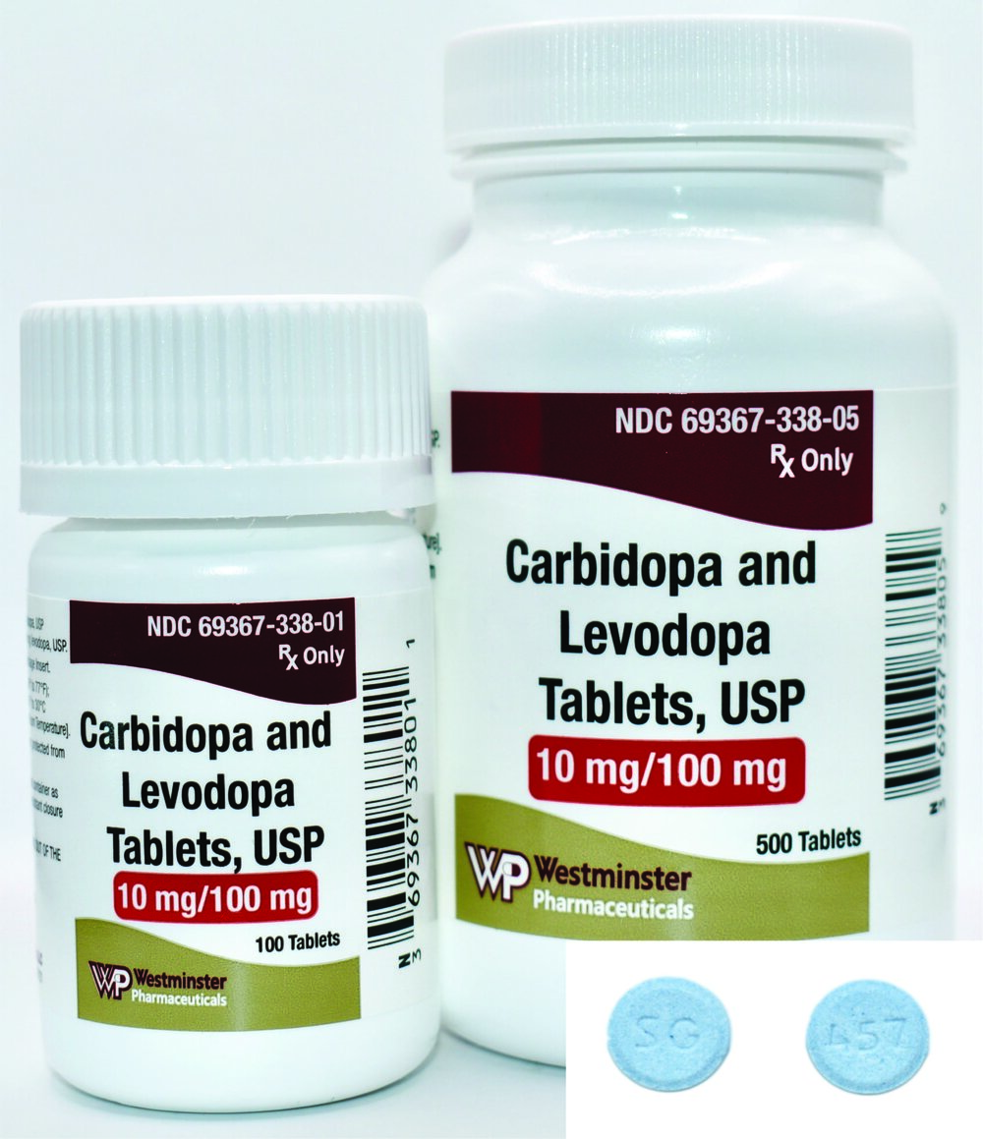
Can we treat Parkinson’s by Restoring Dopaminergic Signaling?
1. Pharmaceuticals (L-DOPA)
L-Tyrosine
L-DOPA

Slide 38
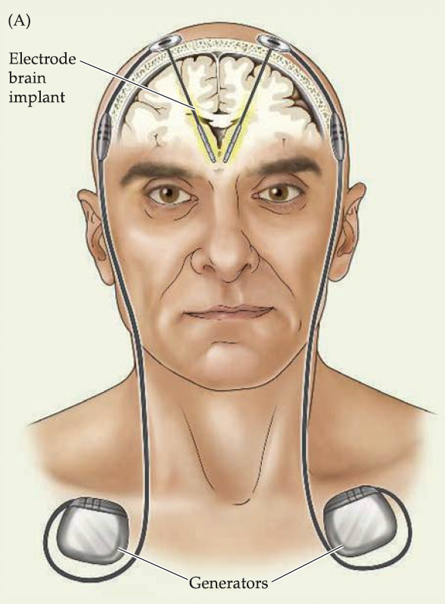
Can we treat Parkinson’s by Restoring Dopaminergic Signaling?
2. Deep Brain Stimulation

Slide 39
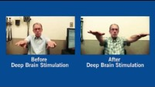
Can we treat Parkinson’s by Restoring Dopaminergic Signaling?
2. Deep Brain Stimulation

Slide 40

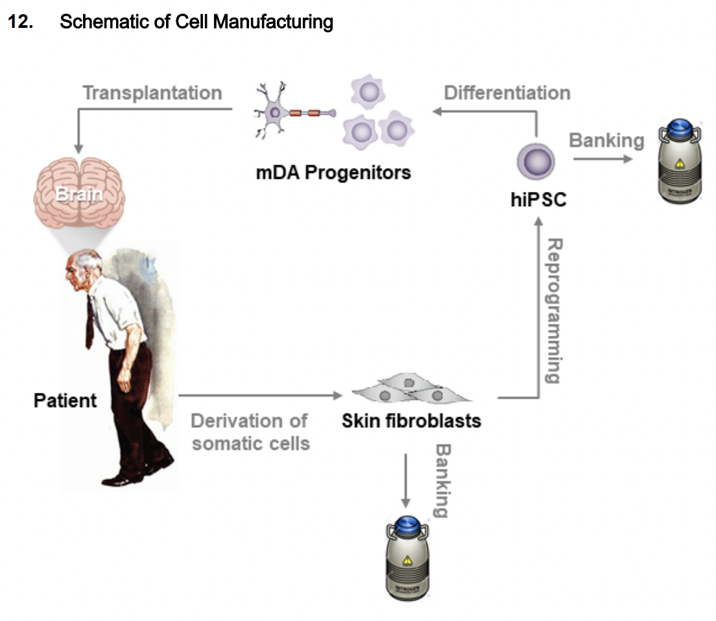
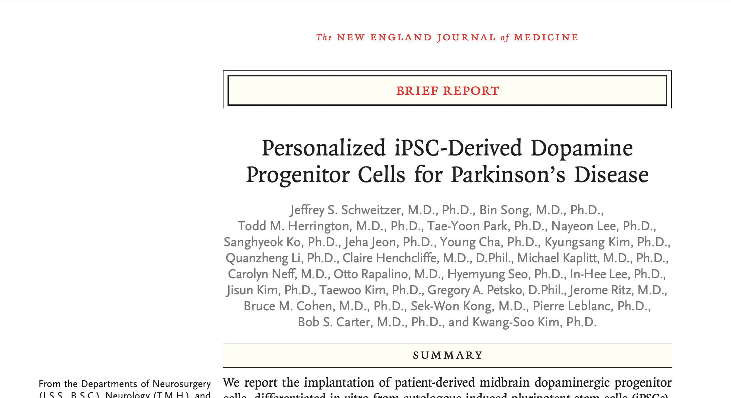
Can we treat Parkinson’s by Restoring Dopaminergic Signaling?
3. Stem Cell Therapy
Kwang-Soo Kim, PhD
Schweitzer et al. 2020

Slide 41
4. What is norepinephrine and how is it related to dopamine?

Slide 42
Dopamine is created by neurons that project from the substantia nigra.

Slide 43
Norepinephrine, dopamine’s cousin is produced in the locus coeruleus.
Functions:
Arousal
Fight or Flight
Pupil Dilation
Memory
Movement
Senses
Hunger/Thirst

Slide 44
Manufacturing Norepinephrine
L-Tyrosine
L-DOPA
Purves et al. 2012)

Slide 45
Manufacturing Norepinephrine
Purves et al. 2012)
L-Tyrosine
L-DOPA
Dopamine

Slide 46
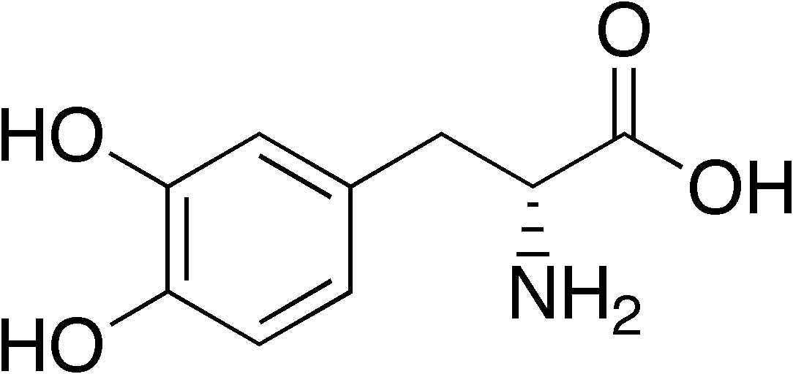
Manufacturing Norepinephrine
Purves et al. 2012)
L-Tyrosine
L-DOPA
Dopamine
Norepinephrine
(Noradrenaline)

Slide 47
Aside: Epinephrine is also produced in the brain.

Slide 48
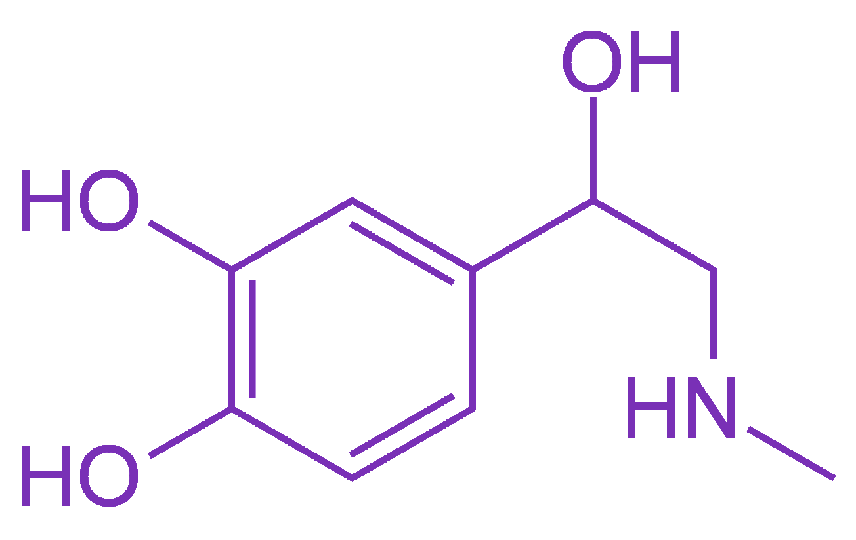
Manufacturing Epinephrine
Purves et al. 2012)
L-Tyrosine
L-DOPA
Dopamine
Norepinephrine
(Noradrenaline)
Epinephrine
(Adrenaline)

Slide 49
5. What does this have to do with Alzheimer’s Disease?

Slide 50
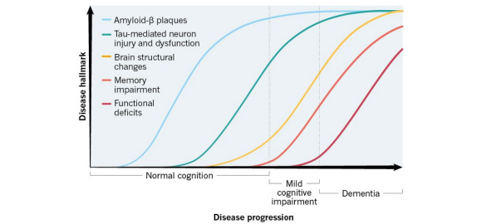
Progression of Alzheimer’s Disease

Slide 51
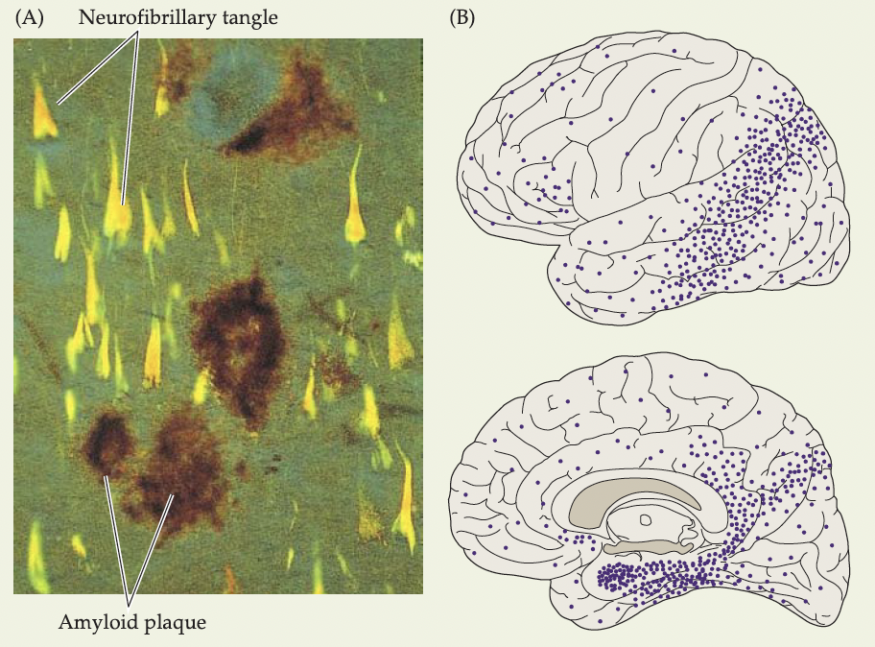
Amyloid Plaques and Tau Tangles

Slide 52
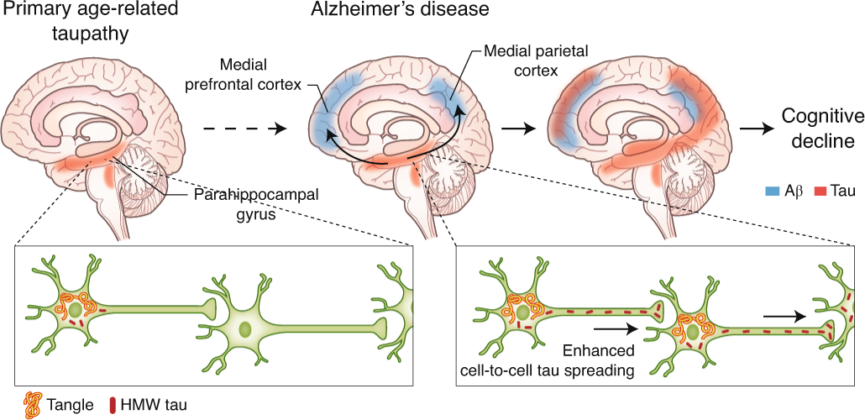
The spread of Tau tangles follows neural circuits.
Busche & Hyman 2020

Slide 53
One of the first areas to accumulate tau is the locus coeruleus

Slide 54
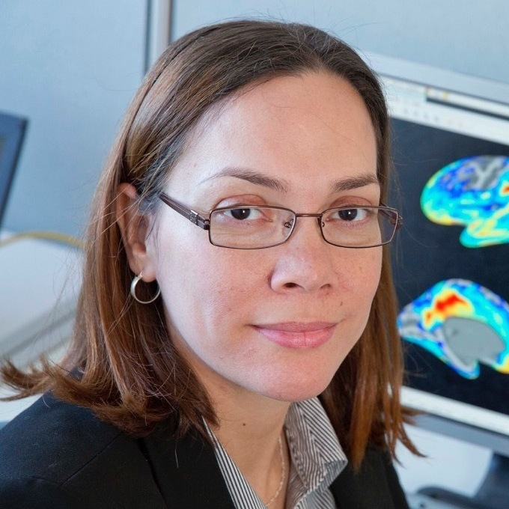

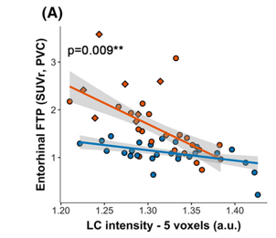

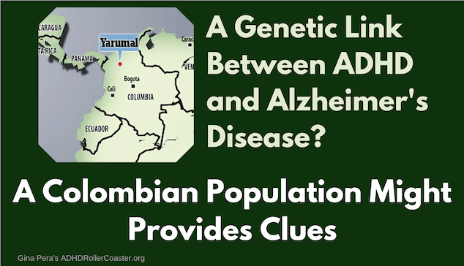
Is locus coeruleus integrity predictive of oncoming Alzheimer’s?
Yakeel Quiroz, PhD
Heidi Jacobs, PhD
Tau Burden
Tau
Locus Coeruleus Integrity

Slide 55
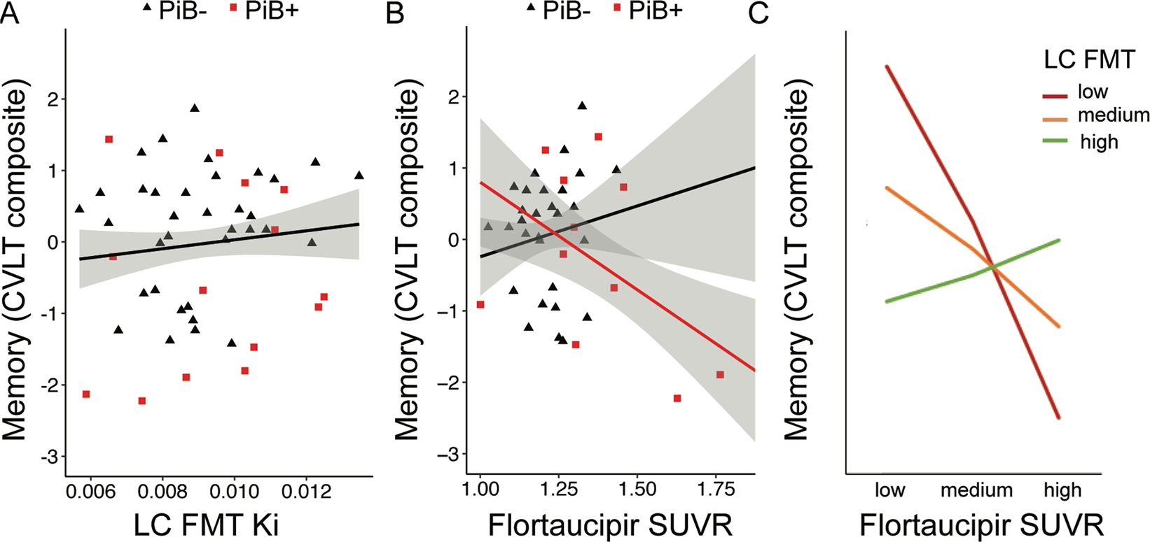
Production of norepinephrine in the locus coeruleus may help to defend against the effect of tau tangles.
LC Norepinephrine
Synthesis Capacity
Memory Score
Memory Score
LC Norepinephrine
Synthesis Capacity
Tau Burden

Slide 56
Future Directions at the Brandeis Aging Brain Study
Tau brain imaging
Dopamine receptor brain imaging
Dopamine/Norepinephrine Synthesis brain imaging
High resolution structural imaging of the locus coeruleus and substantia nigra

Slide 57

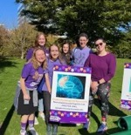



Acknowledgements
MGH Martinos Center
Chemical Neuroscience:
Jacob Hooker
Krista Fariel
Nicole Zürcher
Changning Wang
Hsiao-Ying (Monica) Wey
Michael Placzek
Chieh-En (Jane) Tseng
Chi-Hyeon Yoo
Mary Catanese
Peter Schaffer
Emma Johnston
Camila Canales
Donna Crowe
Mike Vest
Brandeis Universty
Berry Lab:
Anne Berry
Katherine O’Malley
Jordyn Cowan
Alex Adornato
Hsiang-Yu Chen
Jenny Crawford
Jourdan Parent
Claire Ciampa
Teodora Markova
Bailey Gold
Maya Stiefel
Arielle Schutt
Funding
R01 AG074330

Slide 58
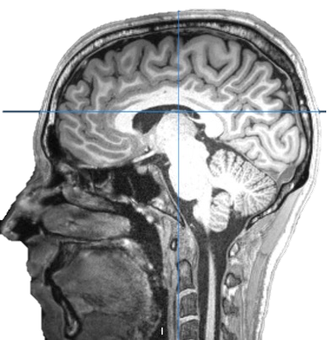
Questions?
Tom Morin, PhD
tmorin2@mgh.harvard.edu
tommorin@brandeis.edu
www.tmmorin.com
Brandeis Aging Brain Study
781-736-3243
agingbrainstudy@brandeis.edu

