Slide 1
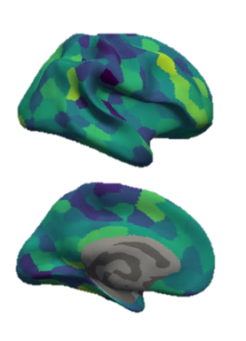
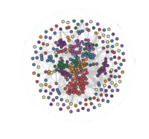
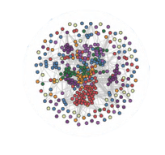
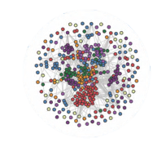

Dynamic Brain Network Reconfiguration Supports Rule Learning and Abstract Reasoning
Berry Lab Meeting
February 10, 2022
Tom Morin
PhD Candidate, Computational Neuroscience

Slide 2
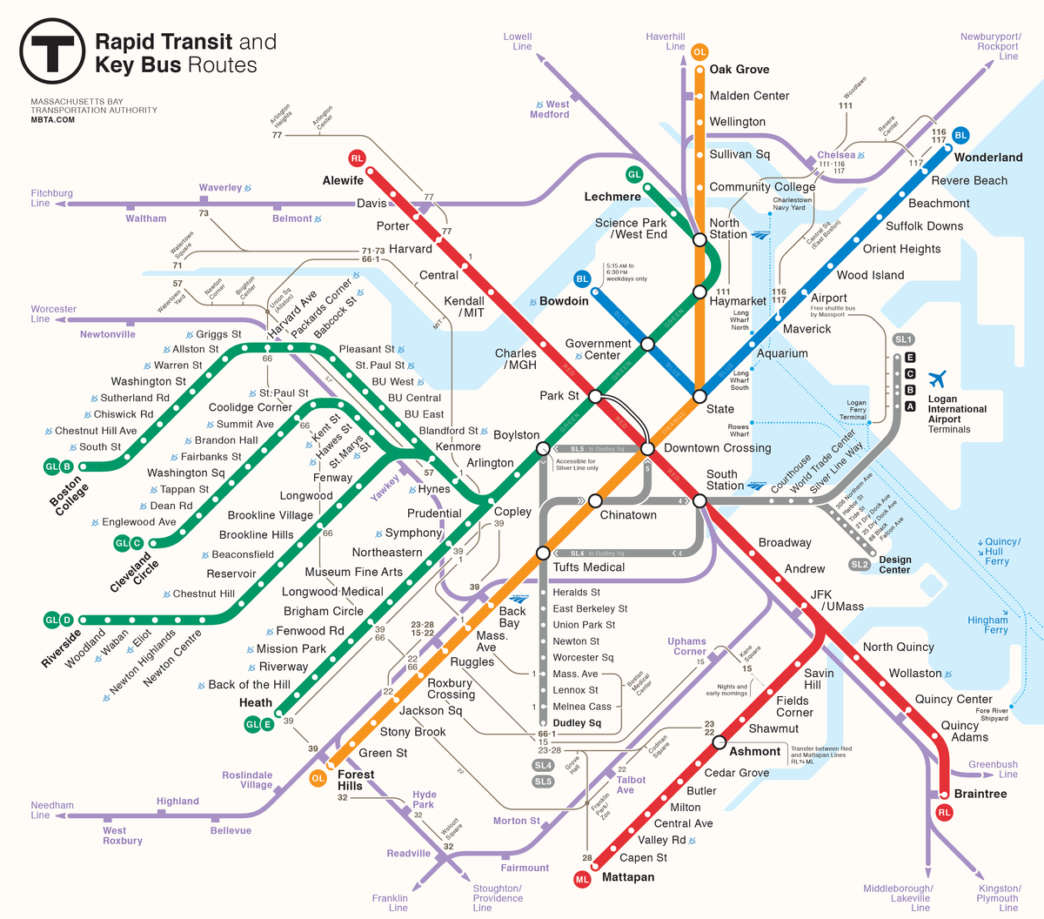
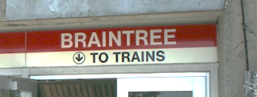

Slide 3



Slide 4


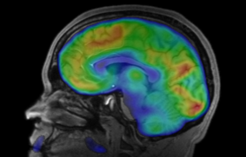

Slide 5

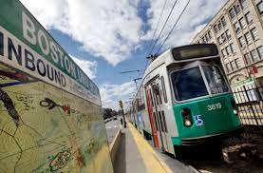

Slide 6

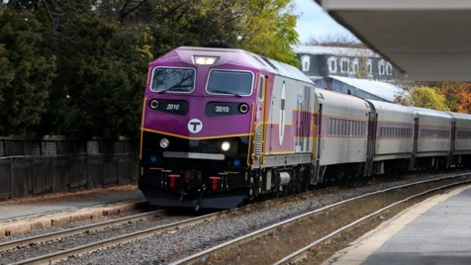


Slide 7
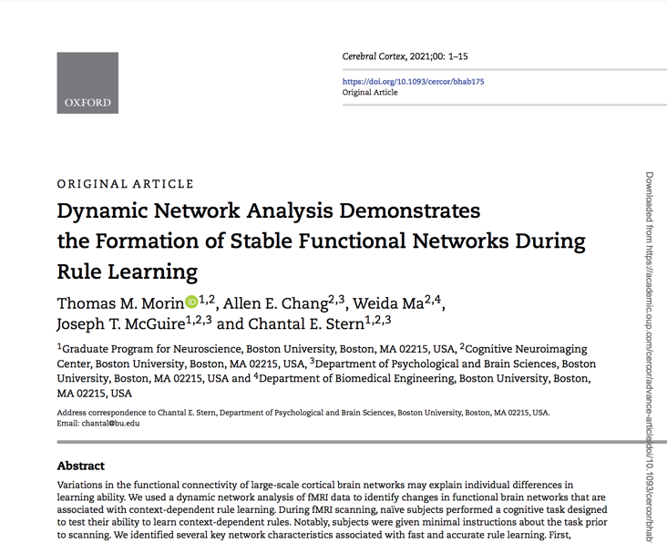
Agenda
Introduction
Stable Functional Networks Support Successful Rule Learning
Stable Functional Networks Support Abstract Reasoning
Future Directions

Slide 8
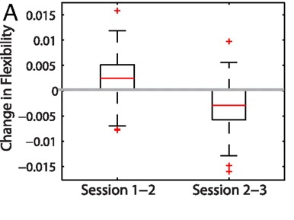
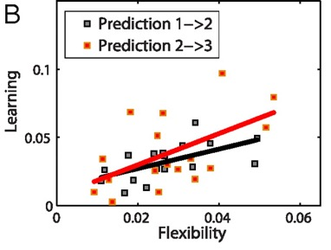
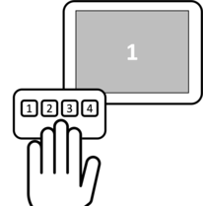
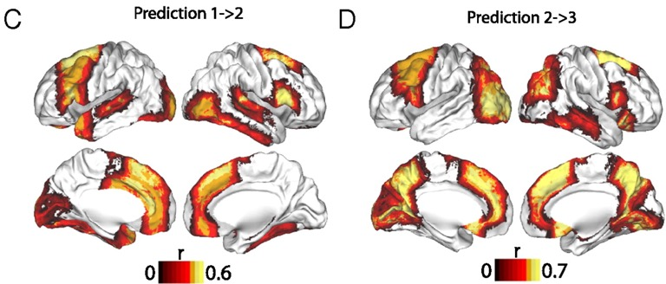
Brain Network Flexibility Predicts Performance on Motor Sequence Learning
Flexibility increased during learning, and decreased once motor sequences became learned
Flexibility of frontoparietal regions was predictive of learning
Bassett et al. 2011
Notes:
Flexibility and learning. (A) Boxplots showing that the increase in flexibility from experimental session 1 to session 2 was significantly greater than zero (a one-sample t-test gives the result t ≈ 6.00 with p ≈ 2 × 10⁻⁸), and that the magnitude of the decrease in flexibility from session 2 to session 3 was significantly greater than zero (t ≈ 7.46, p ≈ 2 × 10⁻¹¹). (B) Significant predictive correlations between flexibility in session 1 and learning in session 2 (black curve, p ≈ 0.001) and between flexibility in session 2 and learning in session 3 (red curve, p ≈ 0.009). Note that relationships between learning and network flexibility in the same experimental sessions (1 and 2) were not significant; we obtained p > 0.13 using permutation tests. (C) Brain regions whose flexibility in session 1 predicted learning in session 2 (p < 0.05, uncorrected for multiple comparisons). Regions that also passed false-positive correction were the left anterior fusiform cortex and the right inferior frontal gyrus, thalamus, and nucleus accumbens. (D) Brain regions whose flexibility in session 2 predicted learning in session 3 (p < 0.05, uncorrected for multiple comparisons). Regions that also passed false-positive correction for multiple comparisons were the left intracalcarine cortex, paracingulate gyrus, precuneus, and lingual gyrus and the right superior frontal gyrus and precuneus cortex. In (C) and (D), colors indicate the Spearman correlation coefficient r between flexibility and learning.

Slide 9
Context Dependent Rules
Notes:
Here, I have an example of a context-dependent rule you might encounter if you’re parking your car in the US.
This sign on the left indicates that you cannot park your car in this zone. The signs on the right, which are real signs that you can find in Boston, show you just how complicated it can be when deciding whether or not it is ok to park your car. Depending on the context (the time of day, your residency status, etc.) your actions have to change in order to follow the rule.

Slide 10
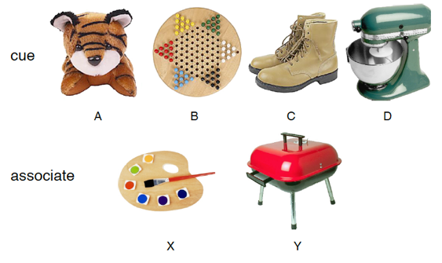


Context Dependent Rule Learning Task
Allen Chang, PhD
Weida Ma
Morin et al. 2021

Slide 11


Incorrect
Correct
Pair?

Slide 12
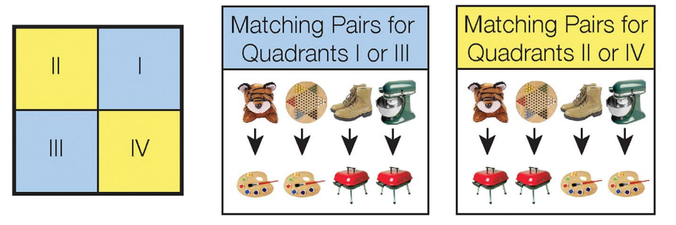
Context Dependent Rule Learning Task – Underlying Rule Structure
Morin et al. 2021

Slide 13
Learning Varies Across Subjects
n = 19
n = 10
Morin et al. 2021
Notes:
If you think that is confusing, you are not alone, as 30% of our subjects never performed above chance during the task. Here you can see subject performance across the 9 scanning runs. Blue dots show subjects that successfully learned the task, and red dots show subjects that were unsuccessful. You can see that for the successful participants, accuracy is generally increasing over time. Our main question is: what is different about the brain network dynamics between these successful and unsuccessful participants.

Slide 14

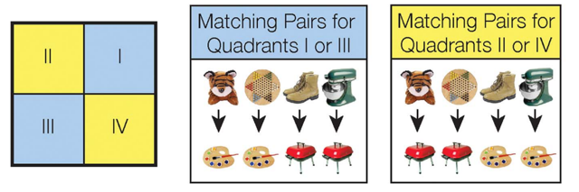

Study Goals
Assess how network dynamics differed between successful and unsuccessful learners.
Characterize how network measures shifted as subject performance improved on the task.

Slide 15
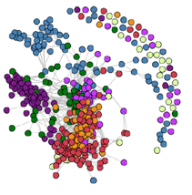
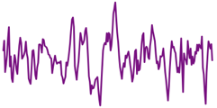
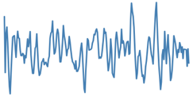
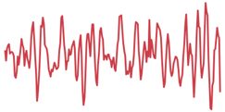
The Brain as a Network
1
2
r
…
400
(Schaefer et al. 2018)
Node: A brain region of interest
Edge: Functional connectivity (correlation) between two nodes
Community: A group of nodes that exhibit strong connectivity to each other

Slide 16
Dynamic Network Construction
Morin et al. 2021
Notes:
To answer this question, we formed a multilayer functional connectivity network for each subject, using the regions found in the Schaefer 400 atlas. To create the network, each region in the atlas becomes a node. If the BOLD signal is highly correlated between two nodes, then we connect them with an edge. We repeat this for all nine-scanning runs, and create this multi-layered network for each of our subjects. With a network constructed, we can start to ask questions about the network’s structure.

Slide 17
Dynamic Network Construction
Scan Run #1
Scan Run #2
Scan Run #3
Scan Run #4
…

Slide 18
Characterizing the Dynamic Network: Guiding Questions
Do some brain regions show more frequent changes in functional connectivity?
  (Flexibility)
How does connectivity between communities change during learning?
  (Inter-community Edge Strength)

Slide 19
Characterizing the Dynamic Network: Guiding Questions
Do some brain regions show more frequent changes in functional connectivity?
  (Flexibility)
How does connectivity between communities change during learning?
  (Inter-community Edge Strength)

Slide 20
Calculating Node Flexibility
# Community Switches
Flexibility =
= 0.25
# Possible Switches
Notes:
First, we wanted to know if the overall flexibility of the network was different between learner’s and non-learners. We predicted that successful learner’s would quickly adopt a successful strategy and form a rigid community structure. To test this, we ran a Louvain community detection algorithm on each subject’s multilayered network, essentially giving each node a data-driven community assignment. If we follow the community membership of this node circled in yellow, this is what we find: First the node belongs to the purple network. Then, it spends a few scanning runs in the green network, until it becomes a part of this blue network, and then the subject reaches the end of the scanning session. To calculate the flexibility of this node, we look at how many times its community membership switches, and divide by the total possible number of switches. For this node, that is 2 switches over 8 possible switches, or 0.25.

Slide 21
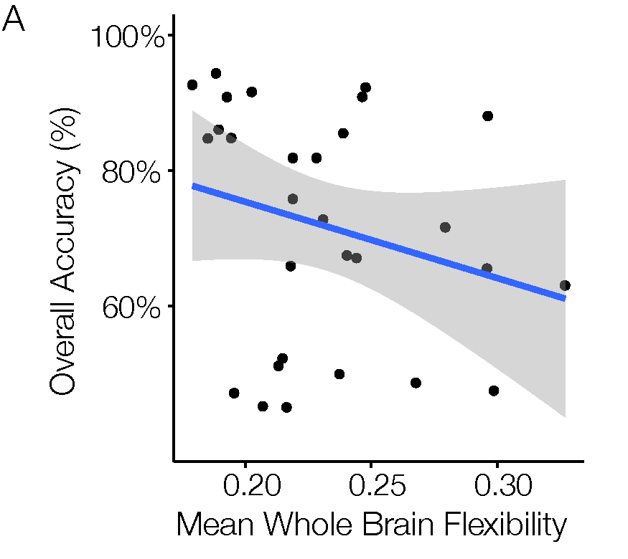
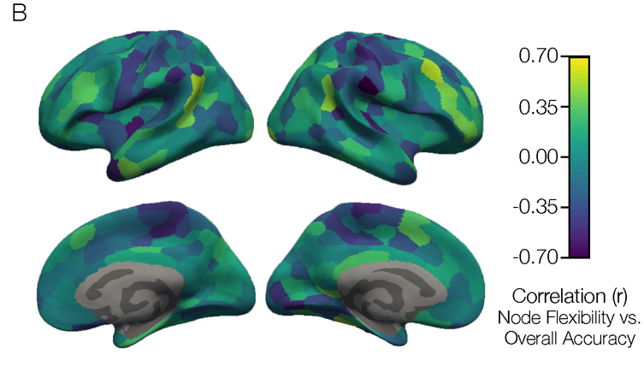


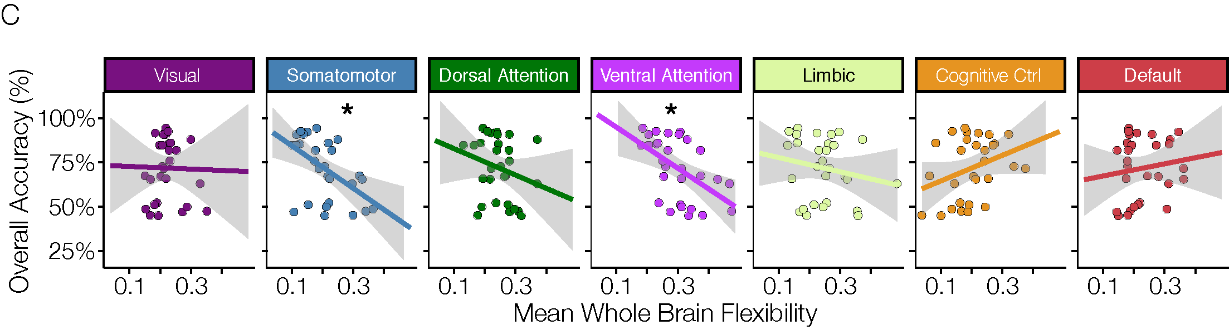
Higher Accuracy is Associated with Reduced Flexibility (Higher Stability)
Mean Community Flexibility
Morin et al. 2021
Notes:
We can take the average flexibility of all 400 brain regions, and correlate it with each subject’s overall accuracy on the task. When we plot that we find that indeed, the successful learners – who had high overall accuracy, show lower flexibility scores, implying that they quickly form stable community structures. We can also map the correlation between flexibility and accuracy onto each individual cortical region to get a brain map like this. And while most of the brain is blue, driving that whole brain negative correlation plotted to the left, we actually see several brain regions with warm colors, demonstrating that there are regions of cortex that are flexibly switching their community allegiance in successful learners.

Slide 22

Successful Learners Have More Stable Rule Representations
Working Model: During learning, brain regions flexibly adapt their community allegiance as subjects adopt different task strategies.
Successful subjects learned quickly, suggesting that they settle on a strategy and have more stable neural representations of the learned rules.

Slide 23
Characterizing the Dynamic Network: Guiding Questions
Do some brain regions show more frequent changes in functional connectivity?
  (Flexibility)
How does connectivity between communities change during learning?
  (Inter-community Edge Strength)

Slide 24
Calculating Inter-community Edge Strength

Slide 25
Calculating Inter-community Edge Strength
2

Slide 26
Calculating Inter-community Edge Strength
2
= 0.22
9

Slide 27
Plotting Inter-community Edge Strength

Slide 28
Inter-community Edge Strength Between Cognitive Control and Ventral Attention Increases with Successful Rule Learning
0.5
Inter-community
Edge Strength
0.0
1
Time
9

Slide 29
Inter-community Edge Strength Shows Segregated Attention Communities in Successful Learners
Morin et al. 2021

Slide 30
Successful Learners Have More Segregated Attention Communities
Previous work shows that anticorrelation between dorsal attention and default communities is associated with higher working memory capacity (e.g. Keller et al. 2015).
Connectivity between attention communities and other communities could be an indication of how attentional resources are being allocated to benefit rule learning.
0.5
Inter-community
Edge Strength
0.0
1
Time
9

Slide 31
Key Takeaways
Overall, successful learners have a more “stable” brain network structure.
  Working Hypothesis: Successful learners latch onto an effective strategy quickly, and form stable representations of the rules.
A stable and segregated attention system is maintained in successful learners

Slide 32
Agenda
Introduction
Stable Functional Networks Support Successful Rule Learning
Stable Functional Networks Support Abstract Reasoning
Future Directions

Slide 33
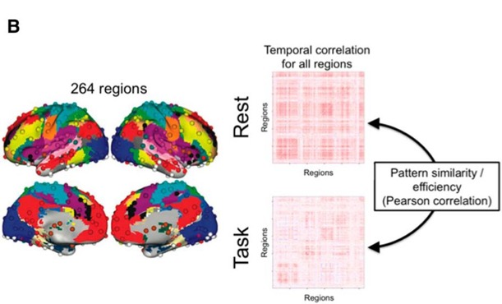
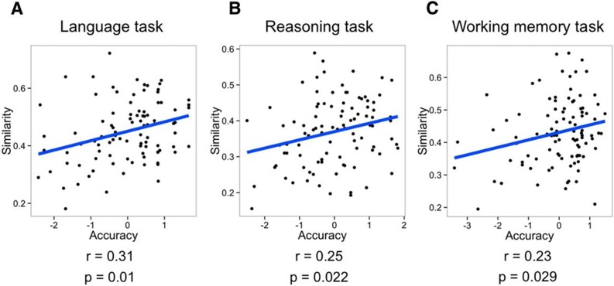
Task Performance is Associated with Less Task-Related Brain Network Reconfiguration
Subjects with more stable brain networks between rest and task performed better on a variety of tasks
Schultz & Cole 2016

Slide 34
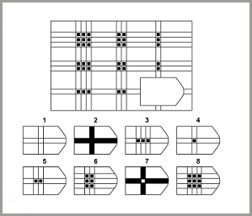
Does a Stable Task Network Support Abstract Reasoning?
Through reasoning, the brain can apply previously learned information, strategies, and ideas to new situations.
Raven, 1936

Slide 35
Simplified Raven’s Progressive Matrices Task

Slide 36
Unique Activity Patterns Associated With Perceptual and Symbolic Reasoning
n = 27

Slide 37

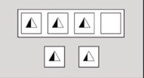
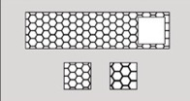

Stable Community Structure Across Reasoning Conditions

Slide 38
Task Community Structure

Slide 39
Community C is Most Active and Most Reconfigured During Reasoning

Slide 40
Conclusions
Activation patterns supporting reasoning:
  Anterior prefrontal cortex supports symbolic reasoning
  Inferior temporal cortex supports perceptual reasoning
Functional reconfiguration supporting reasoning:
  A stable network core (default and somatomotor nodes) is maintained
  A flexible task-active system (cognitive control and visual nodes) becomes more strongly interconnected during the task compared to rest.

Slide 41
Overall Conclusions
A stable functional network structure and segregated attention system support successful context-dependent rule learning
A stable network core and more flexible task-active system support abstract reasoning
These results provide support for the hypothesis that reduced task-reconfiguration of functional brain networks is associated with cognitive ability

Slide 42
Agenda
Introduction
Stable Functional Networks Support Successful Rule Learning
Stable Functional Networks Support Abstract Reasoning
Future Directions

Slide 43
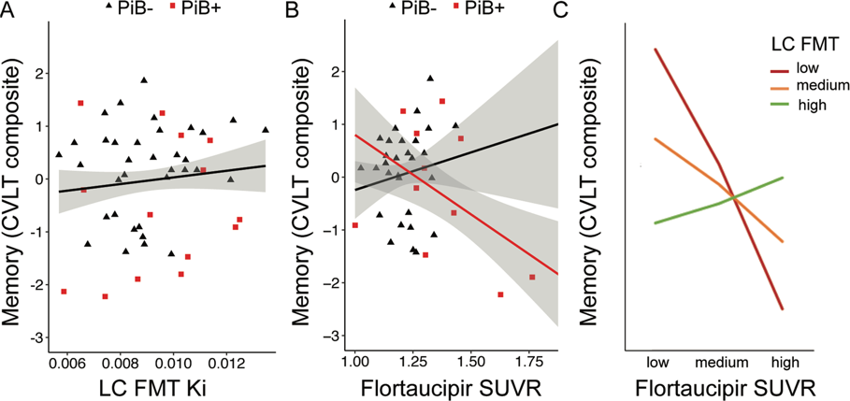
Potential Future Directions
Does catecholamine synthesis moderate network connectivity changes that are associated with aging and disease?
LC catecholamine synthesis moderates tau’s negative effect on memory
Ciampa, Parent et al. 2022

Slide 44
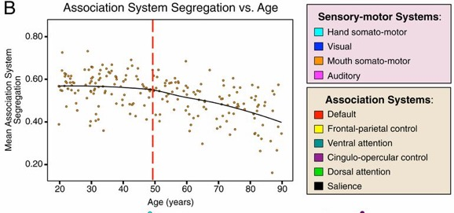
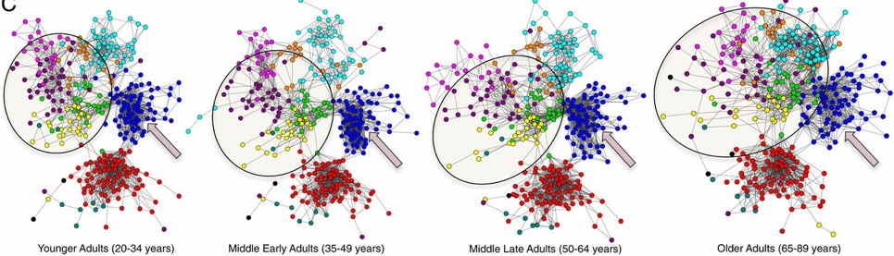
Potential Future Directions
Does catecholamine synthesis moderate network connectivity changes that are associated with aging and disease?
Segregation of functional brain networks typically decreases with age
Chan et al. 2014

Slide 45
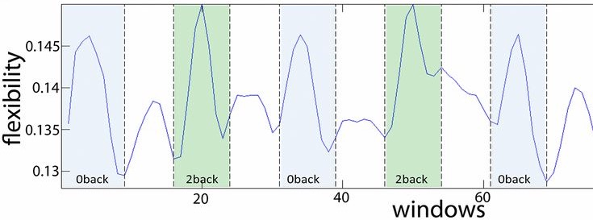
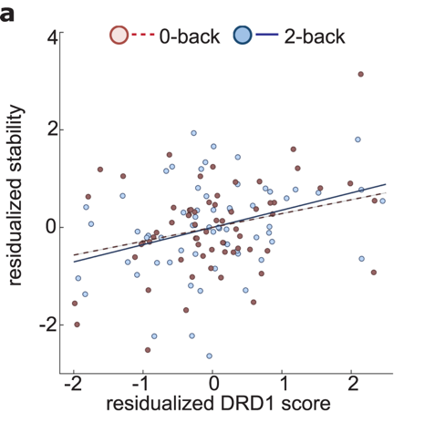
Potential Future Directions
How do catecholamines (e.g. dopamine, norepinephrine) influence network dynamics (e.g. flexibility/stability)?
  Flexibility of prefrontal regions is higher during a 2-back vs. 0-back working memory task
  Stability on both conditions is associated with genetically-predicted D1 receptor expression
Braun et al. 2015
Braun et al. 2021

Slide 46
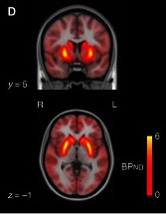
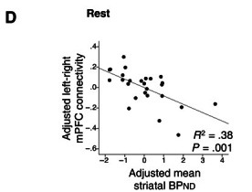
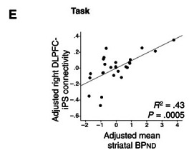
Potential Future Directions
How do catecholamines (e.g. dopamine, norepinephrine) influence network dynamics (e.g. flexibility/stability)?
Increased Striatal D1 signal is associated with:
  Reduced within-network connectivity in the default network
  Enhanced within-network connectivity in the frontoparietal control network
Roffman et al. 2016

Slide 47



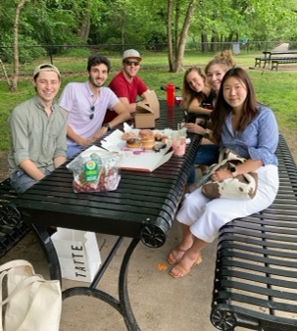


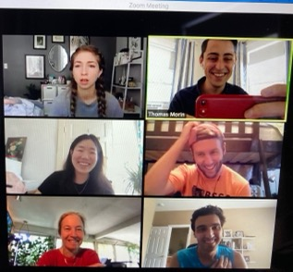
Acknowledgements
Collaborators
Allen Chang
Weida Ma
Joe McGuire
Dissertation Advisory Committee
Chantal Stern
Joe McGuire
David Badre
Mike Hasselmo
GPN Admin
Shelley Russek
Sandi Grasso
Stern Lab
Chantal Stern
Matt Dunne
Stamati Liapis
Kylie Moore
Caroline Ahn
Kylie Isenburg
Cognitive Neuroimaging Center
Stephanie McMaines
Shruthi Chakrapani
Funding
NSF Major Research Instrumentation Award 1625552
ONR MURI Award N00014-16-1-2832
ONR DURIP Award N00014-17-1-2304

Slide 48
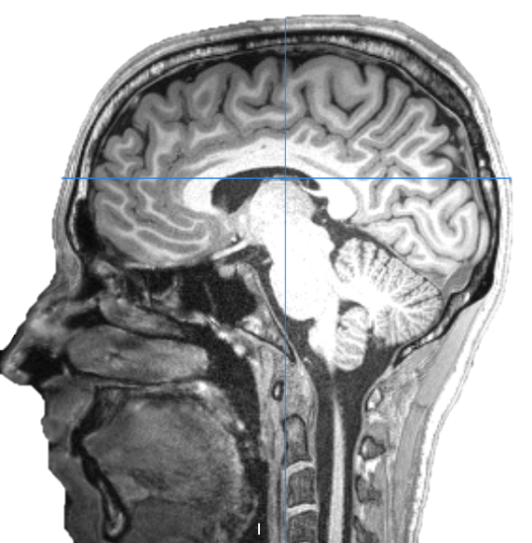
Questions?

Slide 49
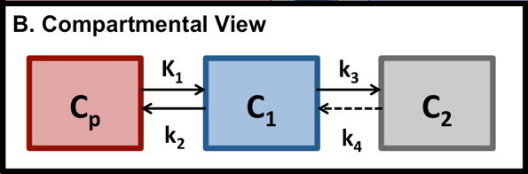
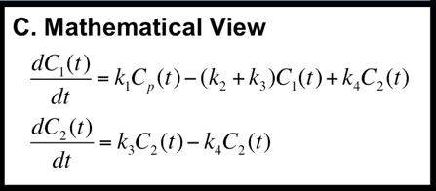
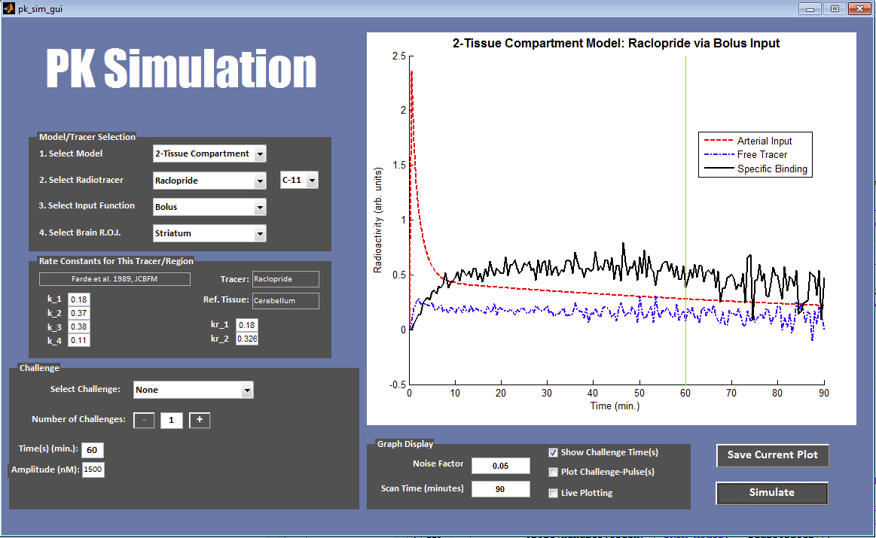
My Previous Work with PET Neuroimaging
Pharmacokinetic Modelling Tool

Slide 50
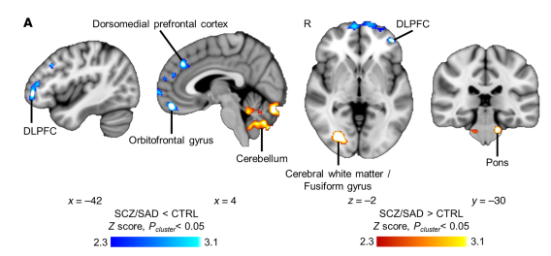
My Previous Work with PET Neuroimaging
Pharmacokinetic Modelling Tool
Histone Deacetylase Dysregulation in Schizophrenia
Radiotracer: Martinostat
Gilbert et al. 2019

Slide 51
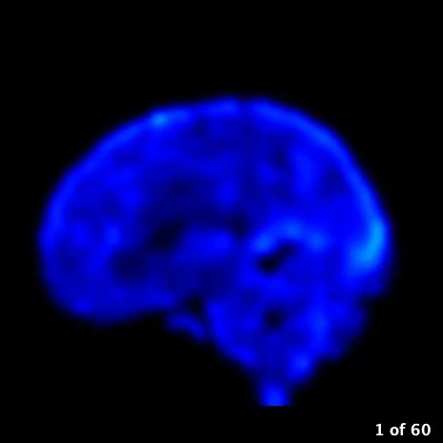

My Previous Work with PET Neuroimaging
Pharmacokinetic Modelling Tool
Histone Deacetylase Dysregulation in Schizophrenia
Functional PET Neuroimaging with FDG
fPET-FDG
minutes
5
5
5
5
FDG (kBq/cc)

Slide 52
EXTRA SLIDES

Slide 53

Functional Connectivity
How do fluctuations in BOLD signal correlate between brain regions?

Slide 54
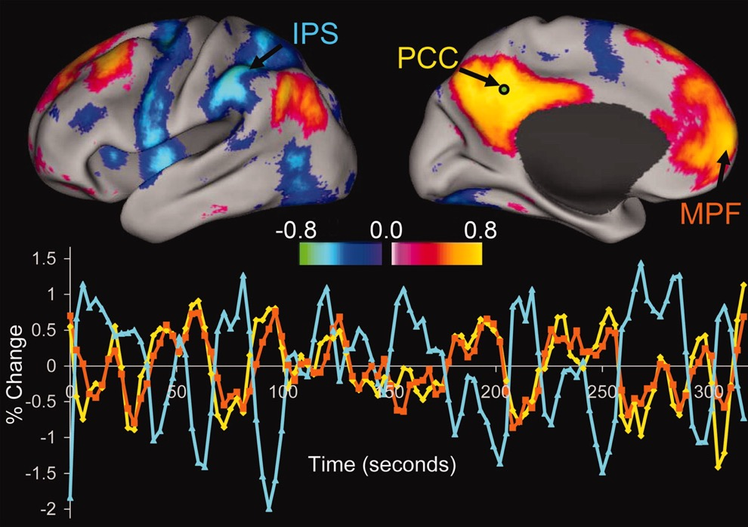
Functional Connectivity
How do fluctuations in BOLD signal correlate between brain regions?
Fox et al. 2005

Slide 55
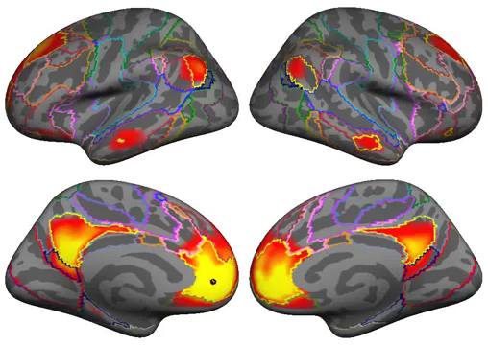
Functionally Defined Networks
Yeo, et al. 2011

Slide 56
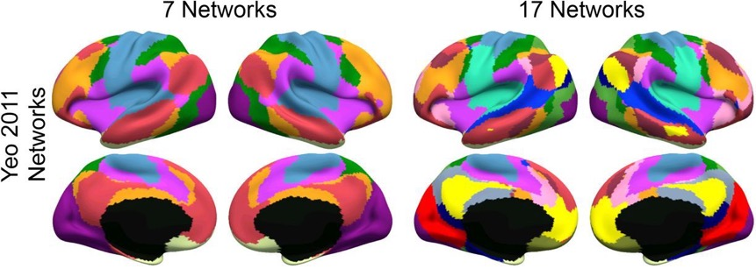
Functionally Defined Networks
Yeo et al. 2011
Schaefer et al. 2018

Slide 57
Motivating Questions
How does functional connectivity within and between networks dynamically change over time?
How is the brain’s functional network representation changed by learning and other tasks?
  Does it flexibly shift or remain stable?

Slide 58
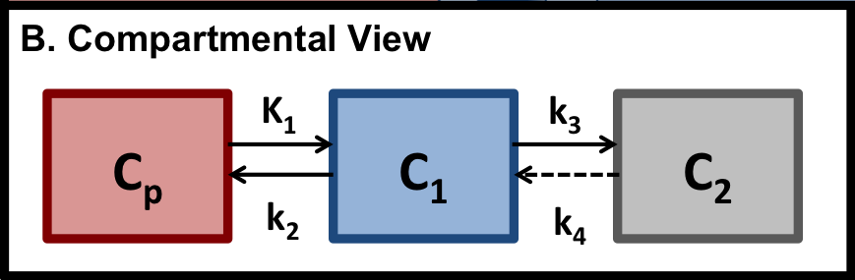
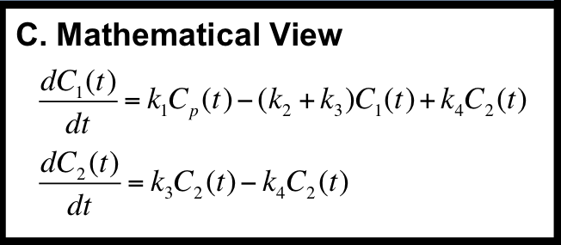
fPET-FDG Signal
FDG in Plasma
FDG in Cell
Phosphorylated FDG
Glut-1 Transporter
ATP
ADP
Hexokinase
Glucose-6-Phosphotase
Simulations can predict the amount of FDG in each of these states, at any given time
Notes:
Our hypothesis is informed by the kinetics of FDG… when we see an FDG image, the signal we observe is actually composed of quite a few things… as an analogue for glucose, FDG behaves very similarly… it can be in the blood, it can enter into the cell through the Glut-1 transport protein, it can exit back out of the cell, it can be phosphorylated once it’s inside the cell... And it can also be dephosphorylated, but this happens at a very low rate… You can see that the amount of radiotracer in each of these states is related… and that by controlling how we inject the tracer (how much is in blood plasma) those changes will propogate down to the other states as well. The main interest we have is in how glucose is being metabolized – how it is being converted into energy… so when we look at a PET image, we are interested in trying to find the portion of the signal that is due to metabolism… we can simulate this and derive it mathematically… I won’t get into those methods in this presentation because they’re pretty dense

Slide 59


Results
fPET-FDG
minutes
5
5
5
5
Occipital ROI shows increased overall signal, and task-specific changes
GLM Model
Occipital ROI
Frontal ROI
Notes:
And here’s the results we saw in one subject
First we look at the occipital cortex (region responsible for vision) and we see that increase throughout the scan
Then look at a frontal region of interest
Frontal region shows lower overall signal
To examine activity in these regions, we fit it with a mathematical model… the model predicts how much signal change we will observe during task periods… Here’s the model fit for the occipital ROI
You can see that in the occipital ROI, we see increased rate of change during each of the task periods, especially the early ones

Slide 62
Characterizing the Dynamic Network: Guiding Questions
Do some brain regions show more frequent changes in functional connectivity?
  (Flexibility)
How does connectivity within communities change during learning?
  (Assortativity)
How does connectivity between communities change during learning?
  (Inter-community Edge Strength)

Slide 63
Positive Assortativity: Communities Are More Connected to Themselves
Positive Assortativity
1.0
0.0
-1.0
Negative Assortativity

Slide 64
Zero Assortativity: Communities Are Equally Connected to Each Other & Themselves
Positive Assortativity
1.0
0.0
-1.0
Negative Assortativity

Slide 65
Negative Assortativity: Communities Are More Connected to Each Other
Positive Assortativity
1.0
0.0
-1.0
Negative Assortativity

Slide 66
Assortativity in a Single Community
Positive Assortativity
1.0
0.0
???
-1.0
Negative Assortativity

Slide 67
Assortativity in a Single Community
Positive Assortativity
1.0
0.0
-1.0
Negative Assortativity

Slide 68
Assortativity in Cognitive Control Network Increased with Learning
Cognitive Control

Slide 69
Assortativity Across Cortex
Morin et al. 2021

Slide 70
Successful Learners Have More Assortative Brain Networks
Assortativity measures how interconnected communities are to themselves as opposed to other communities
Stronger connectivity within the cognitive control community could support the formation of stable rule representations in dlPFC.
Cognitive Control

Slide 71
Characterizing the Dynamic Network: Guiding Questions
Do some brain regions show more frequent changes in functional connectivity?
  (Flexibility)
How does connectivity within communities change during learning?
  (Assortativity)
How does connectivity between communities change during learning?
  (Inter-community Edge Strength)

Slide 72
Betweenness Centrality
Centrality Points
|
|
|

Slide 73
Centrality Results

Slide 74

Hippocampal Neurons Encode Context-Specific Memories
Our context-dependent rule-learning task is based on a similar task designed for rodents!
Komorowski et al. 2009
Morin et al. 2021

Slide 75
Anterior-Posterior Gradient for Place Field Size in Hippocampus
In spatial navigation tasks, the human hippocampus exhibits anterior-posterior organization in place-field size, detectable with fMRI
Brunec et al. 2018
Notes:
Results demonstrated that hippocampal activity and hippocampal–prefrontal functional interconnectivity distinguished retrieval under different levels of hierarchically organized task rules. In explicit contrast to the hippocampal tail, anterior (body and head) regions were recruited specifically for superordinate changes in the contextual hierarchy. The hippocampal body also differed in its functional connectivity with the prefrontal cortex for superordinate versus subordinate changes

Slide 76


Anterior-Posterior Gradient for Abstract Rule Levels in Hippocampus
Brown et al. 2021
When implementing higher-level abstract rules, more anterior regions of hippocampus are activated.
Connectivity between anterior hippocampus and frontal pole increases for higher-level abstract rules.
Notes:
Results demonstrated that hippocampal activity and hippocampal–prefrontal functional interconnectivity distinguished retrieval under different levels of hierarchically organized task rules. In explicit contrast to the hippocampal tail, anterior (body and head) regions were recruited specifically for superordinate changes in the contextual hierarchy. The hippocampal body also differed in its functional connectivity with the prefrontal cortex for superordinate versus subordinate changes

Slide 77

Hypotheses
Functional connectivity between anterior hippocampus and anterior prefrontal cortex supports the integration of higher order contexts.
In successful learners, this connectivity pattern will develop as context-dependent rules are learned.

Slide 78
Hippocampal ROIs
Matt Dunne

Slide 79
Learning-Related FC Changes

Slide 80
Learning-Related FC Changes

Slide 81
Post-Hoc Analysis: Hippocampal Head Functional Connectivity Over Time

Slide 82
Individual Learning Rates Are Associated with FC Changes

Slide 83
Conclusions
Hippocampal Head exhibits increased functional connectivity with orbitofrontal cortex and caudate in successful learners.
Hippocampal Head also shows decreased functional connectivity with precuneus and the mid-cingulate in successful learners
The rate at which this functional connectivity pattern emerges during learning is associated with learning rate.

Slide 84
Abstract Reasoning Activates Frontoparietal Cortex

