Slide 1
fMRI Flow Effect: Explained
Berry Lab Meeting
April 3, 2026
Tom Morin

Slide 4
𝝱₀

Slide 5
RF Pulse

Slide 6
RF Pulse

Slide 7
RF Pulse

Slide 8
RF Pulse

Slide 9
RF Pulse

Slide 10

RF Pulse
RF Pulse
RF Pulse

Slide 12
Flow

Slide 13
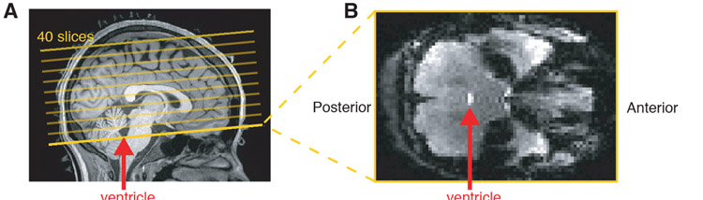
Measuring CSF Flow with fMRI
Inflow signals are caused by fluid moving into the field of view, resulting in brightest signal at edge slices, and decay as fluid passes into central slices.
Fultz et al. 2019

Slide 14
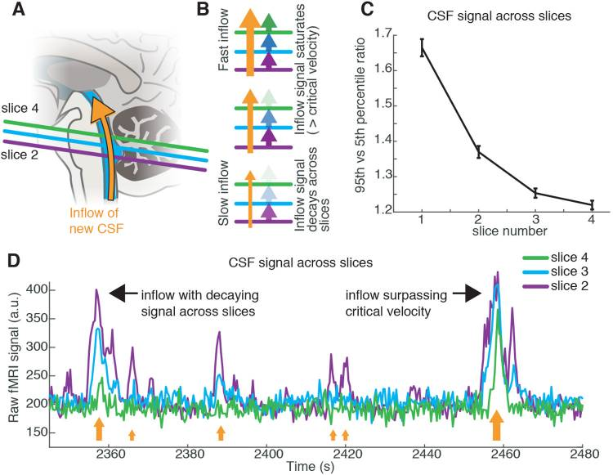
Fultz et al. 2019

Slide 15
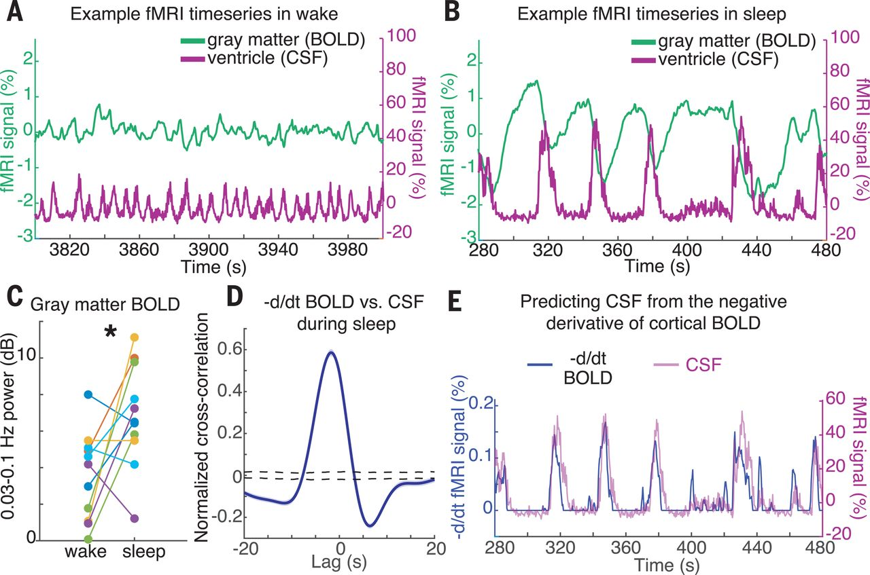
CSF Signal is Anticorrelated from Gray Matter Signal
Fultz et al. 2019

Slide 16
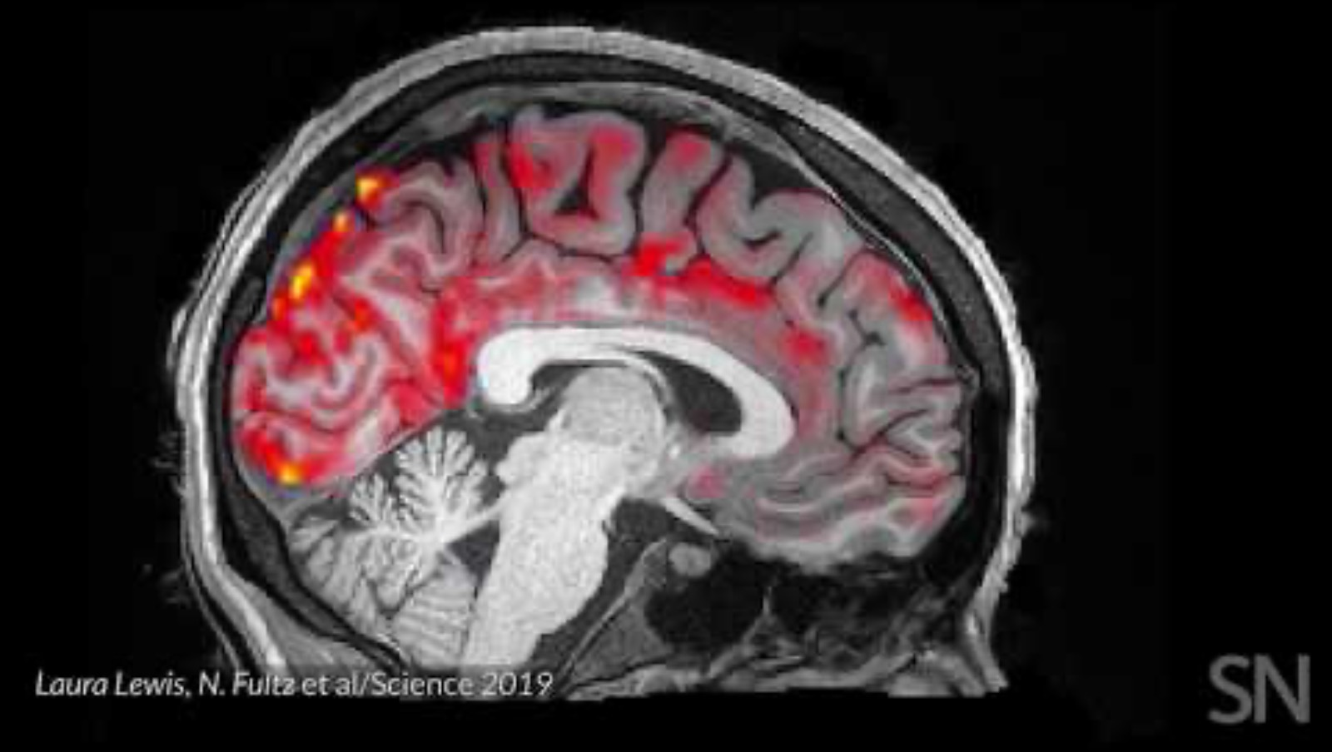

Slide 17
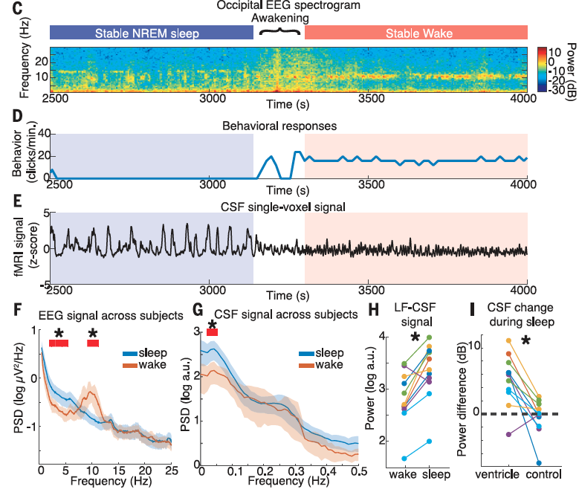
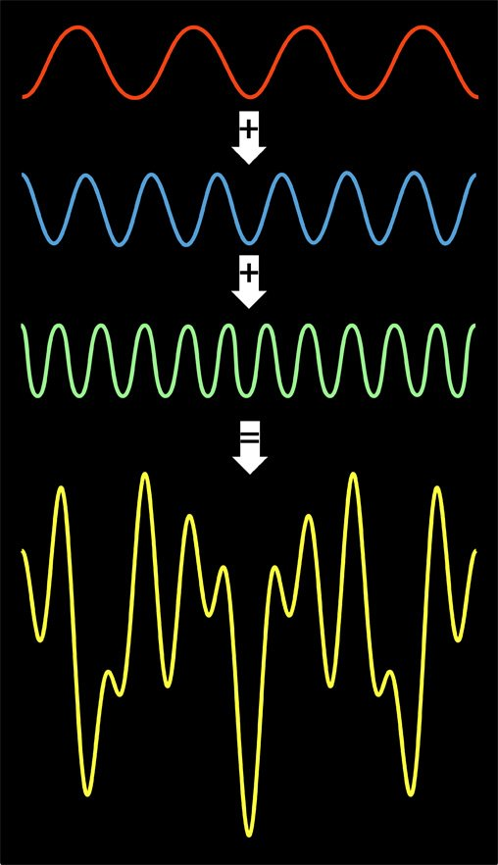
Power Spectrum
How much “power” (strength/intensity) does the signal show at various frequencies?
Power of CSF flow at low frequencies is higher during sleep.
Fultz et al. 2019

Slide 18
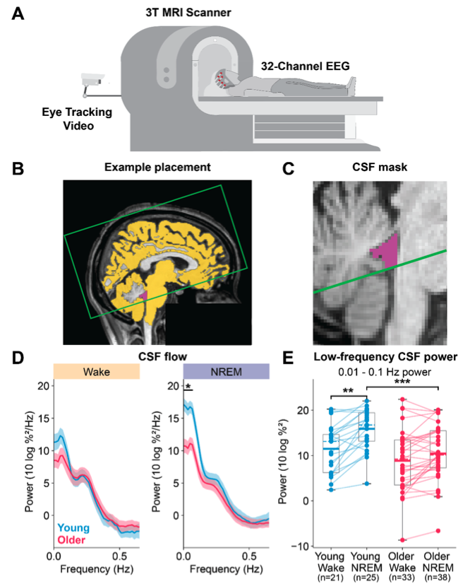
Young Adults show greater sleep-induced CSF power increases.
Bailes et al. 2025 preprint

Slide 19
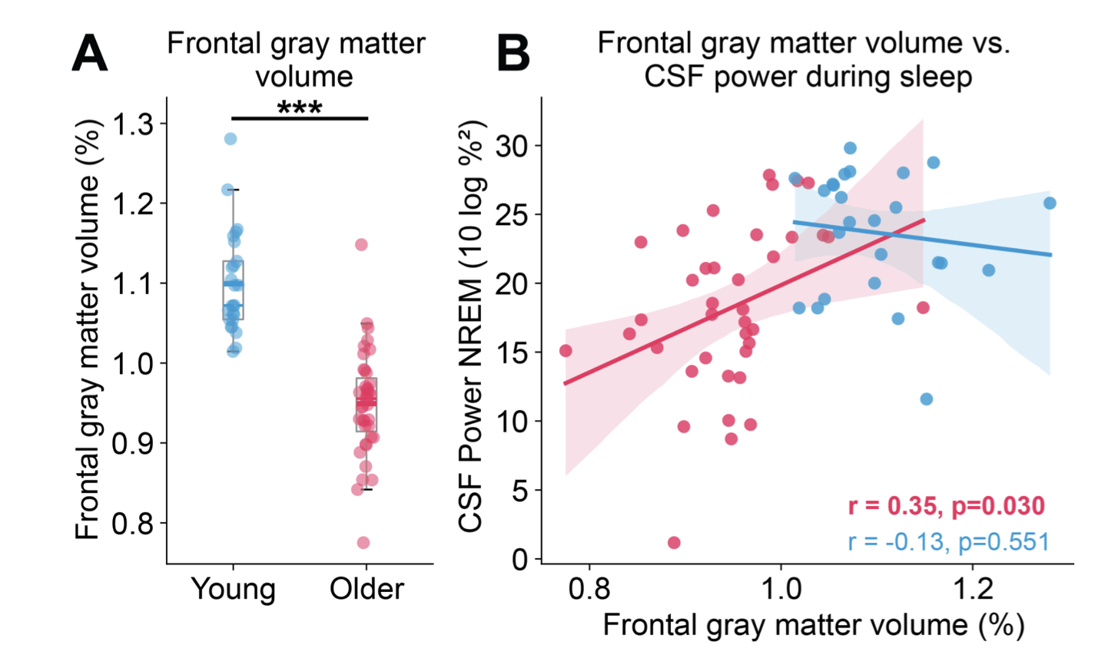
Older adults with higher CSF Power during sleep show greater frontal gray matter volume
Bailes et al. 2025 preprint

