Slide 1
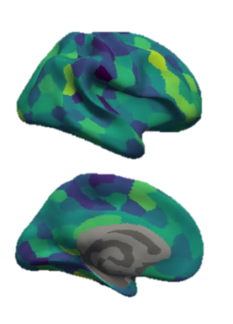
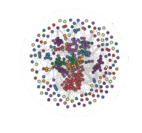
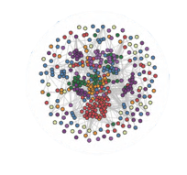
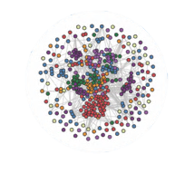

Dynamic Network Analysis Demonstrates the Formation of Stable Functional Networks During Rule Learning
Progress Report
Tom Morin
PhD Candidate, Computational Neuroscience
Graduate Program for Neuroscience

Slide 2
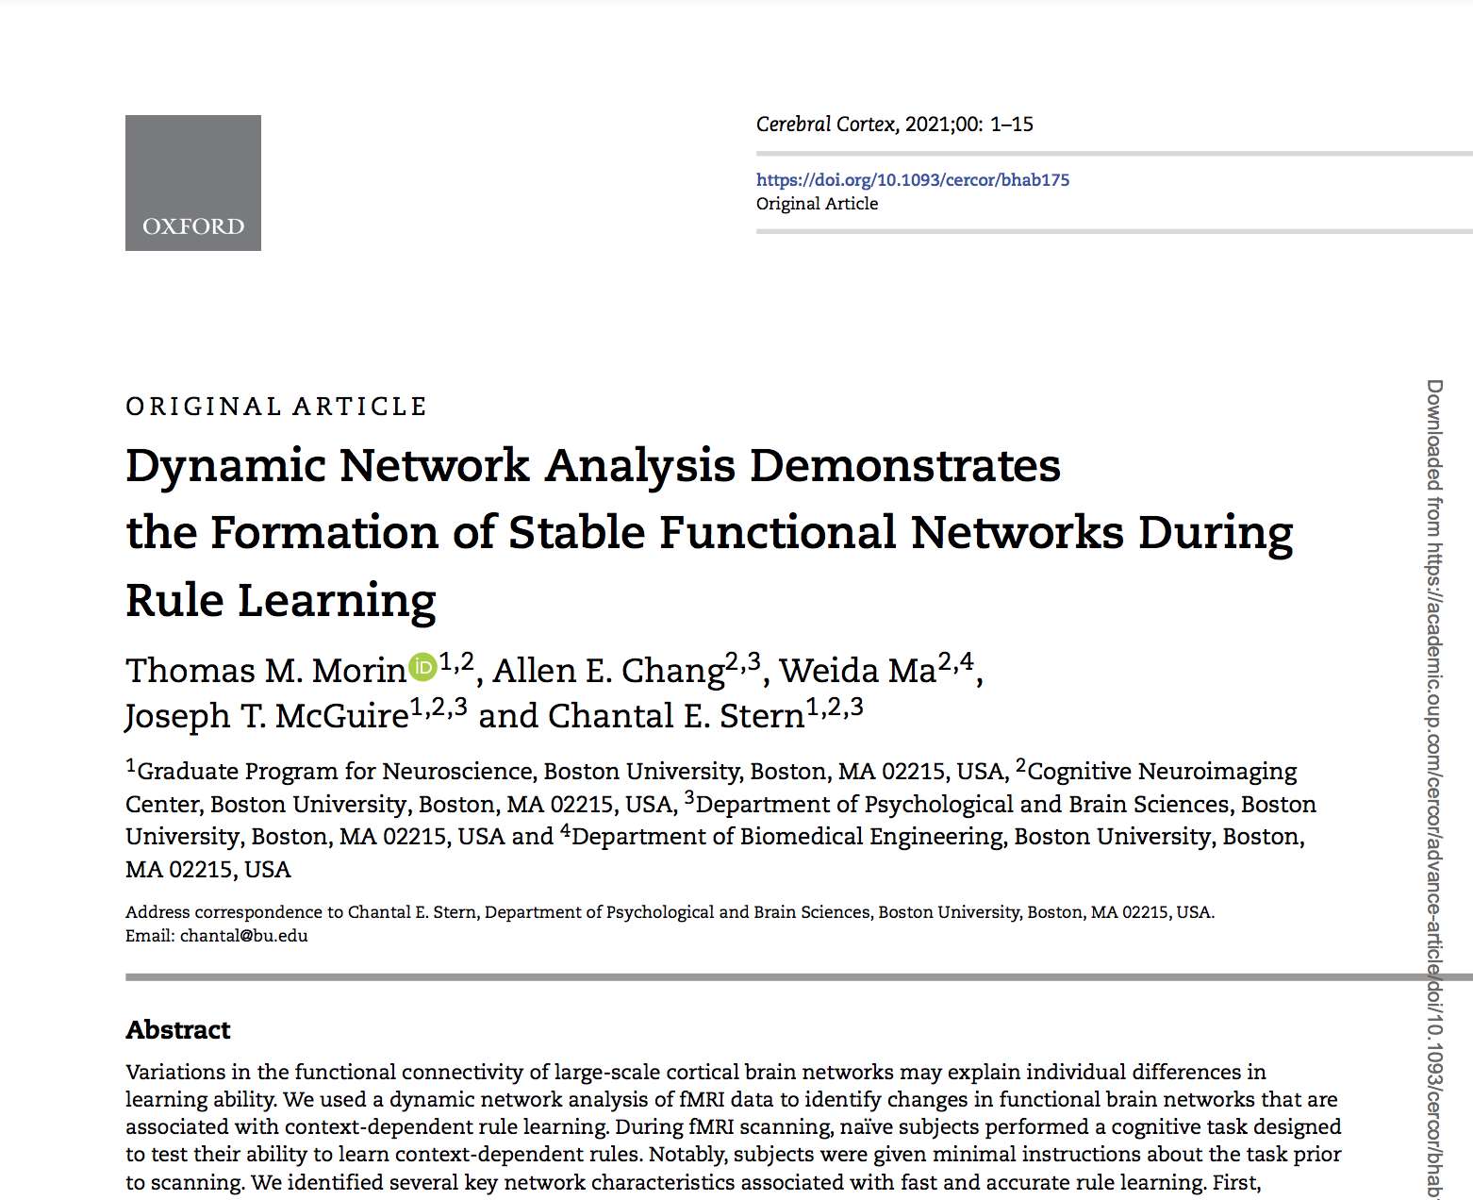
Agenda
Introduction
Stable Functional Networks Support Successful Rule Learning
Preview: Stable Functional Networks Support Abstract Reasoning

Slide 3
Agenda
Introduction
Stable Functional Networks Support Successful Rule Learning
Preview: Stable Functional Networks Support Abstract Reasoning

Slide 4



Slide 5
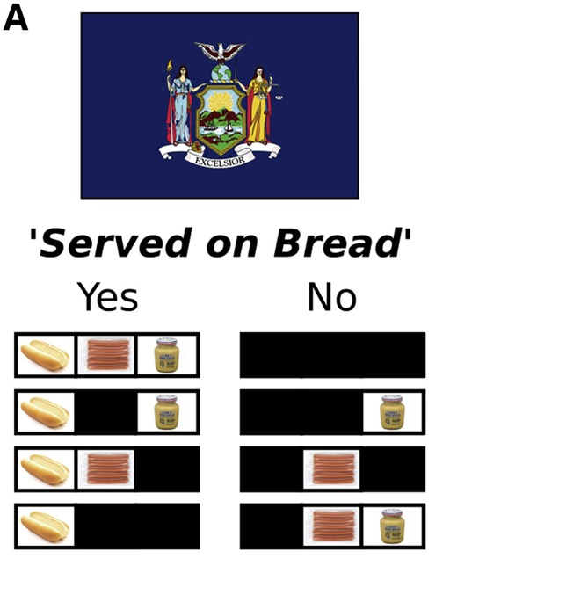
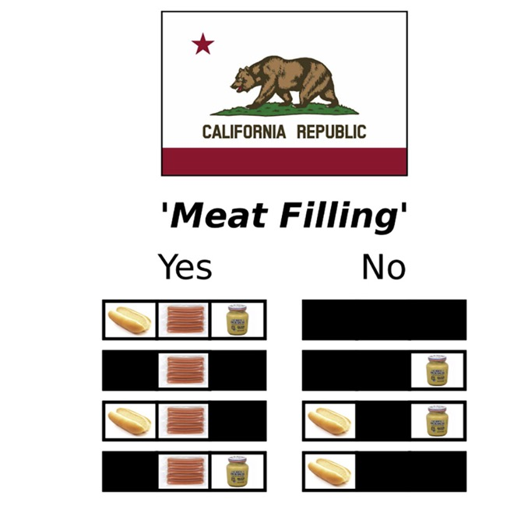
Is a Hotdog a Sandwich?
New York
California
Morrow & Costa 2021
(Commentary on Cohen et al 2021)

Slide 6
Dynamics of Anterior Cingulate Neurons Represent Search for Rules
Neural activity can be mapped in multi-dimensional space where a rule is represented as a weighted combination of multiple features
The animal’s strategy, represented by a vector, approaches the rule-related axis during learning
Morrow & Costa 2021
(Commentary on Cohen et al 2021)

Slide 7
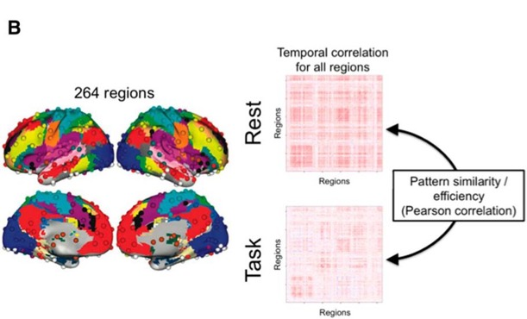
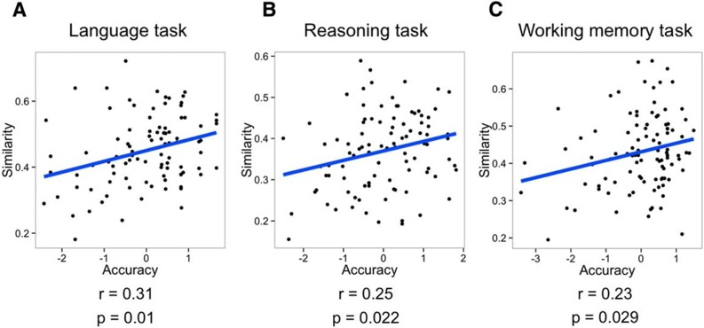
Task Performance is Associated with Less Task-Related Brain Network Reconfiguration
Subjects with more stable brain networks between rest and task performed better on a variety of tasks
Schultz & Cole 2016

Slide 8
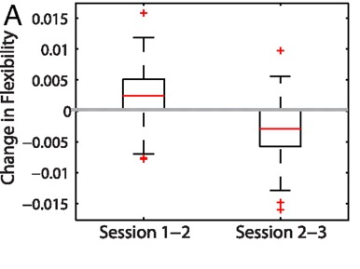
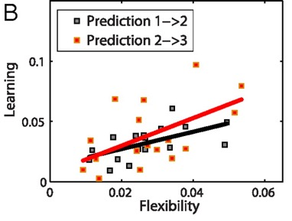
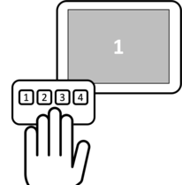
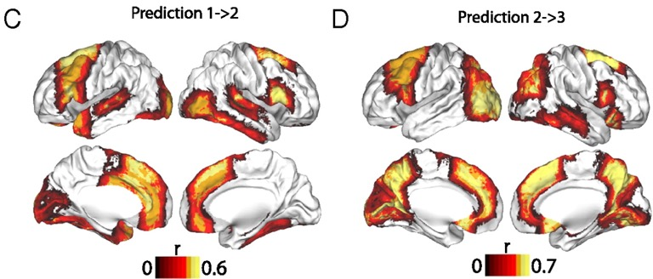
Brain Network Flexibility Predicts Performance on Motor Sequence Learning
During learning, flexibility first increased, then decreased
Flexibility of frontoparietal regions was predictive of learning
Bassett et al. 2011
Notes:
Flexibility and learning. (A) Boxplots showing that the increase in flexibility from experimental session 1 to session 2 was significantly greater than zero (a one-sample t-test gives the result t ≈ 6.00 with p ≈ 2 × 10⁻⁸), and that the magnitude of the decrease in flexibility from session 2 to session 3 was significantly greater than zero (t ≈ 7.46, p ≈ 2 × 10⁻¹¹). (B) Significant predictive correlations between flexibility in session 1 and learning in session 2 (black curve, p ≈ 0.001) and between flexibility in session 2 and learning in session 3 (red curve, p ≈ 0.009). Note that relationships between learning and network flexibility in the same experimental sessions (1 and 2) were not significant; we obtained p > 0.13 using permutation tests. (C) Brain regions whose flexibility in session 1 predicted learning in session 2 (p < 0.05, uncorrected for multiple comparisons). Regions that also passed false-positive correction were the left anterior fusiform cortex and the right inferior frontal gyrus, thalamus, and nucleus accumbens. (D) Brain regions whose flexibility in session 2 predicted learning in session 3 (p < 0.05, uncorrected for multiple comparisons). Regions that also passed false-positive correction for multiple comparisons were the left intracalcarine cortex, paracingulate gyrus, precuneus, and lingual gyrus and the right superior frontal gyrus and precuneus cortex. In (C) and (D), colors indicate the Spearman correlation coefficient r between flexibility and learning.

Slide 9
Agenda
Introduction
Stable Functional Networks Support Successful Rule Learning
Preview: Stable Functional Networks Support Abstract Reasoning

Slide 10
Context Dependent Rules
Notes:
Here, I have an example of a context-dependent rule you might encounter if you’re parking your car in the US.
This sign on the left indicates that you cannot park your car in this zone. The signs on the right, which are real signs that you can find in Boston, show you just how complicated it can be when deciding whether or not it is ok to park your car. Depending on the context (the time of day, your residency status, etc.) your actions have to change in order to follow the rule.

Slide 11
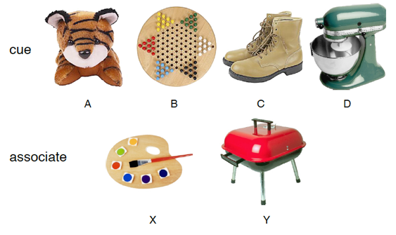

Context Dependent Rule Learning Task
Allen Chang, PhD
Morin et al. 2021

Slide 12


Incorrect
Correct
Pair?

Slide 13
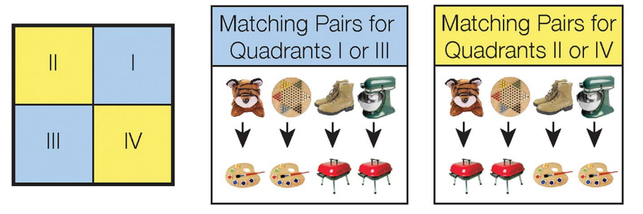
Context Dependent Rule Learning Task – Underlying Rule Structure
Morin et al. 2021

Slide 14
Learning Varies Across Subjects
Morin et al. 2021
Notes:
If you think that is confusing, you are not alone, as 30% of our subjects never performed above chance during the task. Here you can see subject performance across the 9 scanning runs. Blue dots show subjects that successfully learned the task, and red dots show subjects that were unsuccessful. You can see that for the successful participants, accuracy is generally increasing over time. Our main question is: what is different about the brain network dynamics between these successful and unsuccessful participants.

Slide 15

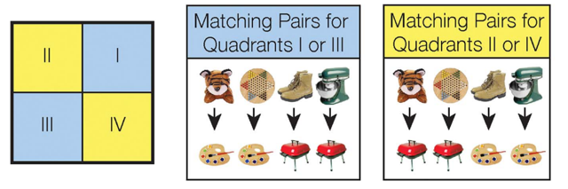

Study Goals
Assess how network dynamics differed between successful and unsuccessful learners.
Characterize how network measures shifted as subject performance improved on the task.

Slide 16
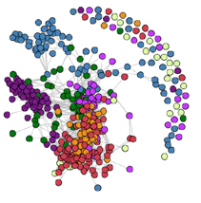
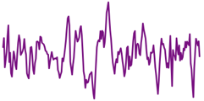
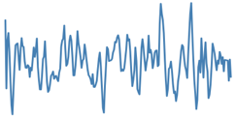
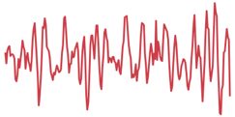
The Brain as a Network
1
2
r
…
400
(Schaefer et al. 2018)
Node: A brain region of interest
Edge: Functional connectivity (correlation) between two nodes
Community: A group of nodes that exhibit strong connectivity to each other

Slide 17
Dynamic Network Construction
Morin et al. 2021
Notes:
To answer this question, we formed a multilayer functional connectivity network for each subject, using the regions found in the Schaefer 400 atlas. To create the network, each region in the atlas becomes a node. If the BOLD signal is highly correlated between two nodes, then we connect them with an edge. We repeat this for all nine-scanning runs, and create this multi-layered network for each of our subjects. With a network constructed, we can start to ask questions about the network’s structure.

Slide 18
Dynamic Network Construction
Scan Run #1
Scan Run #2
Scan Run #3
Scan Run #4
…

Slide 19
Characterizing the Dynamic Network: Guiding Questions
Do some brain regions show more frequent changes in functional connectivity?
  (Flexibility)
How does connectivity within communities change during learning?
  (Assortativity)
How does connectivity between communities change during learning?
  (Inter-community Edge Strength)

Slide 20
Characterizing the Dynamic Network: Guiding Questions
Do some brain regions show more frequent changes in functional connectivity?
  (Flexibility)
How does connectivity within communities change during learning?
  (Assortativity)
How does connectivity between communities change during learning?
  (Inter-community Edge Strength)

Slide 21
Calculating Node Flexibility
# Community Switches
Flexibility =
= 0.25
# Possible Switches
Notes:
First, we wanted to know if the overall flexibility of the network was different between learner’s and non-learners. We predicted that successful learner’s would quickly adopt a successful strategy and form a rigid community structure. To test this, we ran a Louvain community detection algorithm on each subject’s multilayered network, essentially giving each node a data-driven community assignment. If we follow the community membership of this node circled in yellow, this is what we find: First the node belongs to the purple network. Then, it spends a few scanning runs in the green network, until it becomes a part of this blue network, and then the subject reaches the end of the scanning session. To calculate the flexibility of this node, we look at how many times its community membership switches, and divide by the total possible number of switches. For this node, that is 2 switches over 8 possible switches, or 0.25.

Slide 22
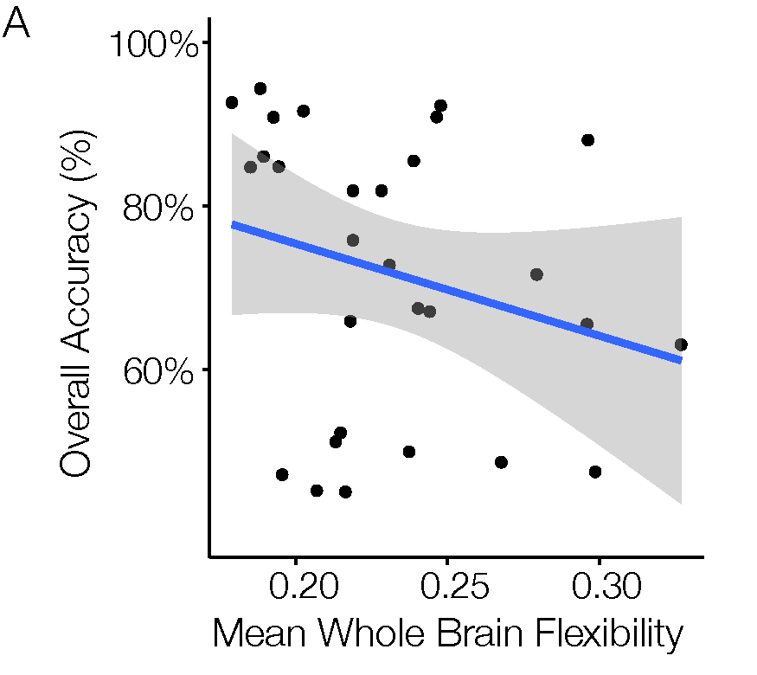
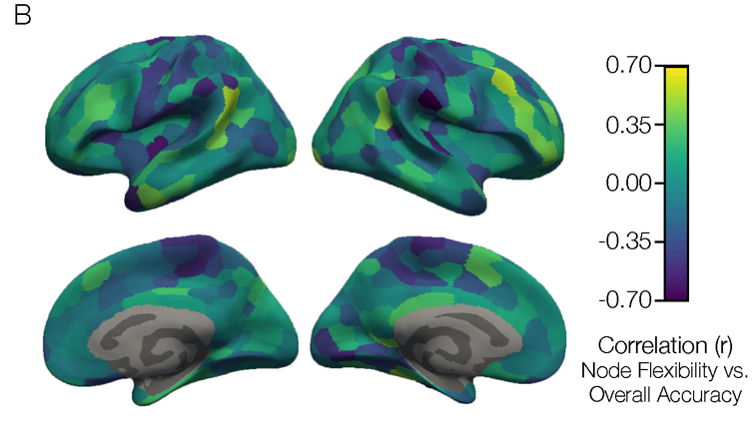


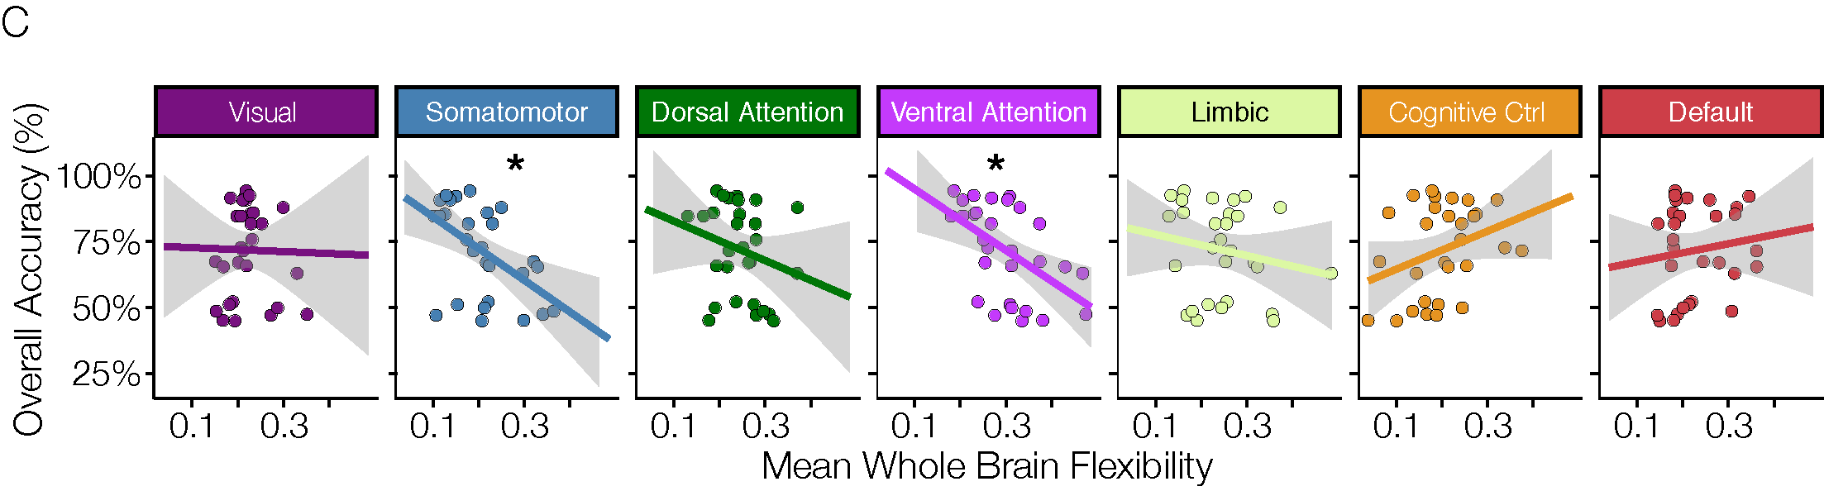
Higher Accuracy is Associated with Reduced Flexibility (Higher Stability)
Mean Community Flexibility
Morin et al. 2021
Notes:
We can take the average flexibility of all 400 brain regions, and correlate it with each subject’s overall accuracy on the task. When we plot that we find that indeed, the successful learners – who had high overall accuracy, show lower flexibility scores, implying that they quickly form stable community structures. We can also map the correlation between flexibility and accuracy onto each individual cortical region to get a brain map like this. And while most of the brain is blue, driving that whole brain negative correlation plotted to the left, we actually see several brain regions with warm colors, demonstrating that there are regions of cortex that are flexibly switching their community allegiance in successful learners.

Slide 23
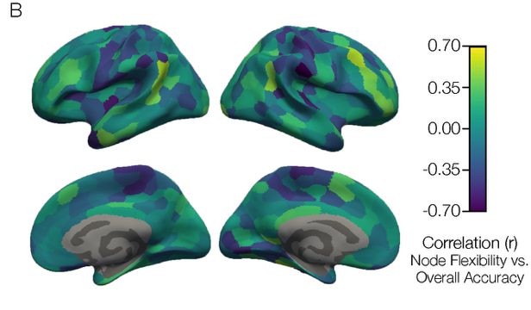
Successful Learners Have More Stable Rule Representations
Working Model: During learning, brain regions flexibly adapt their community allegiance as subjects adopt different task strategies.
Successful subjects learned quickly, suggesting that they settle on a strategy and have more stable neural representations of the learned rules.

Slide 24
Characterizing the Dynamic Network: Guiding Questions
Do some brain regions show more frequent changes in functional connectivity?
  (Flexibility)
How does connectivity within communities change during learning?
  (Assortativity)
How does connectivity between communities change during learning?
  (Inter-community Edge Strength)

Slide 25
Positive Assortativity: Communities Are More Connected to Themselves
Positive Assortativity
1.0
0.0
-1.0
Negative Assortativity

Slide 26
Zero Assortativity: Communities Are Equally Connected to Each Other & Themselves
Positive Assortativity
1.0
0.0
-1.0
Negative Assortativity

Slide 27
Negative Assortativity: Communities Are More Connected to Each Other
Positive Assortativity
1.0
0.0
-1.0
Negative Assortativity

Slide 28
Assortativity in a Single Community
Positive Assortativity
1.0
0.0
???
-1.0
Negative Assortativity

Slide 29
Assortativity in a Single Community
Positive Assortativity
1.0
0.0
-1.0
Negative Assortativity

Slide 30
Assortativity in Cognitive Control Network Increased with Learning
Cognitive Control

Slide 31
Assortativity Across Cortex
Morin et al. 2021

Slide 32
Successful Learners Have More Assortative Brain Networks
Assortativity measures how interconnected communities are to themselves as opposed to other communities
Stronger connectivity within the cognitive control community could support the formation of stable rule representations in dlPFC.
Cognitive Control

Slide 33
Characterizing the Dynamic Network: Guiding Questions
Do some brain regions show more frequent changes in functional connectivity?
  (Flexibility)
How does connectivity within communities change during learning?
  (Assortativity)
How does connectivity between communities change during learning?
  (Inter-community Edge Strength)

Slide 34
Calculating Inter-community Edge Strength

Slide 35
Calculating Inter-community Edge Strength
2

Slide 36
Calculating Inter-community Edge Strength
2
= 0.22
9

Slide 37
Plotting Inter-community Edge Strength

Slide 38
Inter-community Edge Strength Between Cognitive Control and Ventral Attention Increases with Successful Rule Learning
0.5
Inter-community
Edge Strength
0.0
1
Time
9

Slide 39
Inter-community Edge Strength Shows Segregated Attention Communities in Successful Learners
Morin et al. 2021

Slide 40
Successful Learners Have More Segregated Attention Communities
Previous work shows that anticorrelation between dorsal attention and default communities is associated with higher working memory capacity (e.g. Keller et al. 2015).
Connectivity between attention communities and other communities could be an indication of how attentional resources are being allocated to benefit rule learning.
0.5
Inter-community
Edge Strength
0.0
1
Time
9

Slide 41
Key Takeaways
Overall, successful learners have a more “stable” brain network structure.
  Working Hypothesis: Successful learners latch onto an effective strategy quickly, and form stable representations of the rules.
Cognitive Control Community regions become more highly interconnected to each other in successful learners
A stable and segregated attention system is maintained in successful learners

Slide 42
Agenda
Introduction
Stable Functional Networks Support Successful Rule Learning
Preview: Stable Functional Networks Support Abstract Reasoning

Slide 43
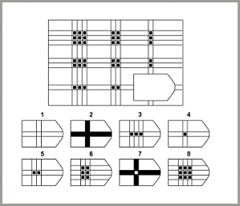
Does a Stable Task Network Support Abstract Reasoning?
Through reasoning, the brain can apply previously learned information, strategies, and ideas to new situations.
Raven, 1936

Slide 44
Simplified Raven’s Progressive Matrices Task

Slide 45
Unique Activity Patterns Associated With Perceptual and Symbolic Reasoning

Slide 46

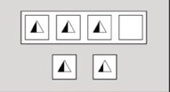
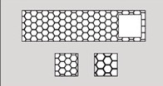

Stable Community Structure Across Reasoning Conditions

Slide 47
Preliminary Conclusions
Frontoparietal cortex supports symbolic and perceptual reasoning
  Anterior prefrontal cortex supports symbolic reasoning
  Inferior temporal cortex supports perceptual reasoning
Abstract reasoning is also supported by a stable functional connectivity network.
Frontoparietal cortex becomes more strongly interconnected during reasoning compared to rest.

Slide 48
Conclusions
A stable functional network structure and segregated attention system support successful context-dependent rule learning
Stable functional networks also appear to support abstract reasoning
These results provide support for the hypothesis that reduced task-reconfiguration of functional brain networks is associated with cognitive ability

Slide 49



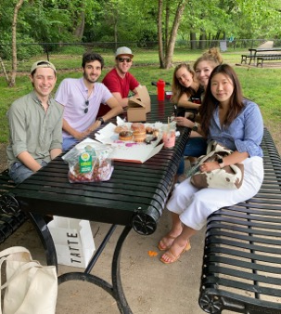


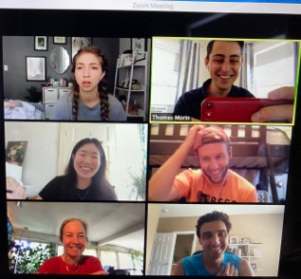
Acknowledgements
Collaborators
Allen Chang
Weida Ma
Joe McGuire
Dissertation Advisory Committee
Chantal Stern
Joe McGuire
David Badre
Mike Hasselmo
GPN Admin
Shelley Russek
Sandi Grasso
Stern Lab
Chantal Stern
Matt Dunne
Stamati Liapis
Kylie Moore
Caroline Ahn
Kylie Isenburg
Cognitive Neuroimaging Center
Stephanie McMaines
Shruthi Chakrapani
Funding
NSF Major Research Instrumentation Award 1625552
ONR MURI Award N00014-16-1-2832
ONR DURIP Award N00014-17-1-2304

Slide 50
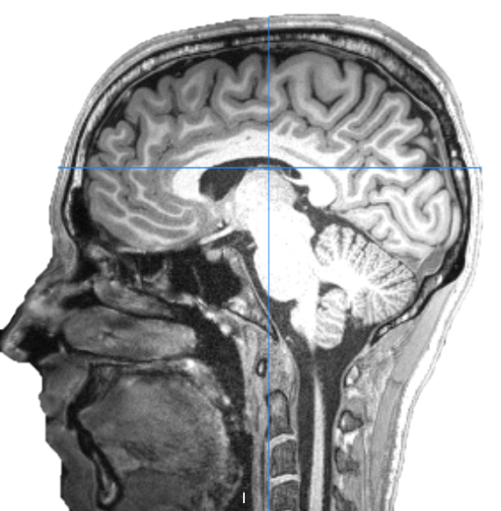
Questions?

Slide 51
Dissertation Outline
Chapter 1: Introduction
Chapter 2: Mapping Brain Activity and Network Reconfiguration During Abstract Reasoning
Chapter 3: Dynamic Network Analysis Demonstrates Formation of Stable Functional Networks During Rule Learning
Chapter 4: Increased Functional Connectivity Between Anterior Hippocampus and Prefrontal Cortex Supports Context-Dependent Rule Learning
Chapter 5: Conclusion

Slide 52
Dissertation Outline
Chapter 1: Introduction
Chapter 2: Mapping Brain Activity and Network Reconfiguration During Abstract Reasoning
Chapter 3: Dynamic Network Analysis Demonstrates Formation of Stable Functional Networks During Rule Learning
Chapter 4: Increased Functional Connectivity Between Anterior Hippocampus and Prefrontal Cortex Supports Context-Dependent Rule Learning
Chapter 5: Conclusion

Slide 53
Dissertation Outline
Chapter 1: Introduction
Chapter 2: Mapping Brain Activity and Network Reconfiguration During Abstract Reasoning
Chapter 3: Dynamic Network Analysis Demonstrates Formation of Stable Functional Networks During Rule Learning
Chapter 4: Increased Functional Connectivity Between Anterior Hippocampus and Prefrontal Cortex Supports Context-Dependent Rule Learning
Chapter 5: Conclusion

Slide 54

Hippocampal Neurons Encode Context-Specific Memories
Our context-dependent rule-learning task is based on the classic context-dependent memory tasks studied in rodents in the Eichenbaum lab.
Komorowski et al. 2009
Morin et al. 2021

Slide 55
Anterior-Posterior Gradient for Place Field Size in HIppocampus
In spatial navigation tasks, the human hippocampus exhibits anterior-posterior organization in place-field size, detectable with fMRI
Brunec et al. 2018
Notes:
Results demonstrated that hippocampal activity and hippocampal–prefrontal functional interconnectivity distinguished retrieval under different levels of hierarchically organized task rules. In explicit contrast to the hippocampal tail, anterior (body and head) regions were recruited specifically for superordinate changes in the contextual hierarchy. The hippocampal body also differed in its functional connectivity with the prefrontal cortex for superordinate versus subordinate changes

Slide 56
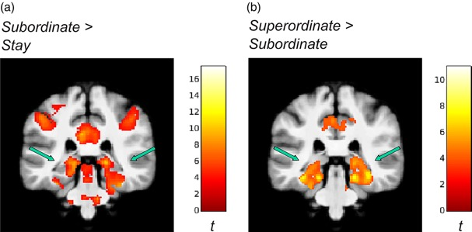
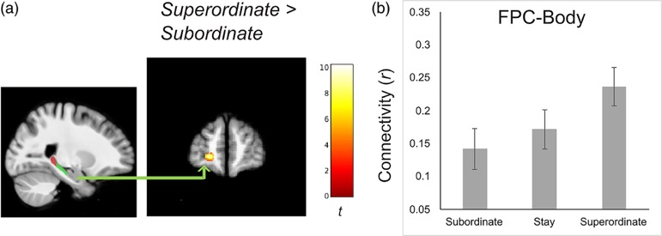
Anterior-Posterior Gradient for Abstract Rule Levels in Hippocampus
Brown et al. 2021
When implementing higher-level abstract rules, more anterior regions of hippocampus are activated.
Connectivity between hippocampal body and frontal pole increases for higher-level abstract rules.
Notes:
Results demonstrated that hippocampal activity and hippocampal–prefrontal functional interconnectivity distinguished retrieval under different levels of hierarchically organized task rules. In explicit contrast to the hippocampal tail, anterior (body and head) regions were recruited specifically for superordinate changes in the contextual hierarchy. The hippocampal body also differed in its functional connectivity with the prefrontal cortex for superordinate versus subordinate changes

Slide 57

Proposed Hypothesis for Experiment #3
Successful learners will exhibit stronger connectivity between anterior hippocampus and prefrontal cortex, because they have stronger representations for the abstract rules.

Slide 58
Dissertation Outline
Chapter 1: Introduction
Chapter 2: Mapping Brain Activity and Network Reconfiguration During Abstract Reasoning
Chapter 3: Dynamic Network Analysis Demonstrates Formation of Stable Functional Networks During Rule Learning
Chapter 4: Increased Functional Connectivity Between Anterior Hippocampus and Prefrontal Cortex Supports Context-Dependent Rule Learning
Chapter 5: Conclusion

Slide 61
Betweenness Centrality
Centrality Points
|
|
|

Slide 62
Centrality Results

Slide 63
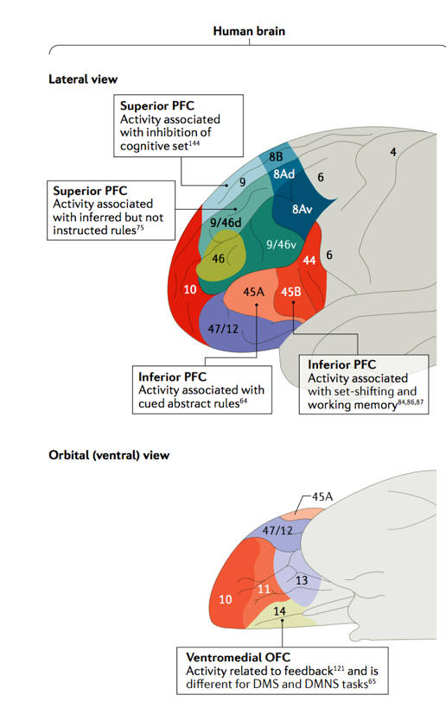
Prefrontal Cortex is Essential for Rule Representation
Mansouri et al. 2020

Slide 64
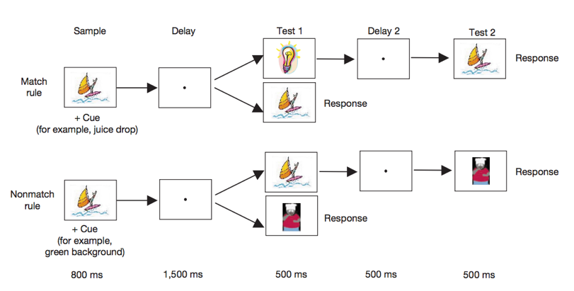
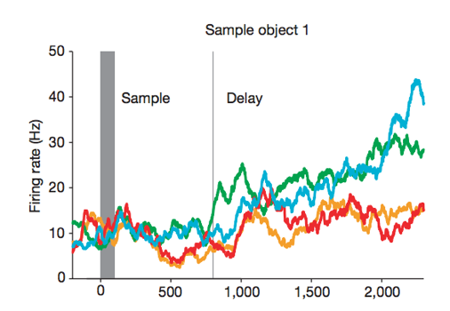
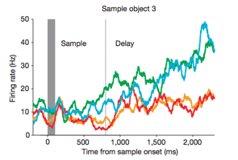
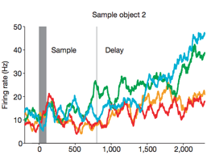

Single Neurons in dlPFC Encode Abstract Rules
Match Rule
Juice or Low Tone
Non-Match Rule
No Juice or High Tone
Wallis et al. 2001

Slide 65
Abstract Reasoning Activates Frontoparietal Cortex

Slide 66

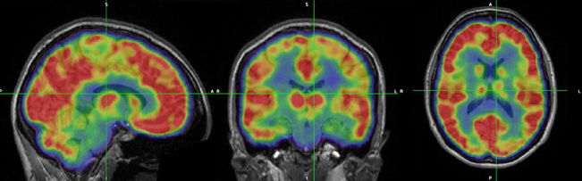
Do more flexible brain regions require more energy at rest? (Simultaneous MR-PET)
Flexibility Stats (fMRI)
Dynamic FDG Time Activity Curves (fPET-FDG)

Slide 67
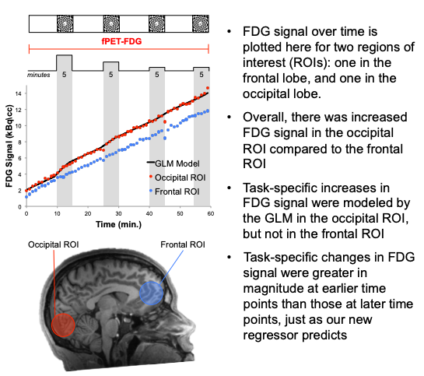

Slide 68
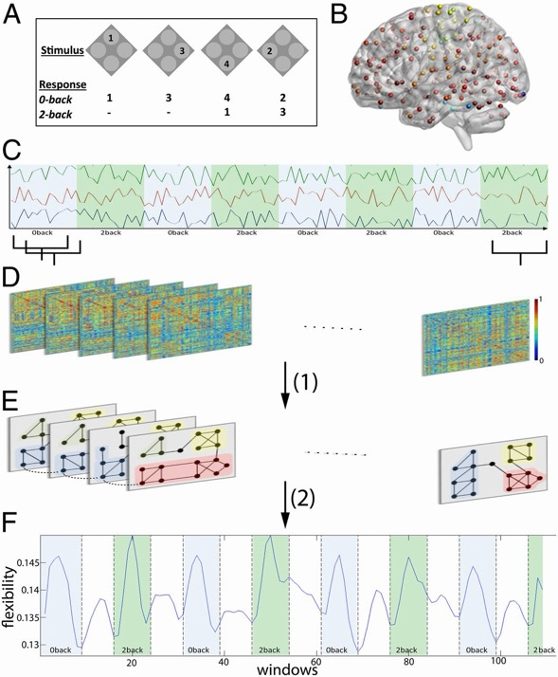
Increased Working Memory Load is Associated with Brain Network Flexibility
Braun et al. 2015
Notes:
Braun et al. 2015 Network reconfiguration during executive function. (A) We use a numerical n-back task consisting of 0-back and 2-back conditions. (B) We define 270 cortical and subcortical regions of interest (36), and (C) extract the mean time course from each region. (D) A sliding window comprising 15 volumes with no gap was applied to regional mean time courses, and for each window we estimated the functional connectivity between pairs of regions using coherence. This procedure resulted in a sequence of 114 time-ordered adjacency matrices. (E) Using a dynamic community detection algorithm (part 1 in panel), we identified network modules in each time window and tracked their evolution over time. (F) By estimating the probability that a brain region changes its allegiance to modules between any two consecutive time windows (part 2 in panel), we observed that whole-brain flexibility oscillated between unitask (2-back or 0-back only) and dual-task (2-back and 0-back in same time window) conditions.

