Slide 1
Brain Health & Alzheimer’s: What Everyone Should Know
Anne Berry, PhD
Associate Professor of Psychology & Neuroscience
Brandeis University
Tom Morin, PhD
Postdoctoral Fellow
Mass. General Hospital
Brandeis University

Slide 2
Agenda
What happens to our brains as we get older? (Anne)
What is Alzheimer’s disease? (Tom)
New treatments and blood tests for Alzheimer’s disease (Tom)
What does the research say on maintaining a healthy brain? (Tom)
Overview of the Brandeis Aging Brain Study (Anne)

Slide 3
Agenda
What happens to our brains as we get older?
What is Alzheimer’s disease?
New treatments and blood tests for Alzheimer’s disease
What does the research say on maintaining a healthy brain?
Overview of the Brandeis Aging Brain Study

Slide 4
The aging brain
Cognition
Super aging
Preclinical
Aging
MCI
Dementia
Years

Slide 5
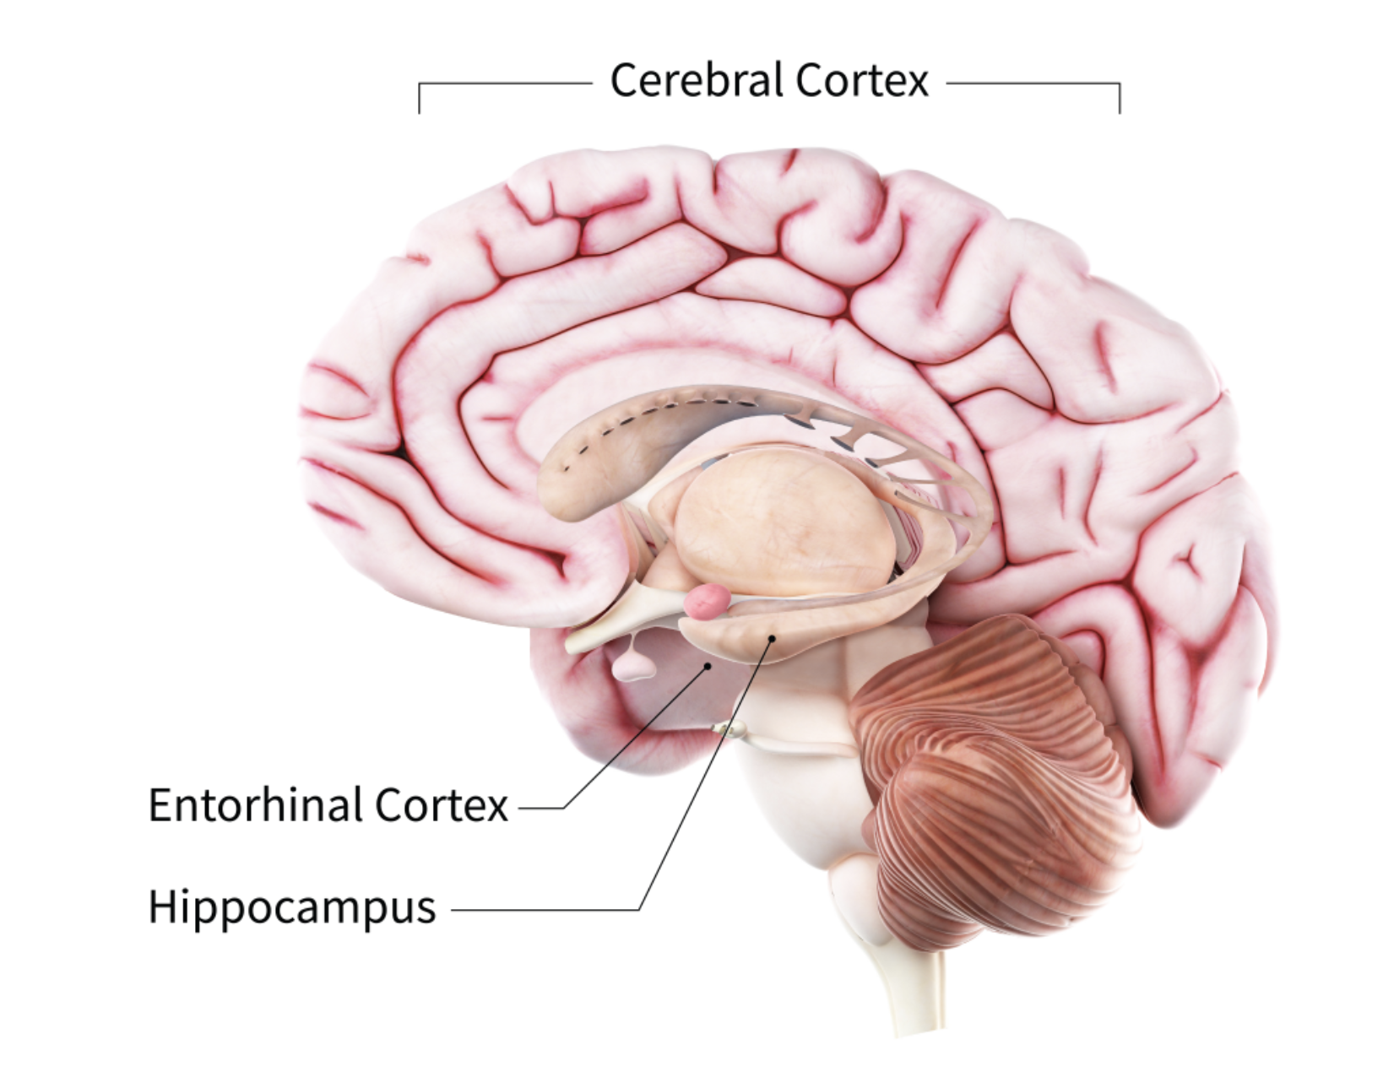
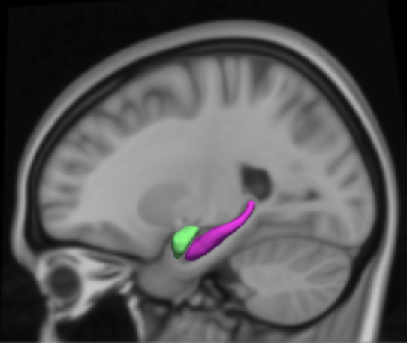
The aging brain

Slide 6
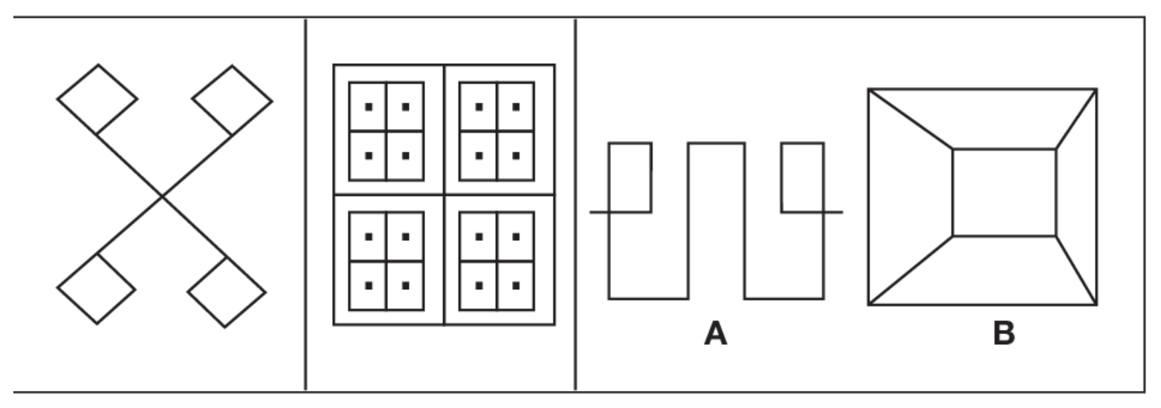
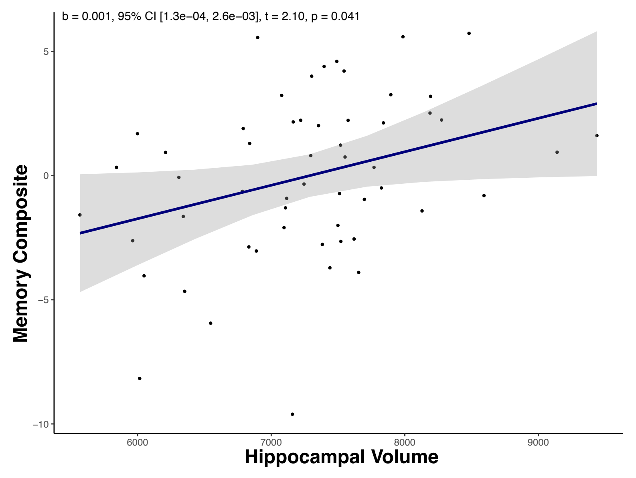
The aging brain
Visual memory:
Verbal memory:
Memory
Drum
Curtain
Bell
Coffee
Moon
Garden
Hat
Farmer
Nose
Turkey
Color
House
Hippocampal Volume

Slide 7
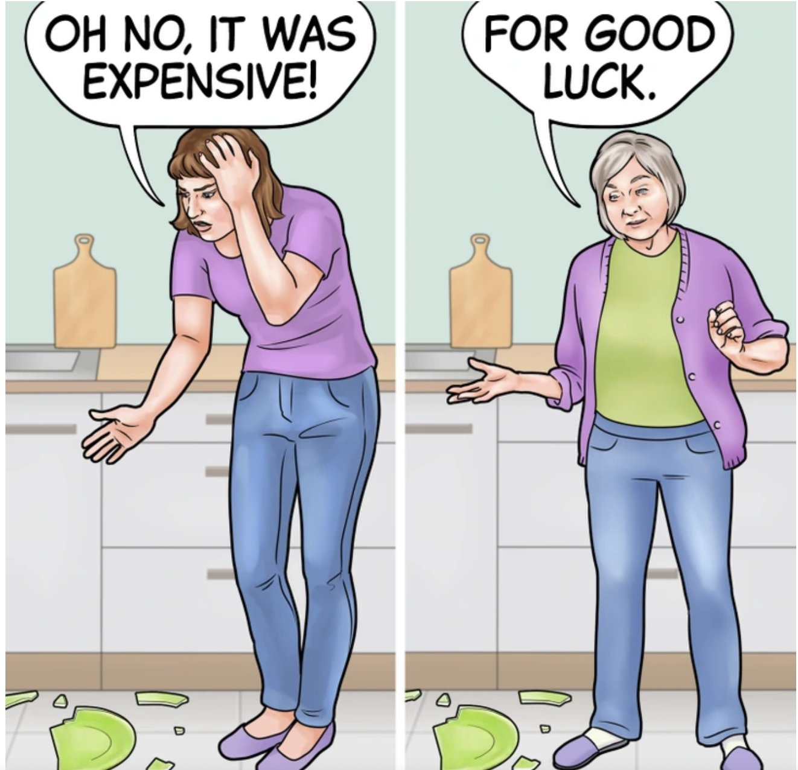
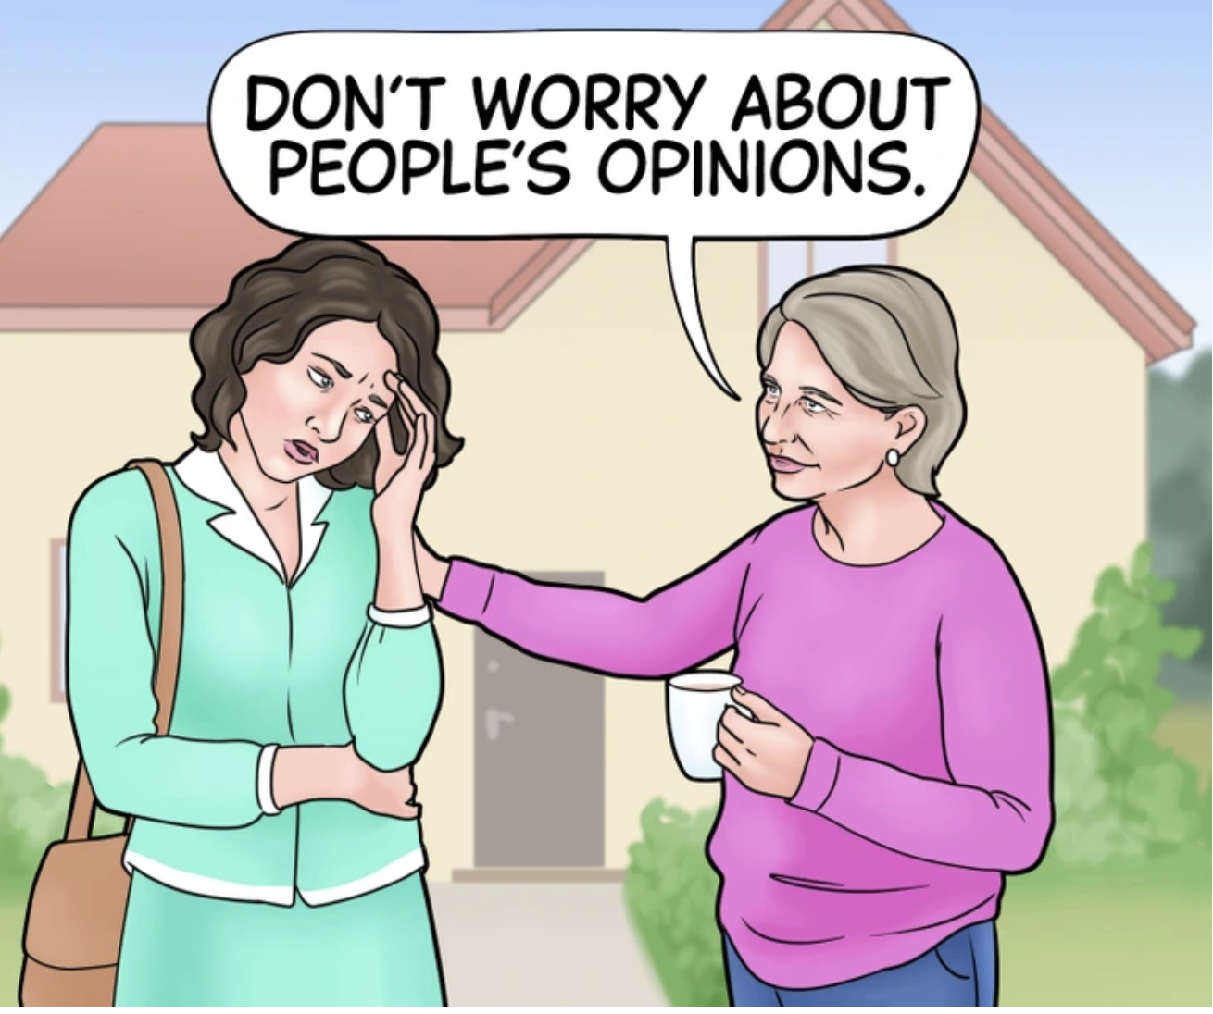
The aging brain

Slide 8
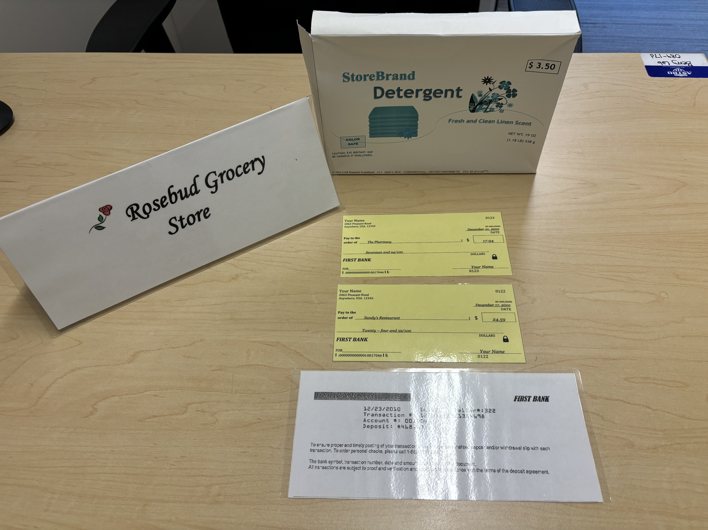

The aging brain
Wisdom and crystallized intelligence goes up across the lifespan

Slide 9
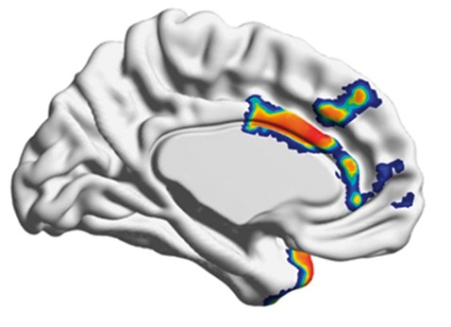
The aging brain
Super aging
The health of this region in prefrontal cortex
is associated with successful aging

Slide 10
Agenda
What happens to our brains as we get older?
What is Alzheimer’s disease?
New treatments and blood tests for Alzheimer’s disease
What does the research say on maintaining a healthy brain?
Overview of the Brandeis Aging Brain Study

Slide 11
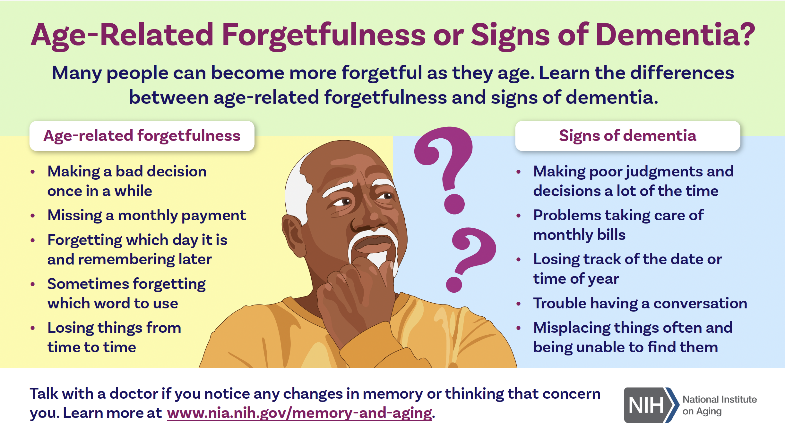

Slide 12
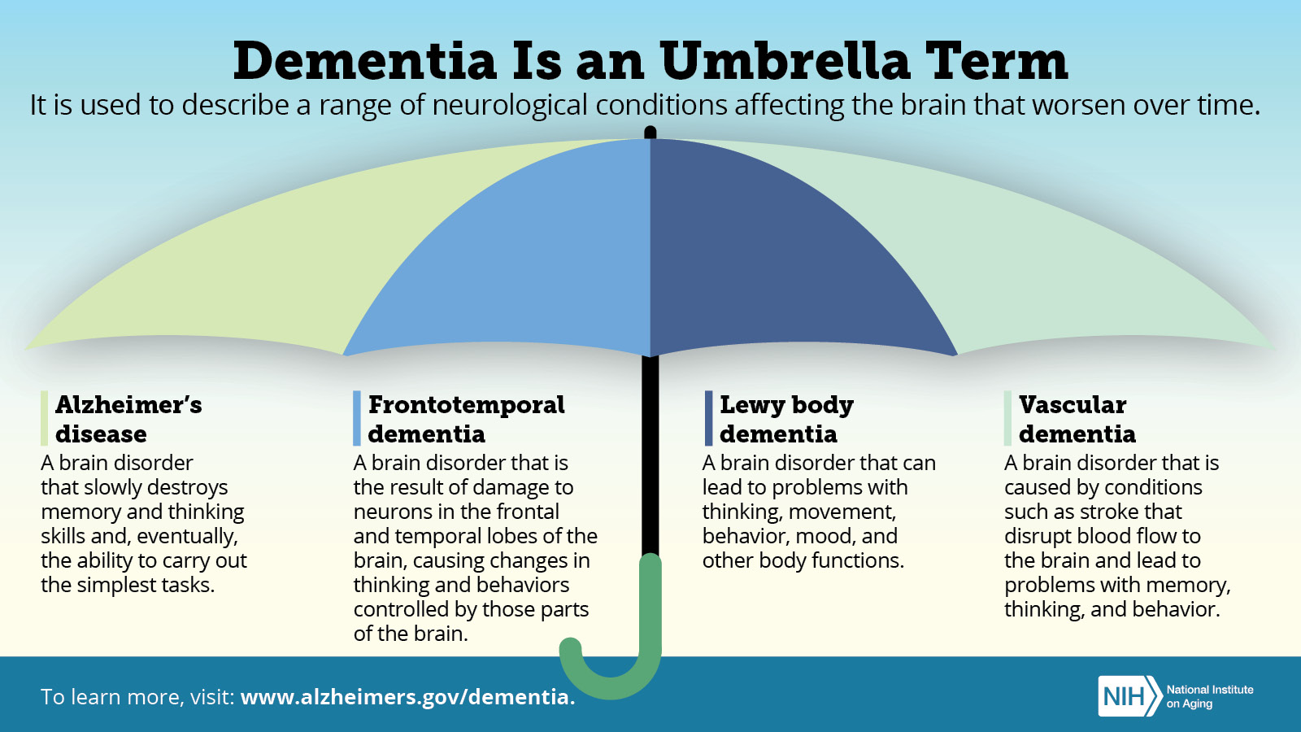
Notes:
Dementia is an overall term for a particular group of symptoms. Dementia symptoms include trouble with memory, language and problem-solving; difficulty concentrating; and struggling to understand and express thoughts. Other symptoms are confusion, poor judgment and acting impulsively, among others. Dementia symptoms are the result of changes in the brain. Many different conditions can cause dementia symptoms

Slide 13
Alzheimer’s Disease: By the Numbers
An estimated 7.2 million Americans are living with Alzheimer’s disease.
Early-onset Alzheimer’s (symptom onset age 40 – 65) is more likely to be genetic, and only accounts for ~5% of Alzheimer’s cases.
(Alzheimer’s Association)
Notes:
1 in 9 of those aged 65+

Slide 14
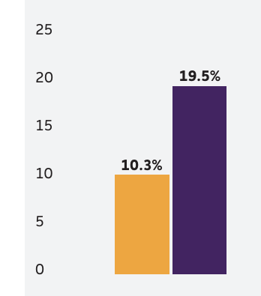
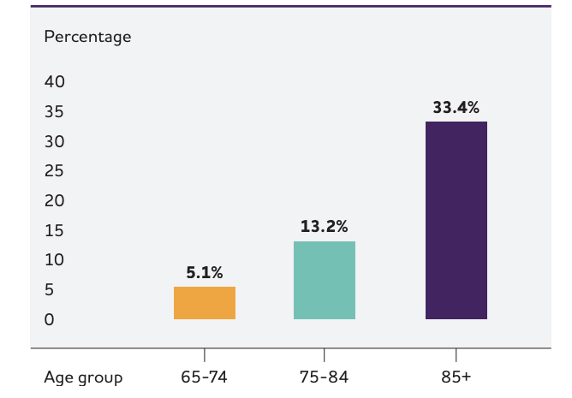
Alzheimer’s Disease: By the Numbers
Lifetime Risk of
Alzheimer’s By Sex
Prevalence of Alzheimer’s by Age Group
Males
Females
(Alzheimer’s Association)

Slide 15
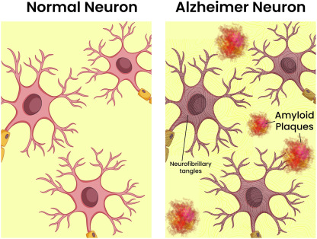
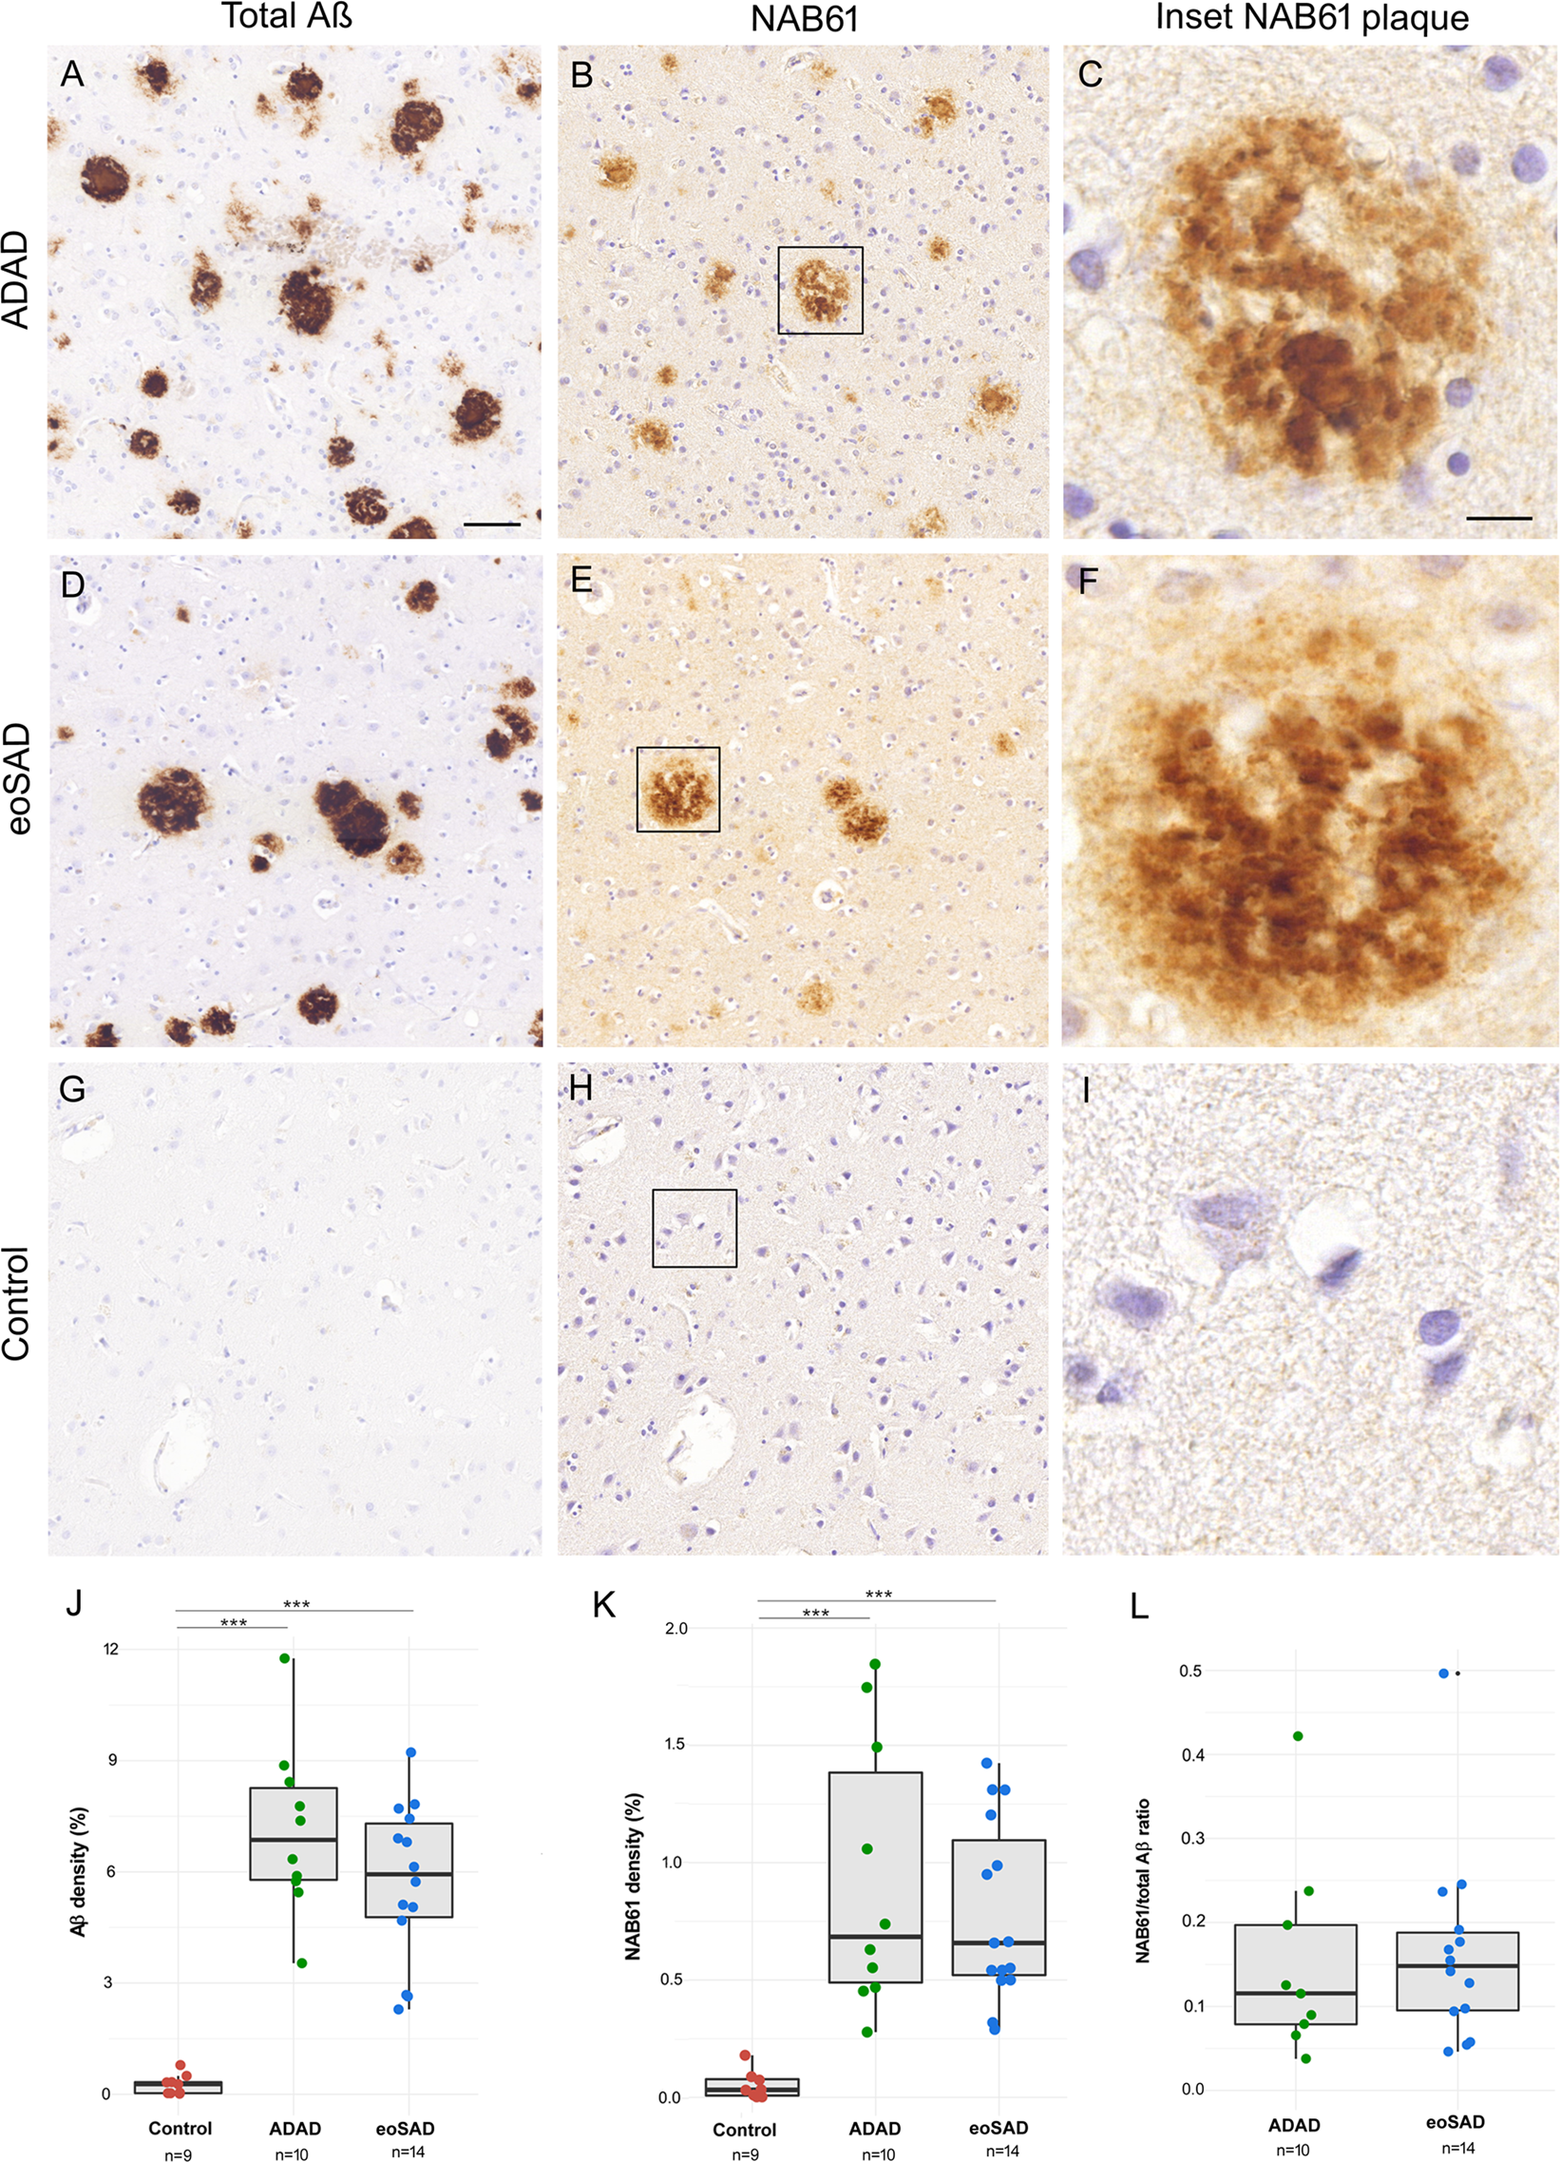
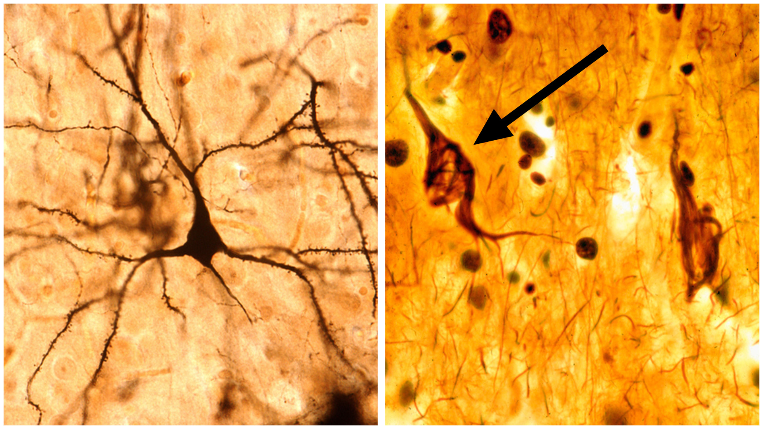
Alzheimer’s Disease is Characterized by
Amyloid Plaques and Neurofibrillary (Tau) Tangles
Normal
Alzheimer’s
Plaque
Tangle
(Querol-Vilaseqa 2019) (Bright Focus Foundation)

Slide 16
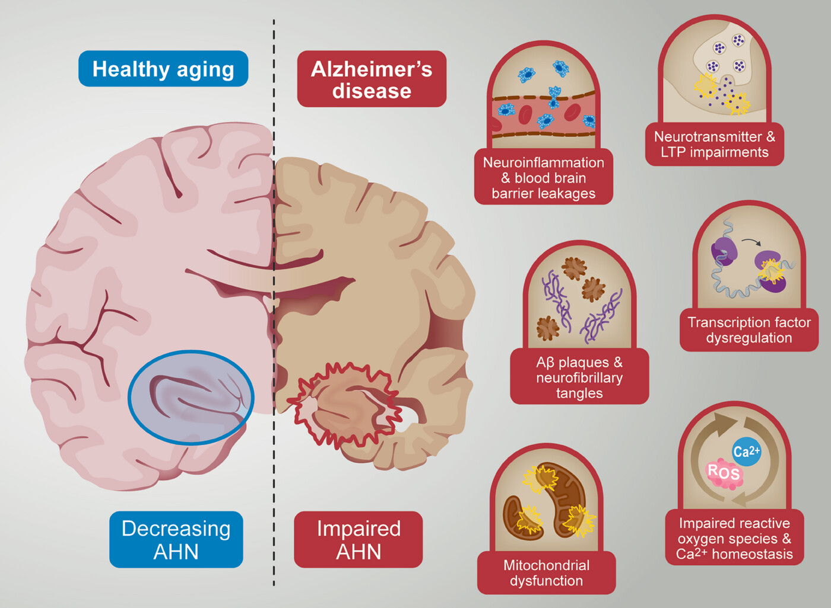
Alzheimer’s Association

Slide 17
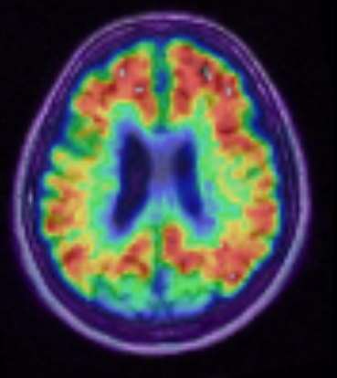
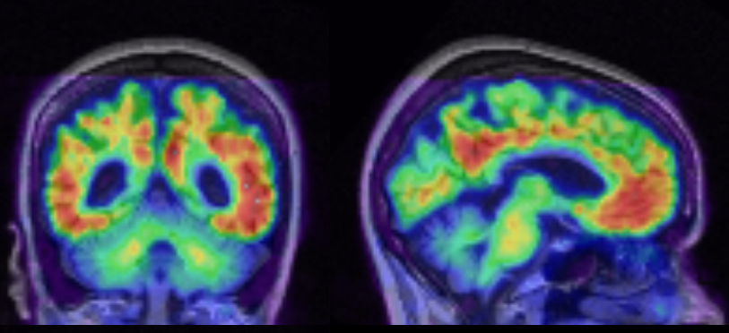
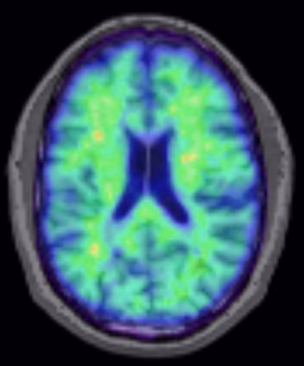
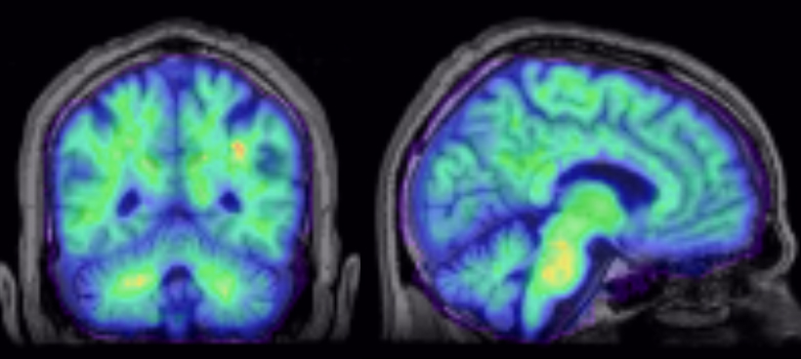
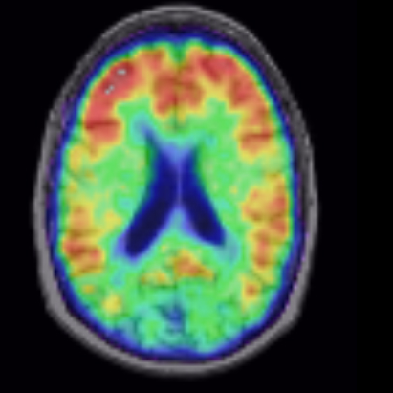
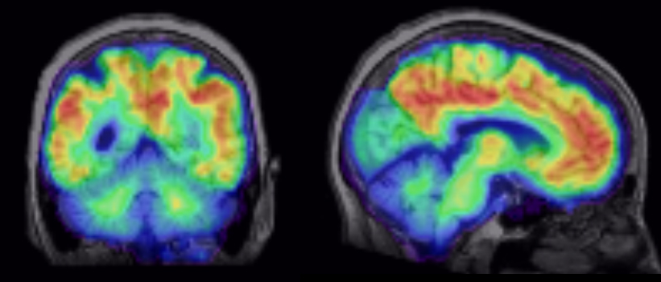
Amyloid Imaging
Alzheimer’s Disease
Normal Aging (Amyloid Negative)
Normal Aging (Amyloid Positive)

Slide 18
Agenda
What happens to our brains as we get older?
What is Alzheimer’s disease?
New treatments and blood tests for Alzheimer’s disease
What does the research say on maintaining a healthy brain?
Overview of the Brandeis Aging Brain Study

Slide 19
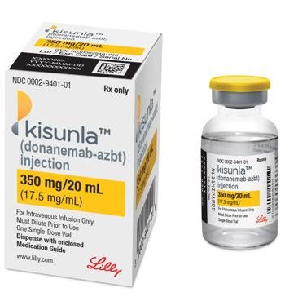
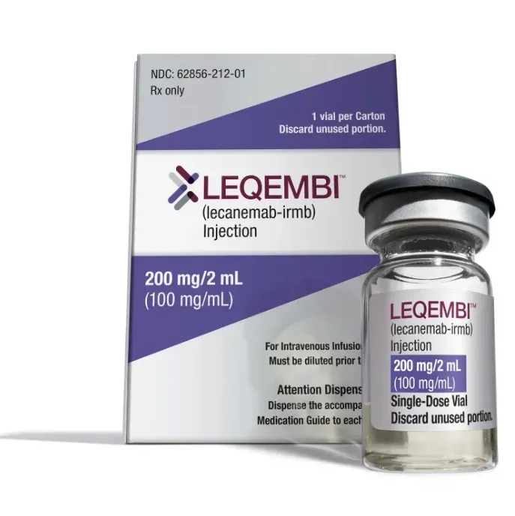
Amyloid Targeting Treatments for Alzheimer’s Disease
Reduce amyloid plaques in the brain
Slow the rate of cognitive decline
Kinsula
(donanemab)
Leqembi
(lecanemab)

Slide 20
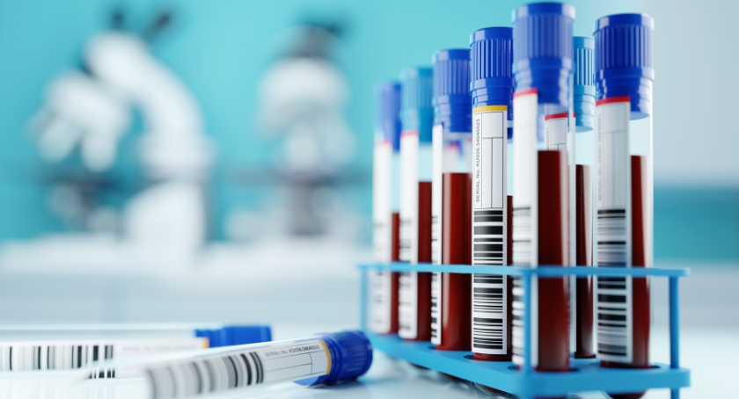
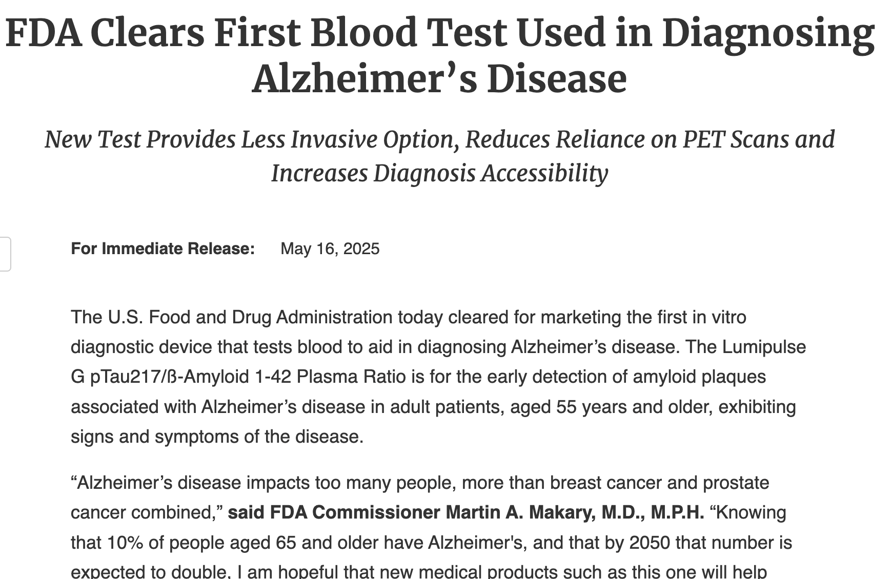
First FDA Approved Blood Test for Use in Diagnosing Alzheimer’s Disease
Measures tau and amyloid proteins in the blood
Effective screening tool
  Which patients need additional testing/monitoring for Alzheimer’s disease?

Slide 21
Agenda
What happens to our brains as we get older?
What is Alzheimer’s disease?
New treatments and blood tests for Alzheimer’s disease
What does the research say on maintaining a healthy brain?
Overview of the Brandeis Aging Brain Study

Slide 22
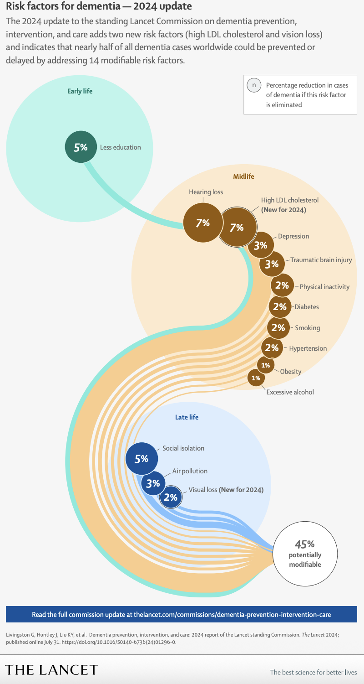
Modifiable Risk Factors

Slide 23
Modifiable Risk Factors

Slide 24
Modifiable Risk Factors

Slide 25
Modifiable Risk Factors

Slide 26
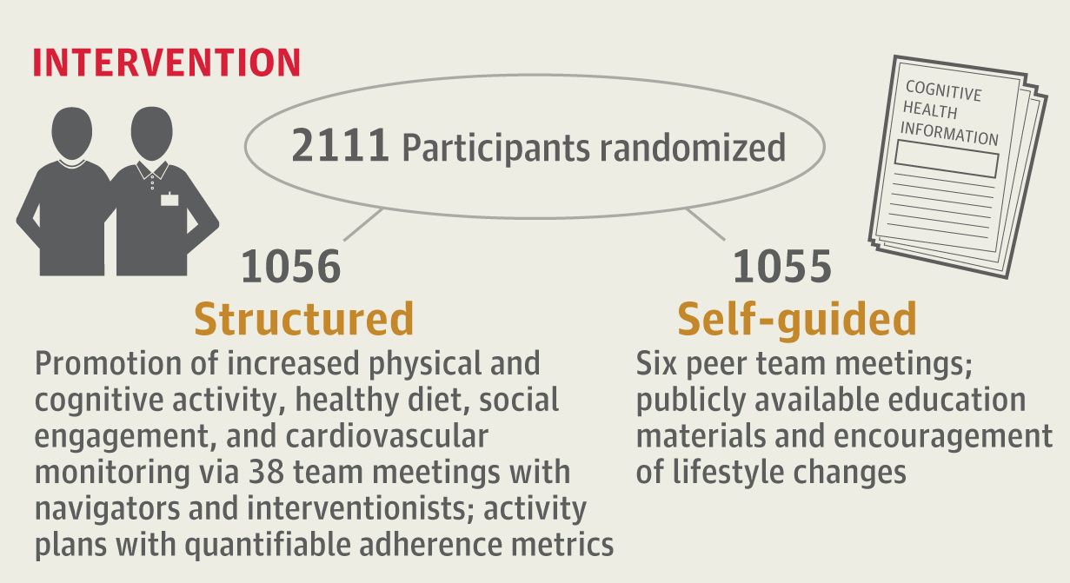
U.S. POINTER Study

Slide 27
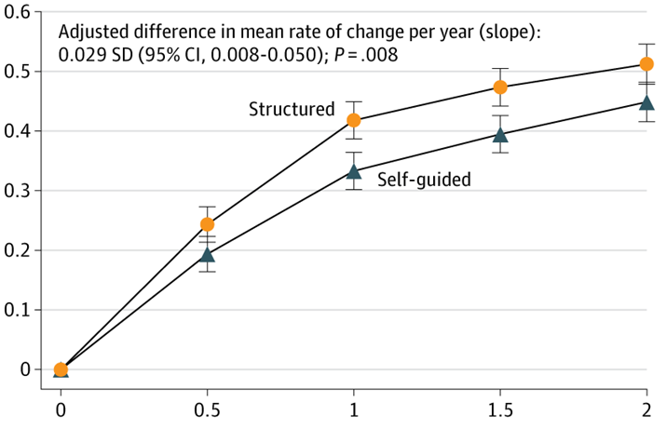
Participants in the Structured Program Showed Greater Cognitive Improvements
Cognitive Score
Time (Years)

Slide 28
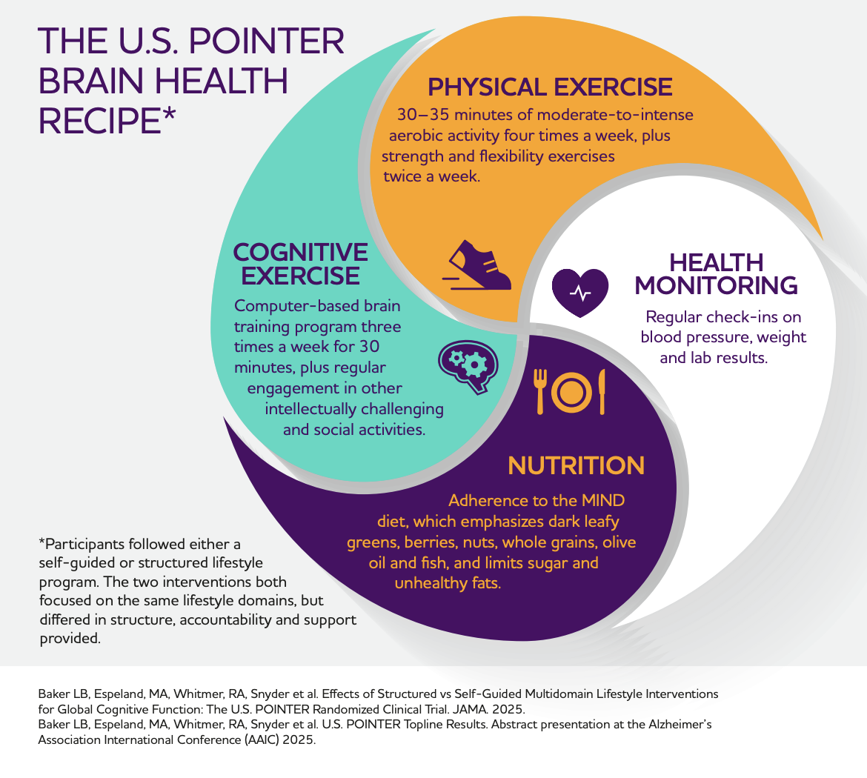
https://www.alz.org/us-pointer/study-results.asp

Slide 29
Agenda
What happens to our brains as we get older?
What is Alzheimer’s disease?
New treatments and blood tests for Alzheimer’s disease
What does the research say on maintaining a healthy brain?
Overview of the Brandeis Aging Brain Study

Slide 30



Brandeis Aging Brain Study
326 participants (at least 1 visit)
160 (at least 2 visits)
39 (3+ visits)

Slide 31
The aging brain
Cognition
Super aging
Preclinical
Aging
MCI
Dementia
Years

Slide 32
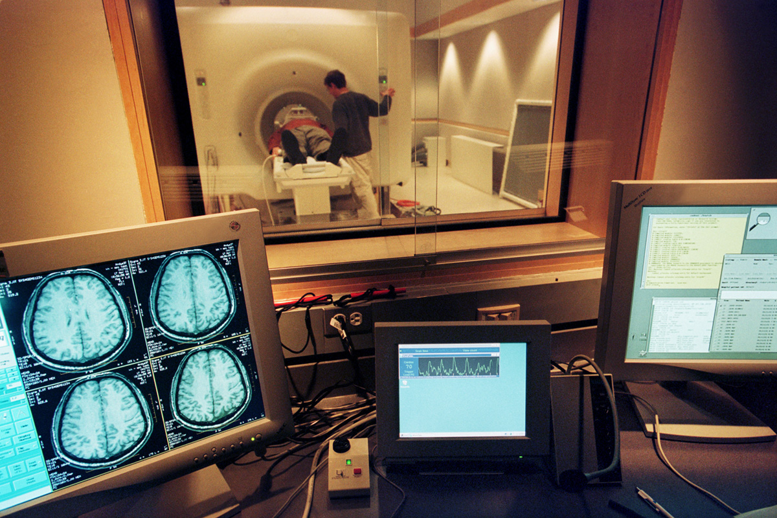
The Brandeis Aging Brain Study
Brain imaging to measure
Brain structure and function (MRI)
Tau pathology (PET)
Dopamine
Norepinephrine
Serotonin
FMT PET

Slide 33
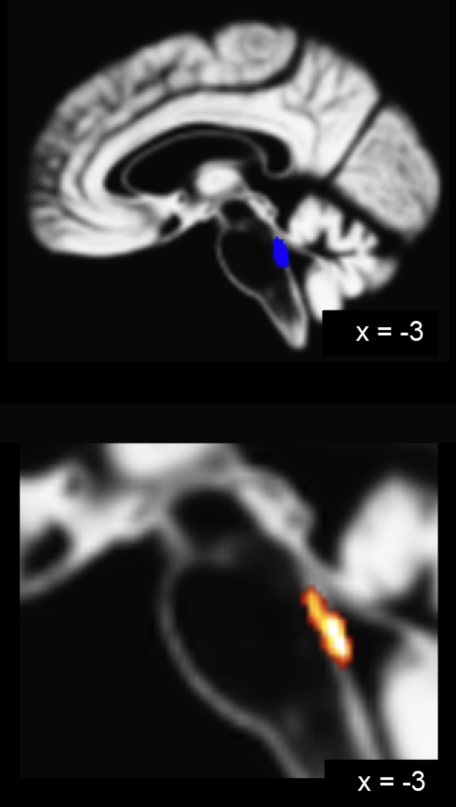
The Brandeis Aging Brain Study
FMT
New method for measuring brain health
The norepinephrine system: where tau first begins
We are developing FMT as an early ”biomarker” to predict who is most likely to develop Alzheimer’s disease

Slide 34

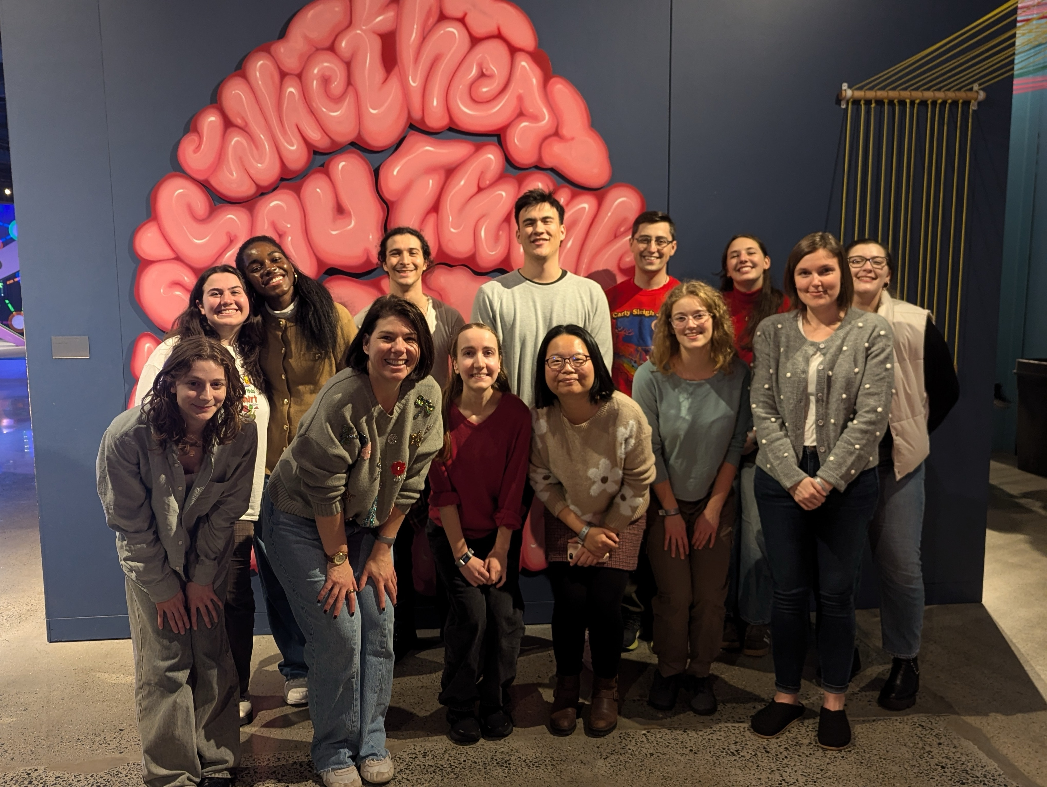
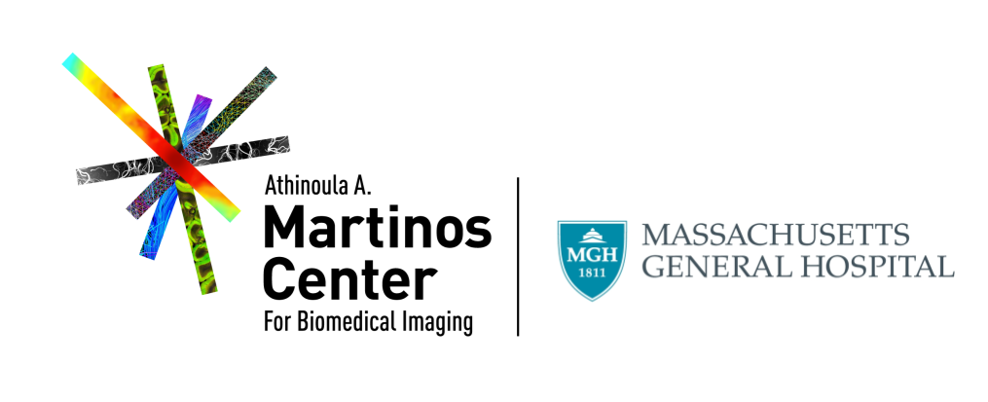
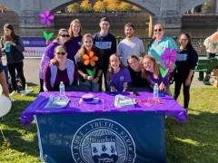
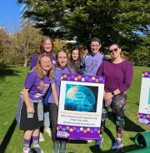
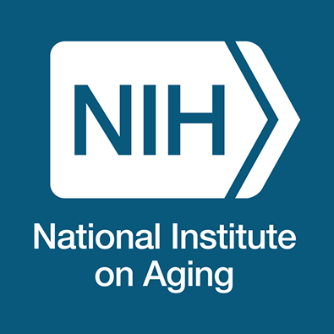
Thank You!
Berry Lab:
Dr. Anne Berry
Alex Kinney
Emma Carlson
Patrick Cao
Dr. Hsiang-Yu Chen
Dr. Jenny Crawford
Dr. Tom Morin
Claire Ciampa
Teodora Markova
Rachel Marcus
Daisy Kiyemba
Griffin Dugan
Aroura Plummer
Kat Xikes
Shaian Aghasoltan
Chiamaka Onyema
Funding:
R01 AG074330
R21 AG086729
F32 AG084259
L30 AG089518

Slide 35
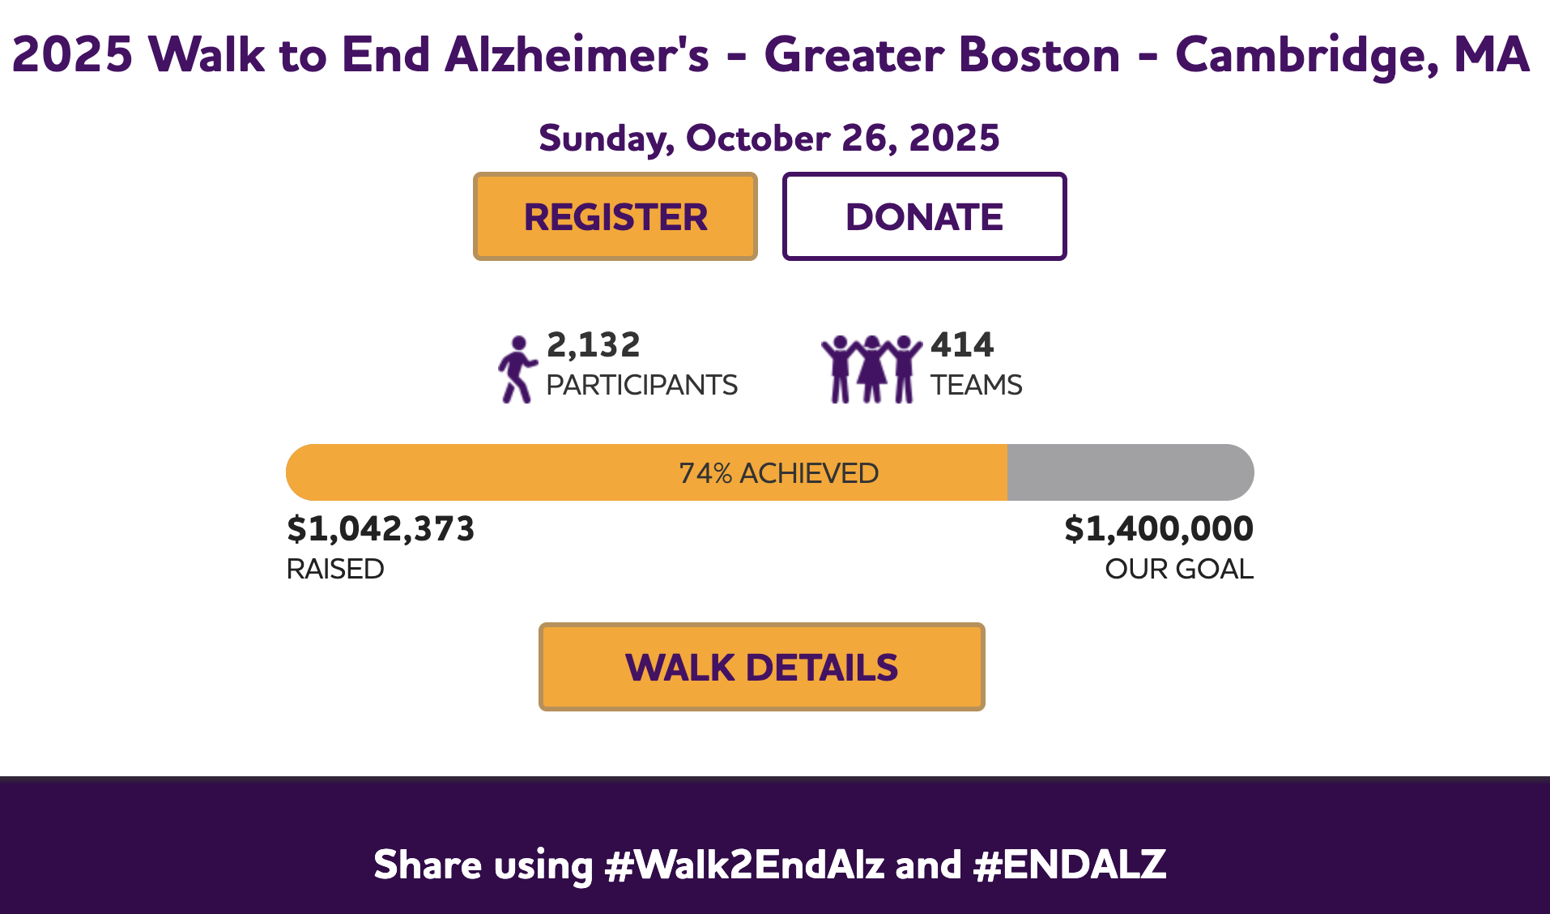
Notes:
Screenshot from 10/6/2025

