Slide 1
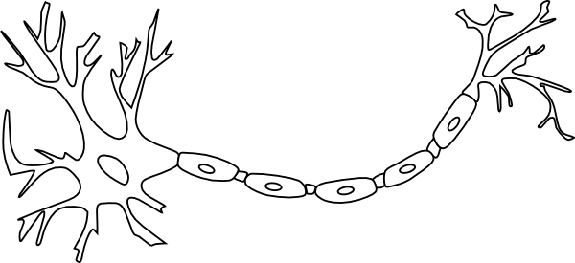
Branching Out
What a Tree
Can Teach You
About Your Brain

Slide 2
+
Notes:
Let’s start with a short experiment. For the next 20 seconds, I’d like you to stare at the cross up on the screen, and let your mind be completely at rest. Ready. Set. Go. [CLICK]
--- 20 seconds ---
How was that? Was your brain completely at rest? Or did your mind begin to wander? For most of us, our minds are never completely at rest. For the last two years, I’ve worked in a Brain-Imaging lab at Mass General Hospital in Boston, and I’ve spent a lot of time thinking about what people think about. If you came to visit me in Boston and we had you repeat this task in the scanner we’d see that indeed, your mind is not at “resting.” Scientists have started using a technique called “resting state analysis” to study the intrinsic, low-frequency signals that permeate through all of our brain activity, whether we are at rest or not. Studies suggest that resting state signal might vary in predictable ways and that some day, these patterns could provide us with a better understanding of mental illnesses like PTSD, Depression, and Schizophrenia. Scientists are still debating exactly how resting state signals should be interpreted, and the work they are doing has the potential to revolutionize our understanding of the human brain. One useful way of better understanding resting state brain signals, is to think of your mind as a tree. [CLICK]

Slide 3
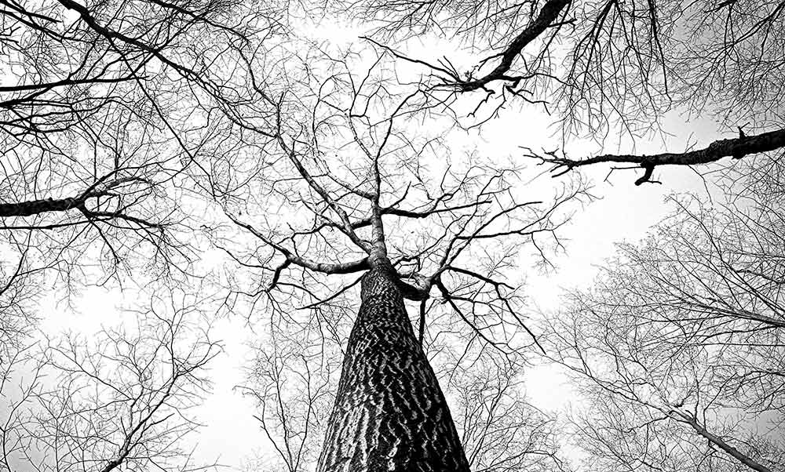
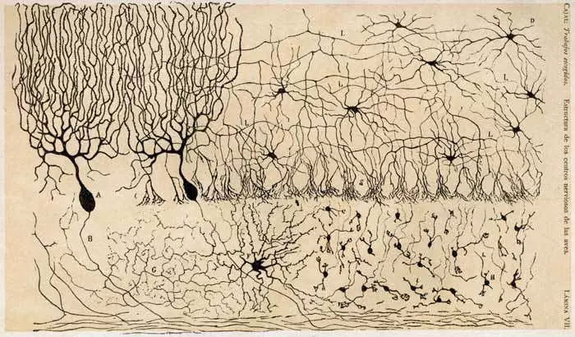
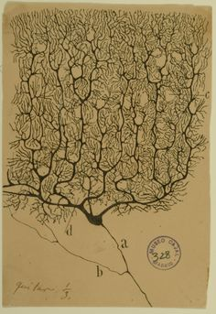
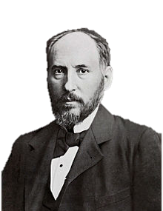
Notes:
The idea that brains are like trees isn’t new. In a famous 1894 lecture before the Royal College of Physicians, Spanish neuroscientist Santiago Ramon y Cajal explained that neurons were like trees: as they grow and develop, they branch out. Cajal was the first person to examine neurons under a microscope and he recorded his observations in detailed and intricate sketches like the ones shown here.
[CLICK] A quick glance is all it takes to see the resemblance. [PAUSE]

Slide 4
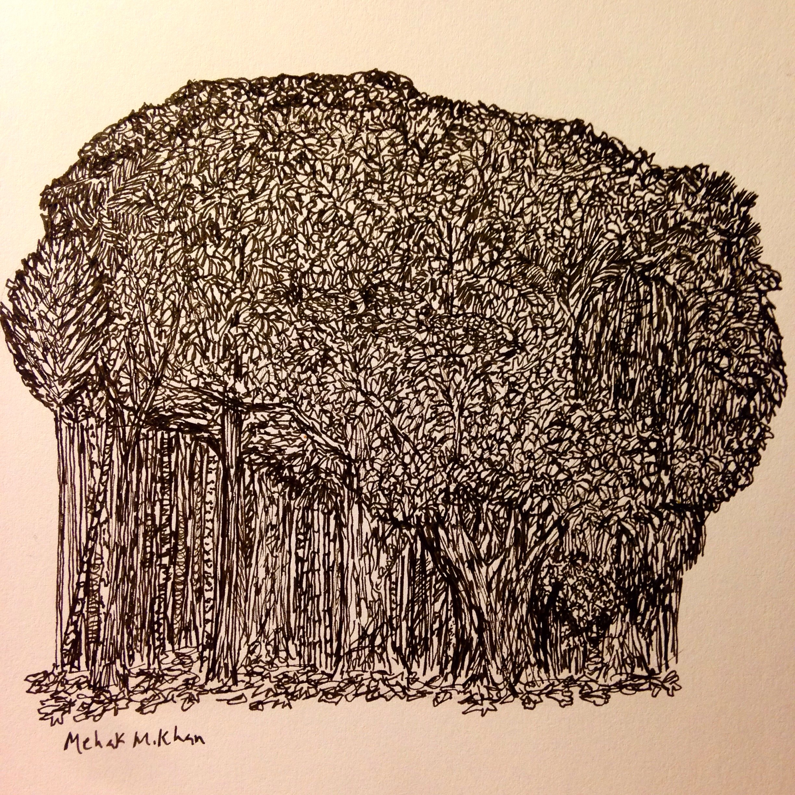
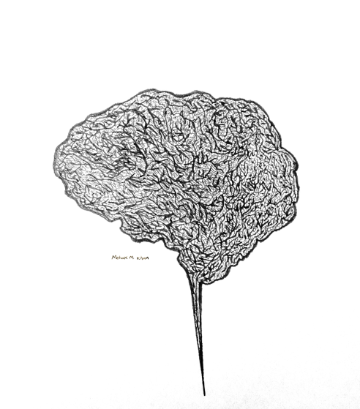
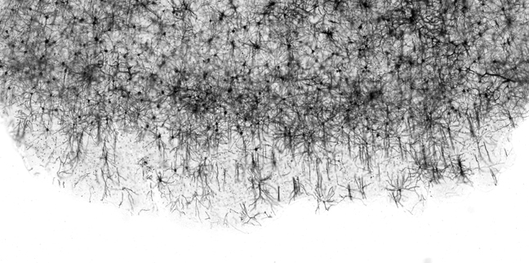
Notes:
When you combine billions of individual neurons together, our brain starts too look like a massive forest – and it acts like on too. Indeed, as Cajal first hypothesized, our neurons do sprout new branches as they grow and develop. And like a hurricane or a forest fire, diseases like Alzheimer's can blaze through, obliterating branches and destroying entire neurons in their wake.
Cajal’s tree metaphor gave us a great way to think about the structure of the brain. But when we talk about the mind at rest, we are concerned with brain activity. [CLICK]

Slide 5
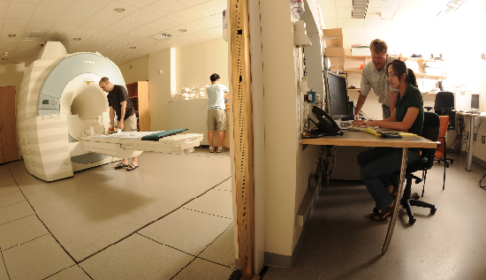
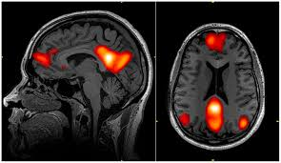
Notes:
One tool that we use to measure brain activity is called functional magnetic resonance imaging, or fMRI. In an fMRI scan, we use a large, powerful, magnet to create a “video” of your brain activity. [CLICK] When you’re mind is at rest, the brain activity looks something like this: If you look closely, you can see the pixels flickering very quickly. [CLICK] To make sense of this noisy data, we use state-of-the-art computers to summarize the brain activity, and color-in any regions that seem to be acting in synch. [CLICK]

Slide 6
Notes:
We can color in the brain any color we want…

Slide 7
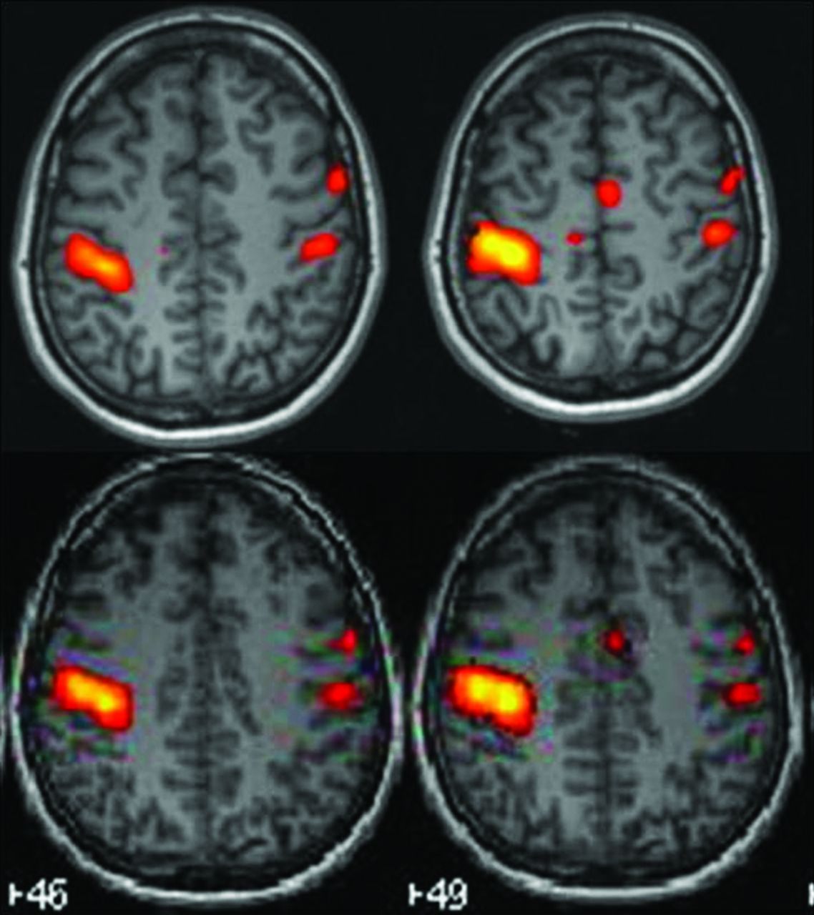
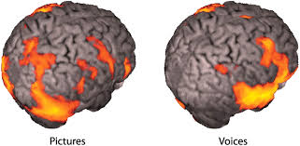
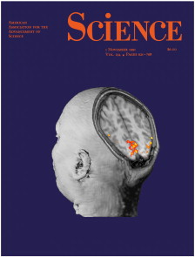
Notes:
Interestingly, we conventionally choose orange because the first fMRI publication was released right around Halloween, and the editors over at Science wanted a cool “black and orange” color scheme for the cover. Something else that happens to be orange right around Halloween time [CLICK]

Slide 8
Notes:
… are the trees back home in New England. In many respects, we can compare the changing color of leaves in the fall to the changing levels of brain activity when the mind is at rest. We can see in this picture, that not all trees change color at the same time, but that some do. Similarly, in the brain, not all brain regions will activate at the same time, but certain regions do emit synchronized signals. [CLICK]

Slide 9
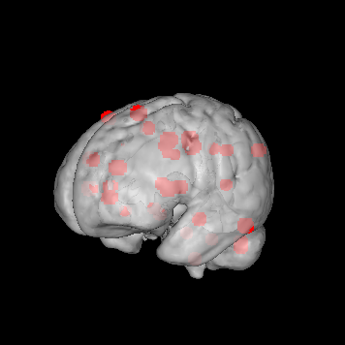
Notes:
When we analyze those brain regions, we can use a series of computational algorithms to summarize which regions are most similar to each other. Here, I’ve shown a brain with 34 regions of interest labeled with red dots. If we analyze the signal that comes from theses regions during a brain scan, we can start to look at which regions are most similar and different from each other. In a way, what we’re doing is picking a few trees in a forest, and saying “ok, we have a few redish trees that are acting similarly in these areas, and a few yellow or orange trees in other areas…” And we know that theses sorts of patterns exist in resting state signal, but how do they differ between people? What causes them to change? Could a mental disorder disrupt these patterns? [CLICK]

Slide 10
Schizophrenia Model
Matched Control Model
✔
Unknown
Notes:
To try and answer these questions, I designed a project where we examined these types of patterns on about 65 resting-state fMRI scans. About half of those scans came from people with a mental disorder called schizophrenia, and the other half came from matched controls. First, we designed a computer program that created “standard models” for each of the two groups. Then, we’d ask the computer to analyze the patterns in a new brain it had never seen before, and to guess which group it was a part of. Last, [CLICK] we checked the computer to see if it picked the right category. [CLICK]

Slide 11
✗
✔
✔
✔
✔
✔
✔
✔
✗
✔
✔
✔
✔
✗
✔
✗
✔
✔
78% Correct
✔
✔
✔
✗
✔
✔
✔
✔
✗
✔
✔
✗
✔
✔
✔
✔
✔
✗
Notes:
We repeated this process for all 65 scans, examining the pattern, choosing a category, and [CLICK] checking. And the computer was able to correctly [CLICK] categorize 78% of the scans. This suggests that there are detectable differences in resting-state activity between these two groups. But it leaves us with more questions than answers… [CLICK]

Slide 12
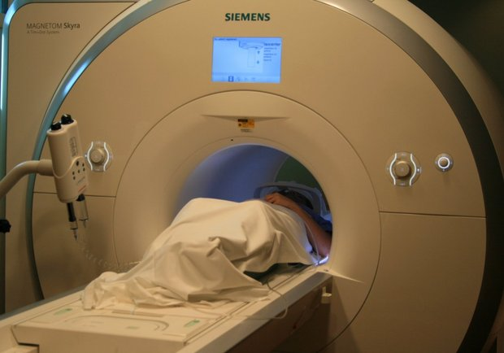
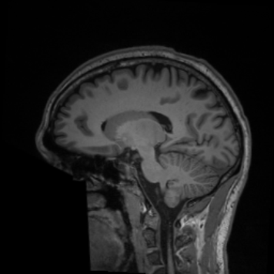
Notes:
First, we have no idea what sorts of thoughts wandered through peoples minds when they were in the scanner. It’s possible that two subjects could be thinking about completely different things, which might influence their resting state signals. [CLICK] Second, we know that many people with schizophrenia are prescribed anti-psychotic drugs and that these medications could influence brain activity. [CLICK] And another common problem with all fMRI studies is the issue of head-motion. Maybe one group had a tougher time sitting still. We know that moving your head just a millimeter can be enough to alter signals. [CLICK]

Slide 13
+
Notes:
Because of concerns like these, there is a lot of debate about whether fMRI is the right tool to use when we study the mind at rest. In fact, many neuroscientists would argue that you cannot learn anything from the mind at rest, because you just can’t design a properly controlled experiment. No matter how difficult though, I think this work is incredibly important.
So let’s remember back to the cross we stared at in the beginning. Your resting mind conjured up thoughts completely on its own, with no instruction or stimulus to inspire it. The resting brain is like a race-car revving its engines before the start of a race. And it’s a brain state where creativity thrives and seemingly disjointed ideas can be linked. Think about what occupies your mind when you’re not doing anything else. What ideas can you never stop thinking about? Are you an electrical engineer whose interest in music makes you want to design better headphones? Maybe you’re a civil engineer and your semester abroad sparked a new idea for a bridge design. Or maybe you’re like me… [CLICK]

Slide 14
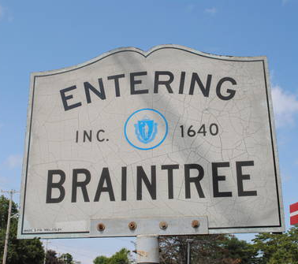
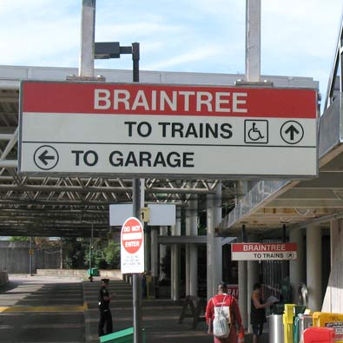
Notes:
I’m from a town in Massachusetts called Braintree. And whenever I’m sitting down on the train ride home and my mind is completely at rest, I think about the name of my town, and I’m inspired to think differently about the brain.

