Slide 1
Designing a Computer Simulation Tool for PET Neuroimaging
Tom Morin
Hooker Research Group
Athinoula A. Martinos Center for Biomedical Imaging
Massachusetts General Hospital
Harvard Medical School

Slide 2
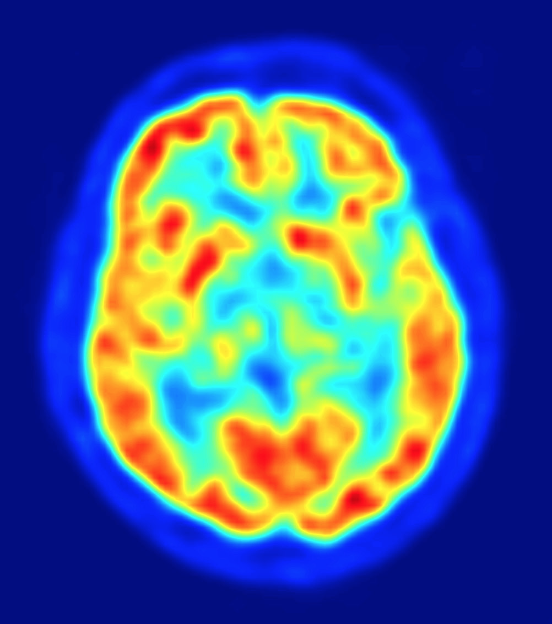
Positron Emission Tomography (PET)
Procedure:
Inject a Radiotracer
Take the Scan
Get Blood Data (optional)
Analyze Data

Slide 3
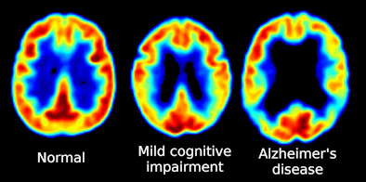
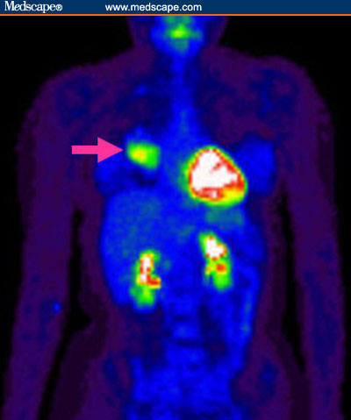
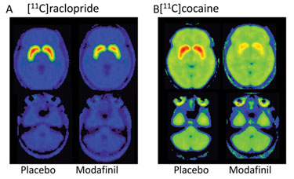
Applications of PET
http://www.medscape.com/viewarticle/471906
http://www.auntminnie.com/index.aspx?sec=ser&sub=def&pag=dis&ItemID=91172
http://www.genengnews.com/gen-articles/in-vivo-imaging-accelerates-development/3174/?page=2

Slide 4
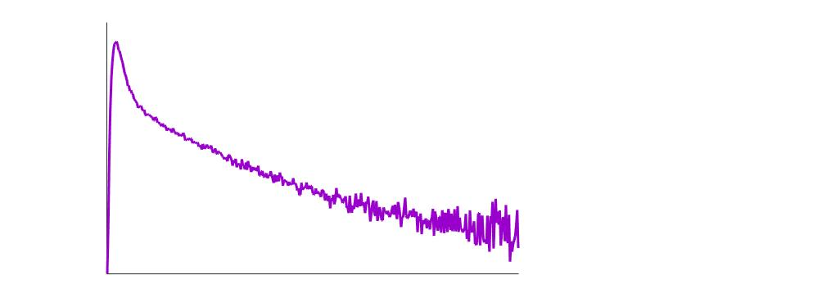
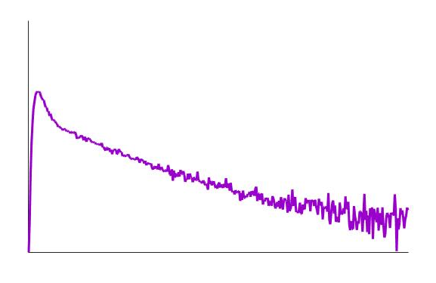
Time Activity Curves (TACs)
Radioactivity
Time →
Time →
Time →

Slide 5
Problems With PET
High cost machinery & staff
Scan requires intense coordination and advanced planning
Small procedural changes can have a big impact on results

Slide 6
Why Use Simulation?
Evaluate study feasibility (conserve resources)
Strategically choose and optimize experimental design
Facilitate new methods development

Slide 7
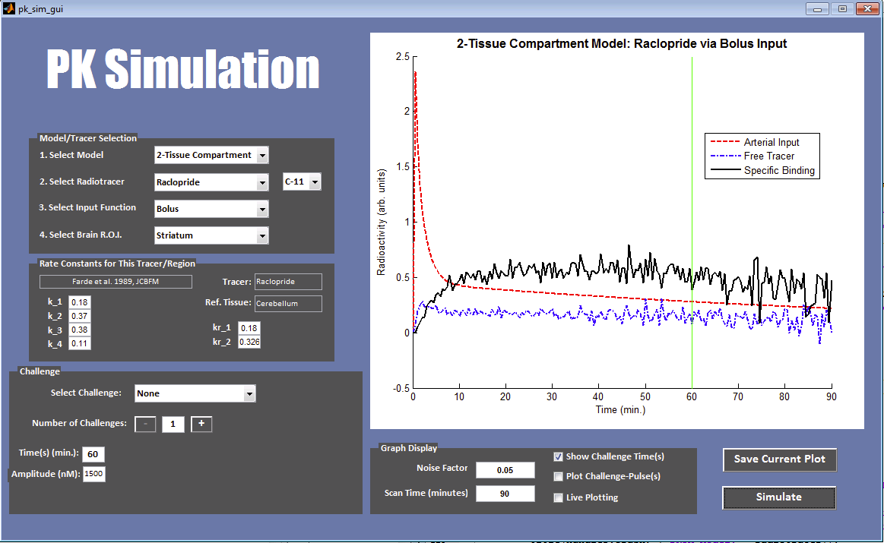
Simulation Tool Screenshot

Slide 8
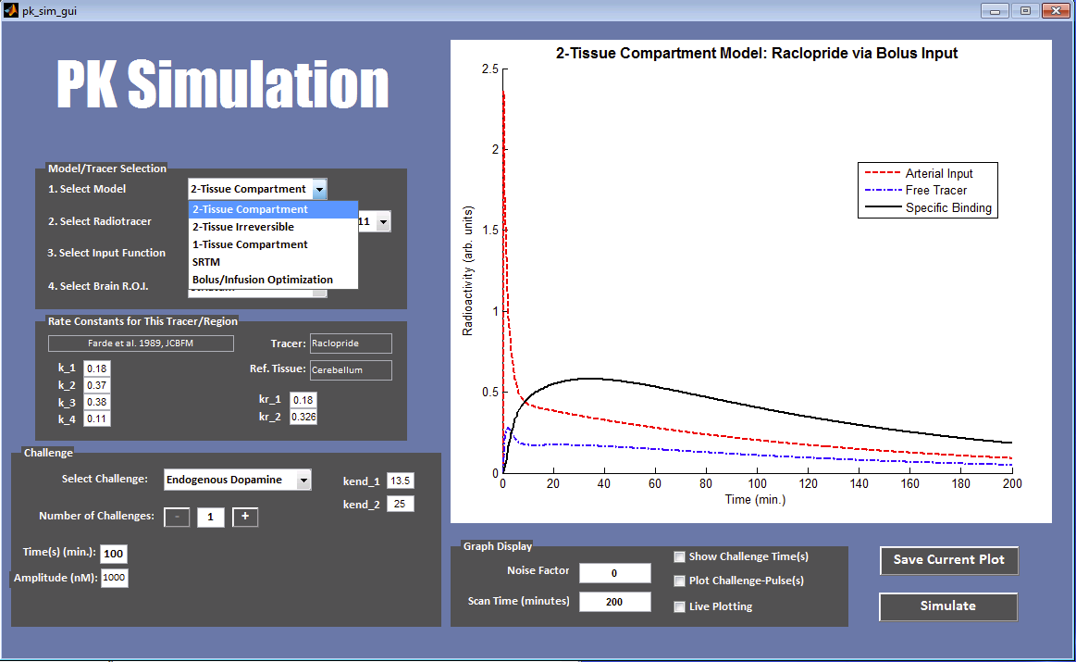
Kinetic Models

Slide 9
2-Tissue Compartment Model
Plasma
Free
Bound
C_{p}
K₁
C₁
k₃
C₂
K₁
k₃
K₂
k₄
Is it really free and bound or is it free and non=specifically bound?
K₂
k₄
http://www.pmod.com/files/download/v31/doc/pkin/2264.htm

Slide 10
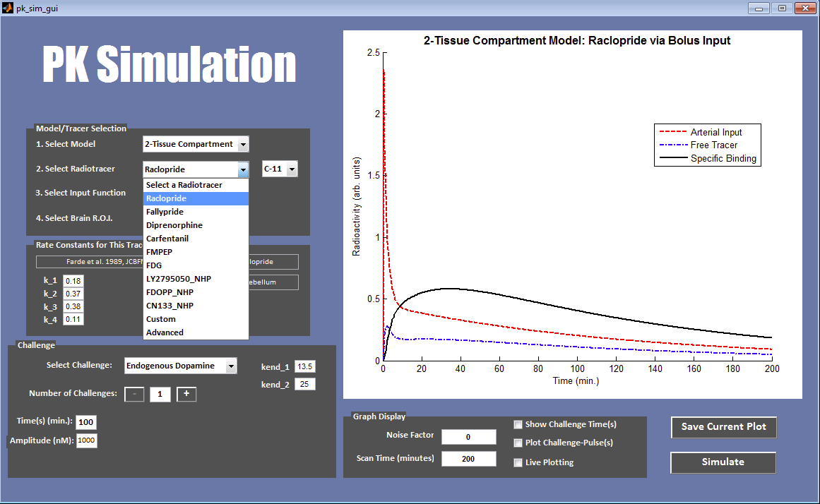
Radiotracers

Slide 11
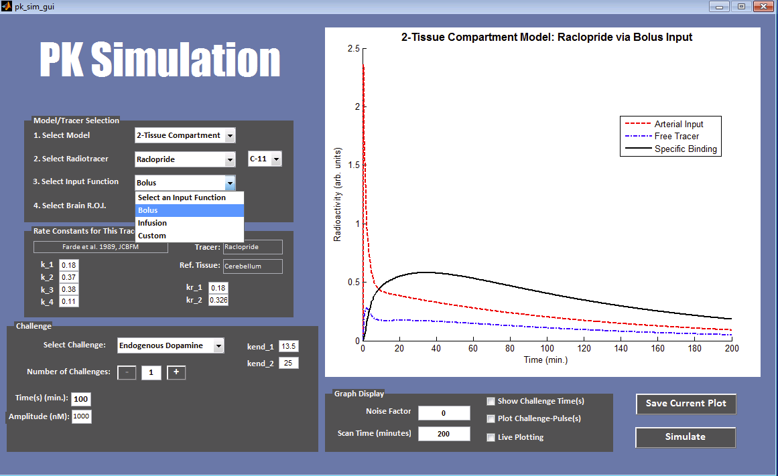
Plasma Input Functions

Slide 12
Plasma Input Functions
Example. [¹¹C]Raclopride (dopamine D2/3 selective)
Bolus Input
Constant Infusion Input
Bolus + Constant Infusion (B/I) Input
Plasma Input
Free
Bound

Slide 13
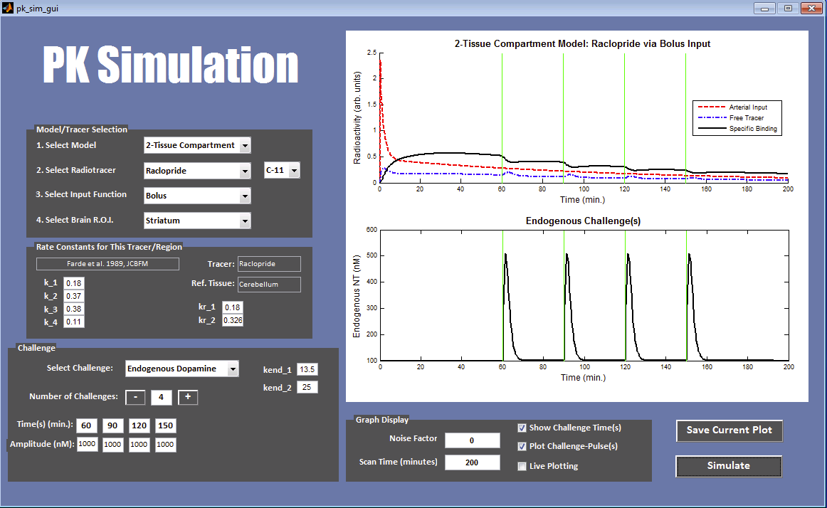
Competition

Slide 14
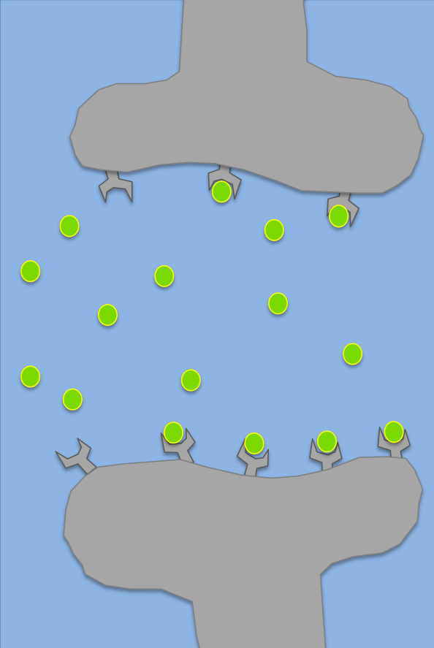
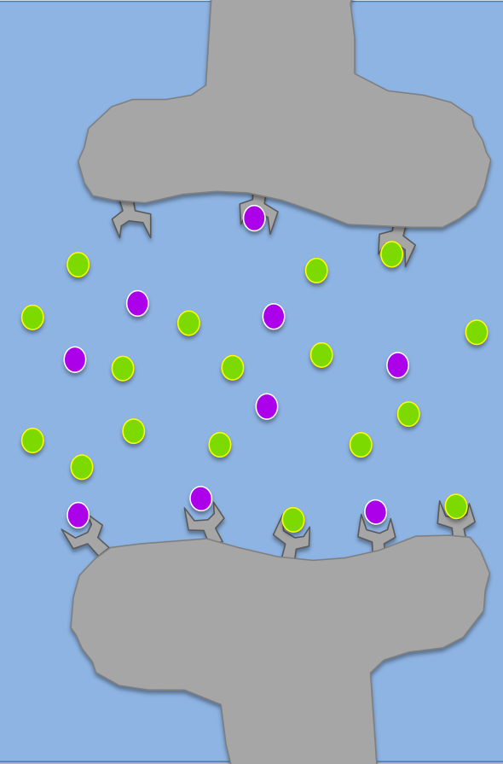
Competition
Endogenous
ex. [¹¹C]raclopride & dopamine-releasing reward task
Exogenous (pharmacological challenge)
ex. [¹¹C]carfentanil with morphine
Before
Challenge
After
Challenge

Slide 15
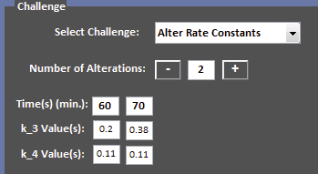
Simulating Competition
Endogenous Pulse
Alter Rate Constants
(One Method to Simulate Exogenous Challenge)
Plasma
Free
Bound
C_{p}
K₁
C₁
k₃
C₂
K₂
k₄
Tissue Response
Plasma Input
Free
Plasma Input
Bound
Free
Bound

Slide 16
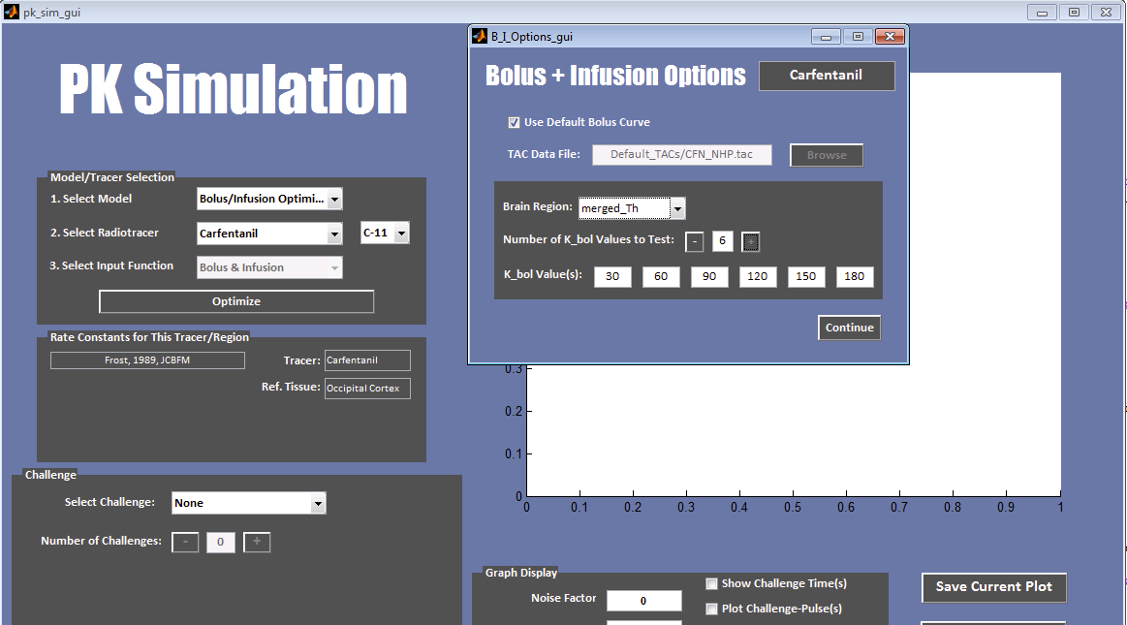
Bolus + Constant Infusion

Slide 17
Bolus + Constant Infusion Optimization
Regular bolus injection followed by continuous infusion
K_{bol}
Bolus dose measured in minutes of infusion dose
Units = minutes
Adjusting K_{bol} (adjusting how much radiotracer is initially injected), allows tracer to reach equilibrium more quickly
Optimal K_{bol} will vary slightly between subjects and must be determined for each radiotracer
Advantages:
Challenges easier to see
No blood/plasma data needed
Disadvantages:
Optimal K_{bol} varies between subjects
An initial bolus study (with blood data) must be performed to establish K_{bol}

Slide 18
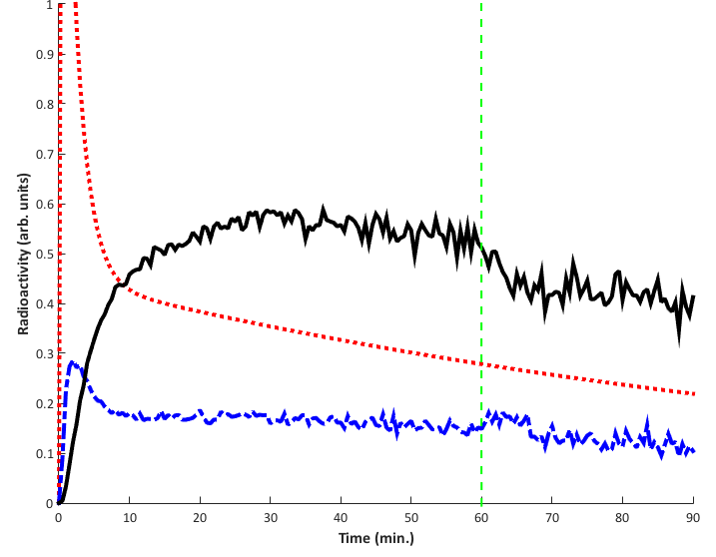
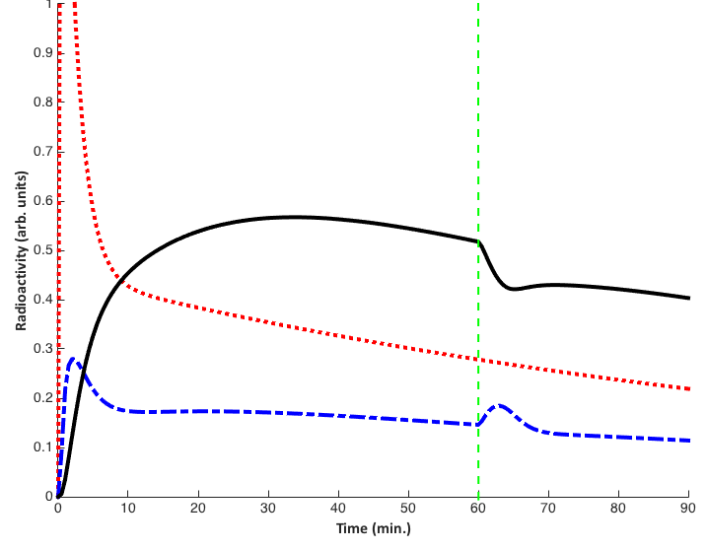
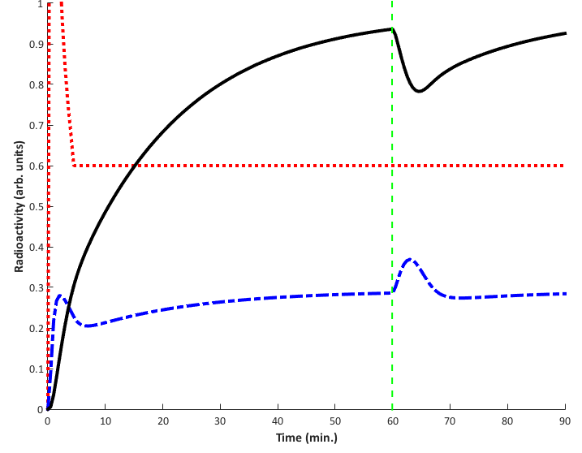
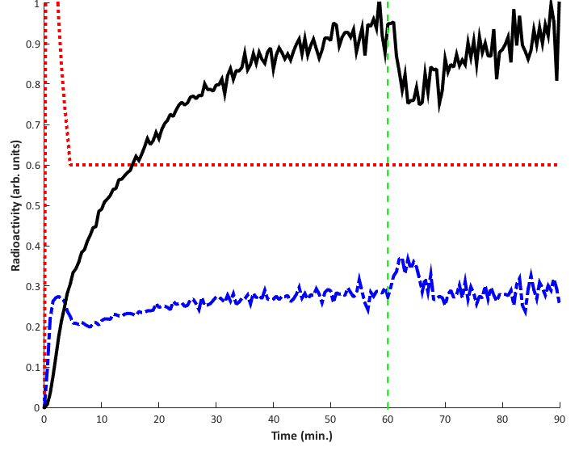
Competition with Bolus + Constant Infusion
Example: [¹¹C]Raclopride with Endogenous Dopamine Challenge at 60 min.
BOLUS Input
BOLUS + CONSTANT INFUSION Input
25% deltaBP
21% deltaBP
Plasma Input
Free
Bound

Slide 19
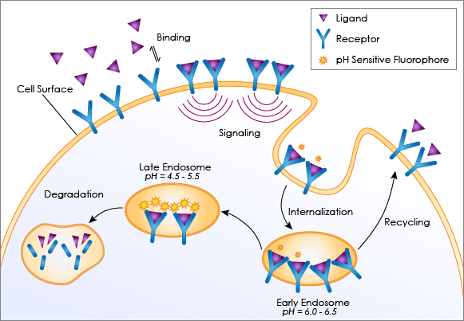
Future Direction
Receptor Internalization Models:
http://www.nexcelom.com/Celigo/receptor-internalization-assay.php

Slide 20
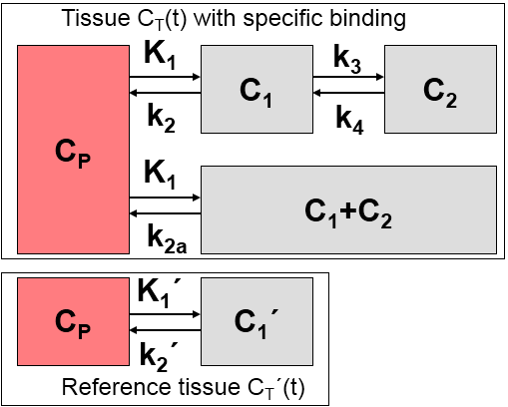
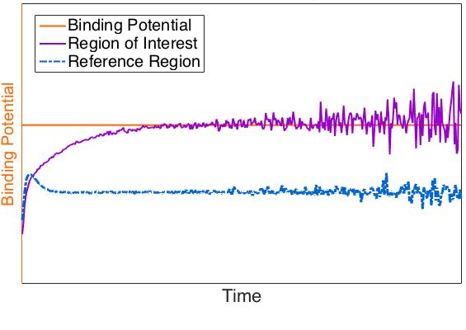
Future Direction
Reference Tissue Models:
C₁
C₁’
Radioactivity (arb. units)
http://doc.pmod.com/pkin/pmclass.lib.pmkin.models.PKlammertsma96NonInvasive.htm

Slide 21
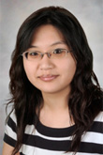
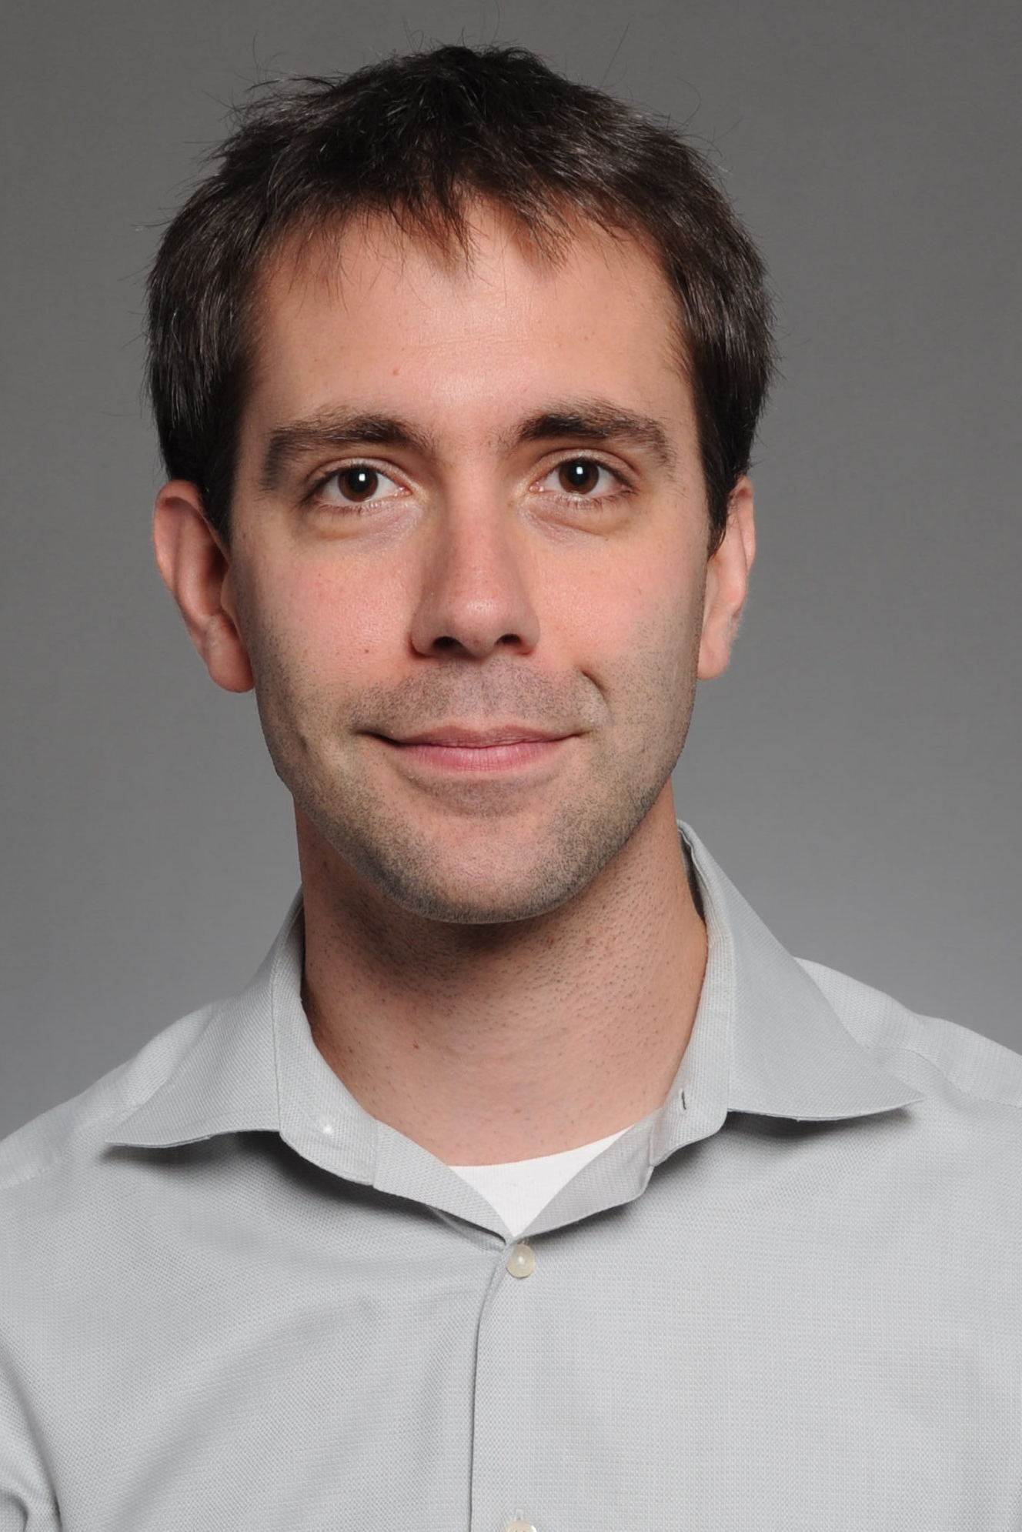
Acknowledgements
Hooker Research Group Members:
Dr. Changing Wang
Dr. Frederick (Al) Schroeder
Dr. Wenjun Zhao
Dr. Genevieve van de Bittner
Misha Riley
Michael Placzek
Dr. Tonya Gilbert
Dr. Nicole Zurcher
Anisha Bhanot
Emily Ricq
Martin Strebl
Project Mentor:
Dr. Hsiao-Ying (Monica) Wey
Principle Investigator:
Dr. Jacob Hooker

